Slide 1
Adams and Jefferson

Slide 2
New Government Answers
A 11. B
A 12. B
B 13. C
C 14. A
D 15. D
A
C
D
A
A

Slide 3
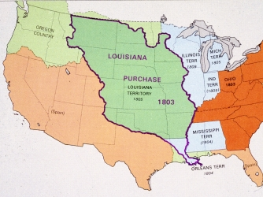
Louisiana Purchase
President Thomas Jefferson was able to work a deal with France and Napoleon
United States wanted control of the Port of New Orleans as well as the Mississippi River
Doubled the size of the United States
Louisiana was purchased through the act of talking and making deals not through fighting

Slide 4
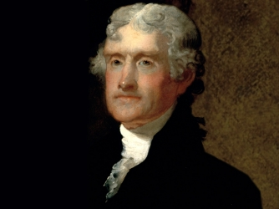
Thomas Jefferson
Strict Interpretation of the Constitution
If the Constitution said you could do something, you do it.
If the Constitution does not mention something you want to do, you do NOT do it
Louisiana Purchase
President Jefferson had to be convinced to purchased the land from France because he was a strict follower of the Constitution and no where did it mention that a President could add new territory

Slide 5
Marbury v Madison
Chief Justice John Marshall decided the Judiciary Act of 1789 unconstitutional.
Judicial Review Supreme Court reviews laws to make sure that they follow the Constitution
This became the role which the Supreme Court
Increased the power of the Federal Government

Slide 6
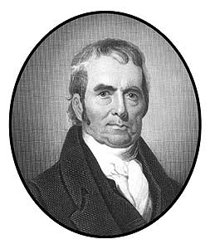
John Marshall
Chief Justice of the Supreme Court
The power of the Federal Government increased under Marshall’s Rulings
Supremacy of federal government over state government

Slide 7
Kentucky and Virginia Resolution
States could nullify, not follow, laws, like the Alien and Sedition Act because they violated the Constitution

Slide 8
Lewis and Clark
Explored the Louisiana Purchase territory so that the United States would have a better understanding of the land they purchased

