Slide 1
Africans and Native Indians

Slide 2
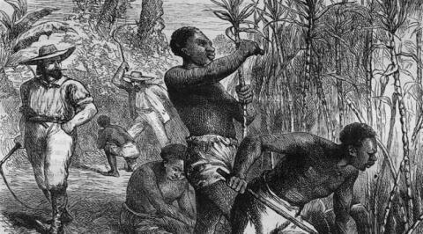
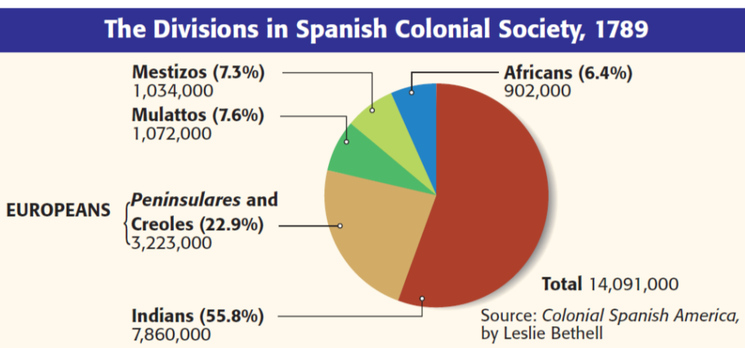
Indians & African slaves made up the bottom of the social hierarchy
Indians & slaves were used as workers for creoles plantations

