Slide 1
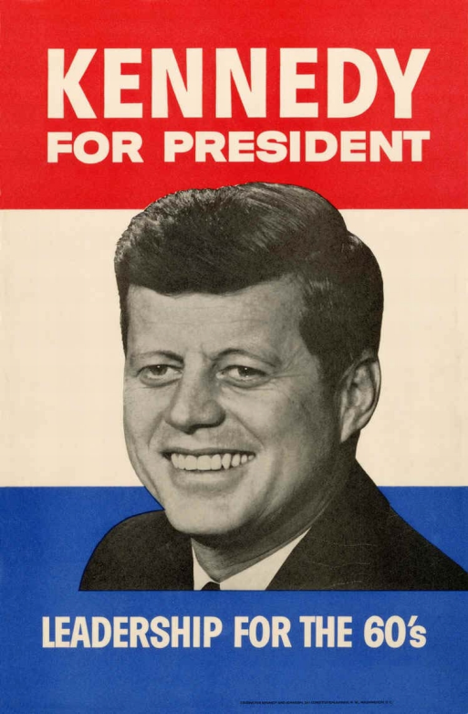
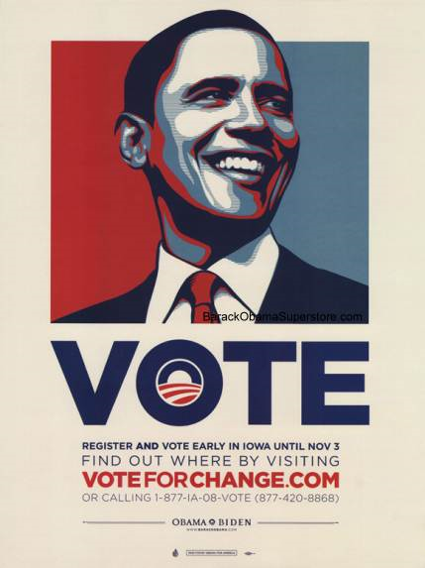
Your Task is to pick the Enlightenment Thinker that you feel has had the biggest impact on Europe and the World and create a campaign poster.
Your Campaign Poster MUST include the Enlightenment Thinkers:
Name
Picture
View on Government
View on Society
Give Examples of the Ideas in Action
BE BRIEF

