Slide 1
Challenges to Authority

Slide 2
Renaissance
A rebirth of Greek and Roman learning in Europe from about the 14th through 16th centuries.
Major cultural and artistic accomplishments
Humanism- philosophy that focused on human interests

Slide 3
Renaissance
Promoted a questioning of authority (the Church) and new ways of thinking
Leonardo
Michelangelo
Raphael

Slide 4
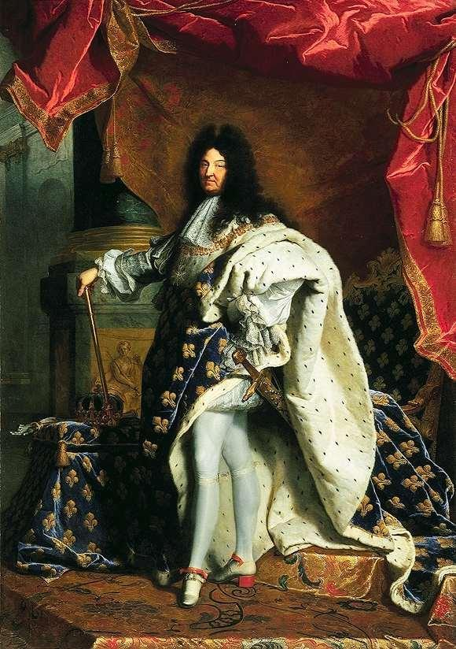
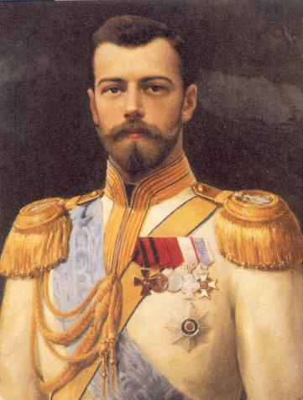
Autocratic rulers have complete authority over the government and lives of their people.
Louis XIV of France
Czar Nicholas of Russia
The “Sun” King
Notes:
*

Slide 5
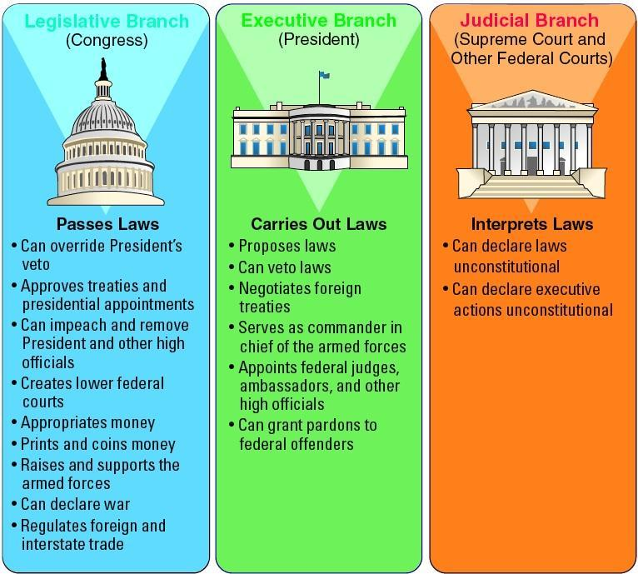
A movement in the 18th century in Western Europe
Stressed the importance of reason and logic
Wanted to improve relationship between the government and people

Slide 6
Locke- natural rights- life, liberty, property; if government does not protect these rights the people can overthrow
Montesquieu- three branches of gov’t.
Voltaire- freedom of speech
Rousseau- will of the people should govern

Slide 7
Protestant Reformation
Causes
Sale of indulgences, payments to forgive sins
Martin Luther’s 95 Theses
- A list of complaints against the Catholic Church and it’s corrupt practices
Questioning spirit of the Renaissance spread to religion

Slide 8
Protestant Reformation
Effects
Decline in religious unity in Europe
The Catholic Church lost power
New religions emerged
Lutheran, Anglican (Church of England), Calvinist, Presbyterian

Slide 9
Mohandas Gandhi
Helped India gain independence from Britain
Nonviolent Civil Disobedience- peaceful protest against unjust (unfair) laws
Exams of nonviolent Civil disobedience
Day of “Prayer” all the Indians stayed home to pray and did not work when British enforced new sedition (can not write against government) laws and new arrest without warrant laws, this hurt British economy in India
Textile Boycott, Indians refused to buy British clothing and homespun, made at home, their own clothes
Salt March, Gandhi lead the Indians on a march to the sea to protest the Salt monopoly that the British had on salt. March was filmed and reached the rest of the world, put pressure on the British

Slide 10
Rebellions Against Foreign Rulers
Boxer Rebellion
Occurred in China
Wanted to remove the British from authority in China
Sepoy Mutiny
Occurred in India
Wanted to remove the British from authority

Slide 11
Magna Carta (1215)
English nobles limited the power of the monarch by law
English Bill of Rights
A set of acts passed by Parliament to ensure its superiority over the monarchy and guarantee certain rights to its citizens
Act of Supremacy
Henry VIII took control of the Church of England because the Pope would not grant him a divorce.
Notes:
*

Slide 12
Tiananmen Square Massacre
Some Chinese were demanding more political freedom and viewed democracy as a way of receiving these freedoms
Demonstrators marched in Tiananmen Square protesting their lack of freedoms
Chinese officials asked the crowd to disperse, which did not, officials sent in troops and tanks
Chinese military killed thousands of protesters, communist Chinese leaders showed they were still in control of China

Slide 13
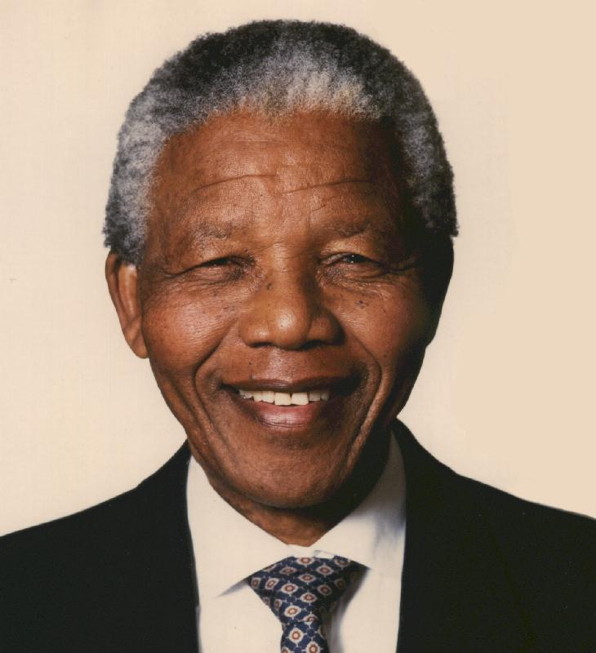
South Africa
Won its independence from Britain in 1910, its white citizens alone held political power and instituted the system of apartheid, or separation of races.
Nelson Mandela was leader of the African National Congress which launched boycotts and practiced nonviolent civil disobedience.
In 1964, he was jailed for 27 years by the government.
After he was released, he became President of South Africa in 1994.

Slide 14
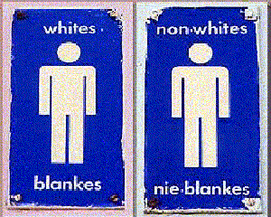
The official system of Apartheid was established in 1948:
Africans had to live in designated zones, use different trains, schools, and other public facilities..
Interracial marriages were banned.
SOCIETY
Whites
Blacks
Asians
Coloureds

Slide 15
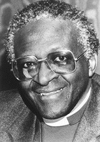
Desmund Tutu: black Anglican bishop and civil rights leader.
Led the anti-Apartheid movement in South Africa.
In 1994, President F.W. de Klerk, caving into pressure, legalized the ANC, ended segregation and released Mandela from Jail.

