Slide 1
Civil War to Reconstruction and Progressive Era

Slide 2
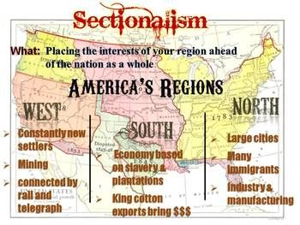
Sectionalism
Economic divide between the North (Manufacturing) and South (Agriculture)

Slide 3
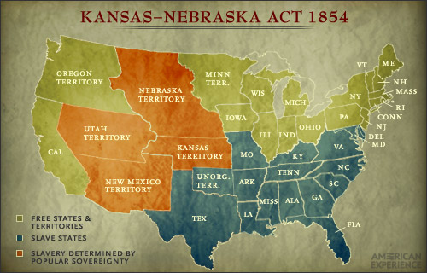
Issue of Slavery
Kansas-Nebraska Act
People in this territory voted on slavery to be allowed in the territory (Popular Sovereignty)
Dred Scott Decision
Supreme Court ruled that Slaves are not citizens of the United States but rather property

Slide 4
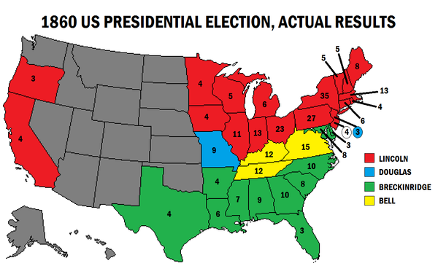
Election of Abraham Lincoln
Lincoln did not win a single southern state
South was afraid that Lincoln would stop slavery
South Carolina seceded (Left) the Union (United States)

Slide 5
Constitutional Issue
Southern States wanted more states’ rights

Slide 6
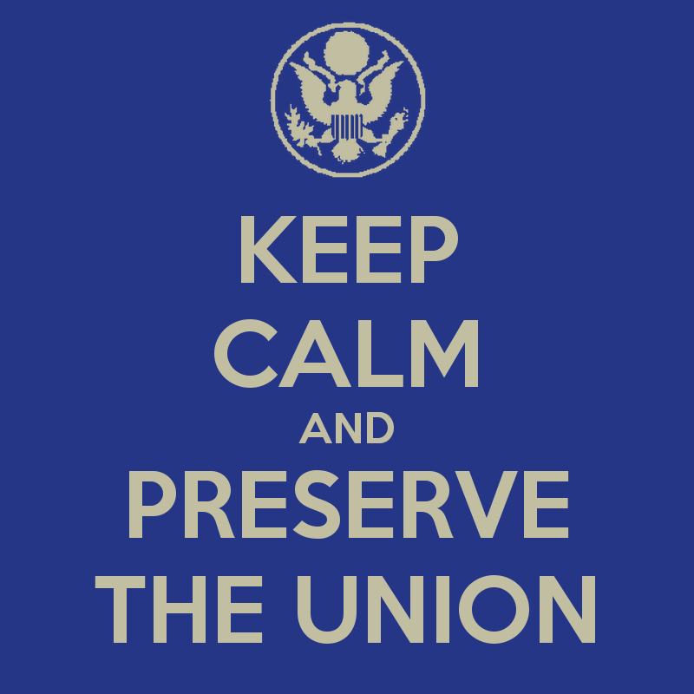
Abraham Lincoln
Slavery Issue
Before election Lincoln wanted to stop the spread of slavery
During Civil War, Emancipation Proclamation freed the slaves if the Union won
Preserve the Union
After the Civil War Lincoln wanted to bring back the South as quickly as possible

Slide 7
Restriction on Freed Slaves
Sharecropping
System where landowners allowed freed slaves to use the land in return for a share of the crops produced on their portion of the land
This system restricted the freed slaves because it did not allow them to make money for themselves but rather the landowner
Black Codes
limited the rights of the newly freed slaves
Jim Crow
Racial segregation (“Whites Only” “Blacks Only”)
Segregated Public bathrooms, movie theaters, schools, restaurants
Voting Restrictions
-Literacy tests were required in order to vote but freed slaves did not know how to read and write
-Poll tax, tax was created in order to vote which the freed slaves had little money to pay

Slide 8
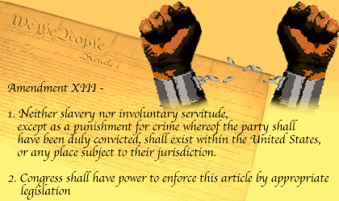
13th Amendment
Addition to the Constitution which ended slavery throughout the United States

Slide 9
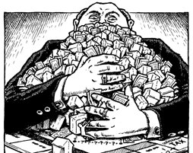
Monopolies
One business controls the all/large majority of an industry, where there is little to no competition and they can set the price of the goods.

Slide 10
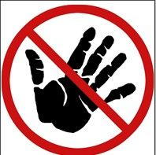
Laissez- Fare
Hands off approach to business that the United States government takes. Does not get involved in business unless business breaks a law.

Slide 11
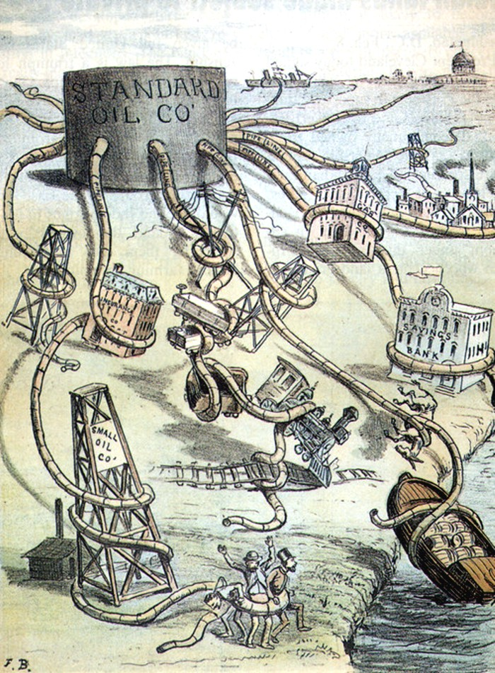
Standard Oil Company
Rockefeller controlled the oil industry

Slide 12
Theodore Roosevelt
Trustbuster
Name given to Roosevelt because he went after the monopolies in the Big Business and broke the monopolies up
Sherman Anti-Trust Act
Law put into place that outlawed/tried to stop monopolies
Foreign Policy
“Speak softly but carry a big stick”. Roosevelt would interfere i in Latin American countries to keep European countries out of Latin America (Compared to Monroe Doctrine)
Environment
Roosevelt wanted to protect nature and passed laws to protect land and create national parks like Yellowstone Park

Slide 13
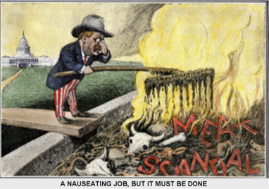
Muckrakers
Muckrakers
Investigative reporters who uncovered problems in society in hopes of solving economic or social problems
Upton Sinclair
Wrote, The Jungle, which exposed the conditions in Meat Packing industry
Jacob Riis
Published, How the Other Half Lives, which exposed the poor living conditions of the tenements.
More Voting Rights
1. Direct Elections of Senators
2. Primaries

Slide 14
Granger/Populist Party
Farmers
Farmers supported the Granger Movement and Populist Party because it took care of issues in agriculture
Railroad Rates
Wanted the rates of railroads to be regulated by the Federal government because of the storage fees for grain and rates that were being charged.

Slide 15
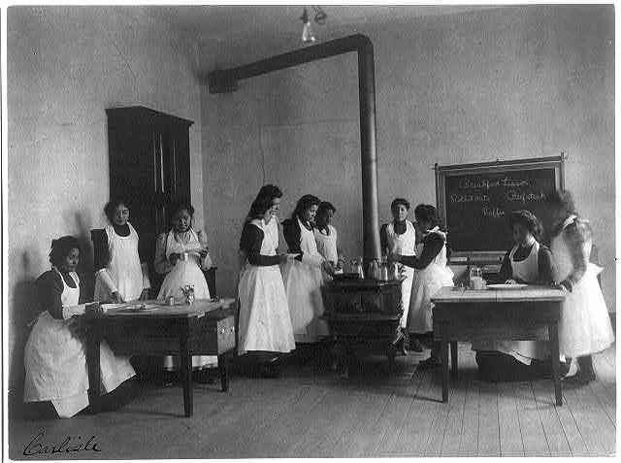
Dawes Act
United States government wanted to assimilate Native Americans into American life
Sent Native American children to schools to teach them how to be more American

