Slide 1
Cold War Through Civil Rights

Slide 2
Stock Market Through WWII Answers
B 11. A 21. C
D 12. D 22. B
A 13. A 23. D
A 14. D 24. A
A 15. A 25. C
B 16. A 26. C
D 17. D 27. C
D 18. A 28. C
B 19. C 29. D
D 20. B 30. B

Slide 3
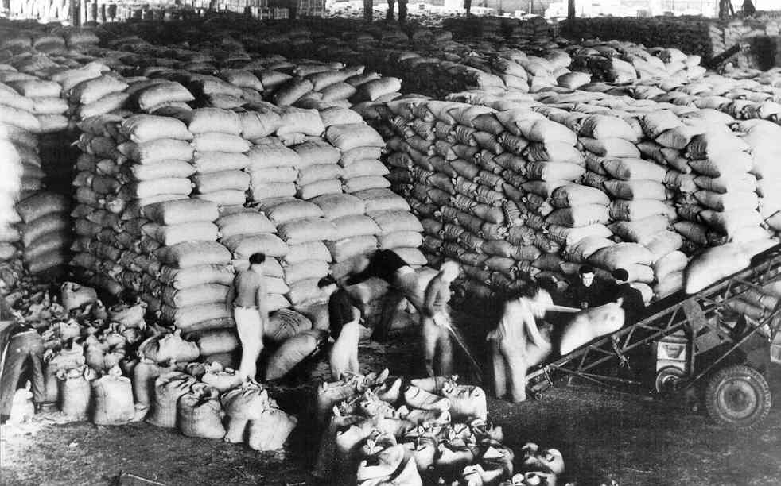
Marshall Plan
- Limit communist influence in Western Europe
- Give money, military assistance and medicine

Slide 4
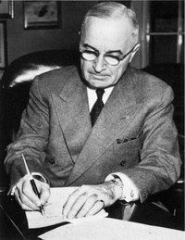
Truman Doctrine
-Give financial, military and medical assistance to both Greek and Turkey to protect them from communism.

Slide 5
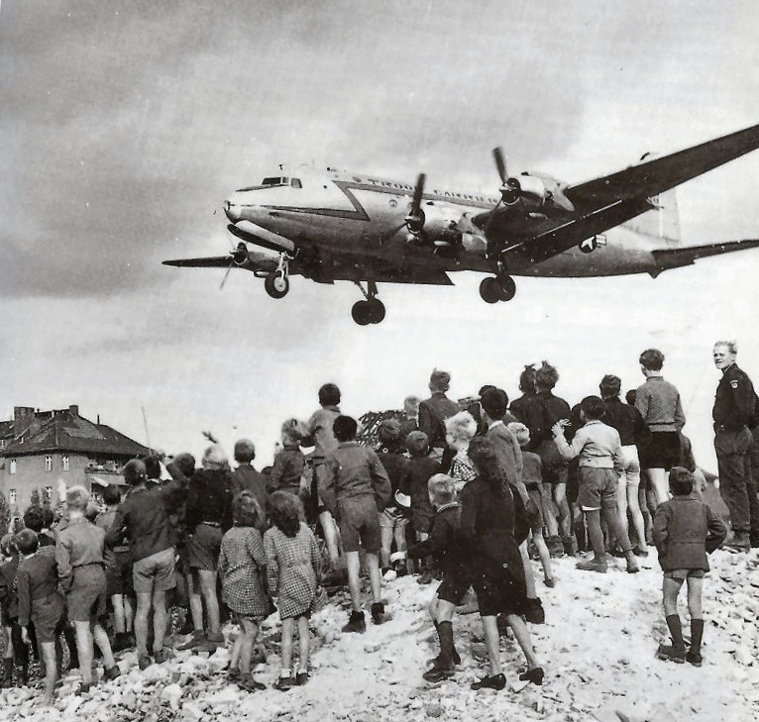
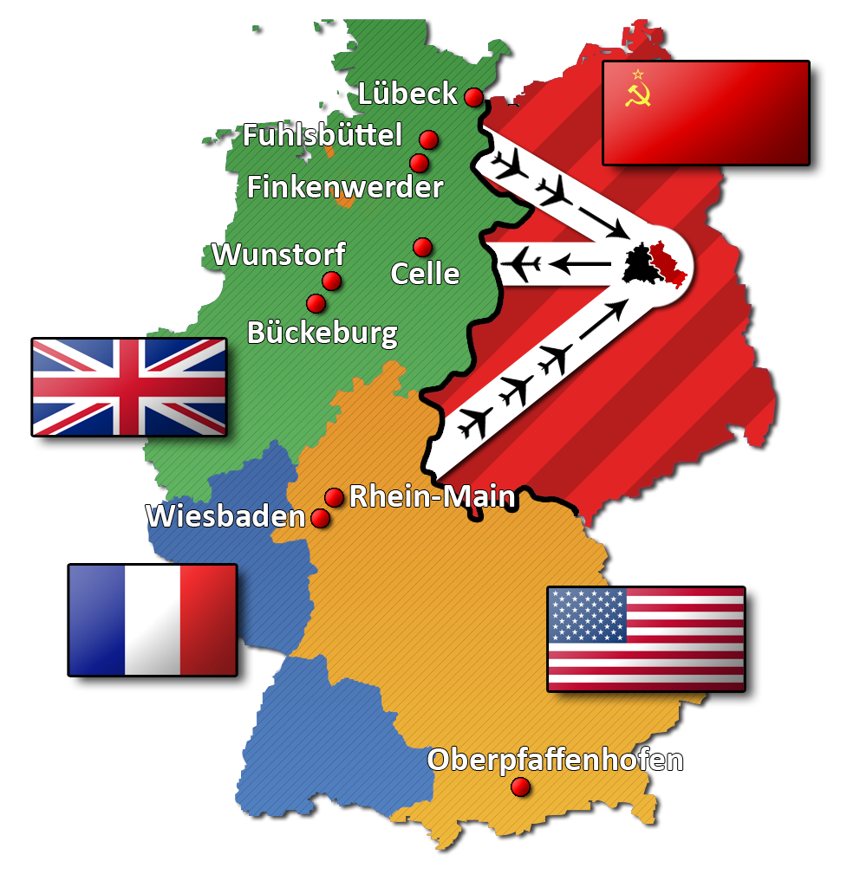
Berlin Airlift
-Soviet Union Closed access to West Berlin
-People in West Berlin were starving, so United States flew in supplies to the West Berliners

Slide 6
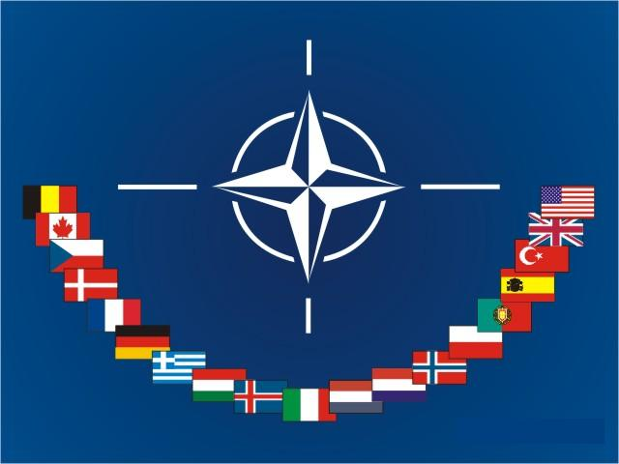
North Atlantic Treaty Organization (NATO)
-Countries that were a Democracy formed an alliance to stick together in the event that one member is attacked by the Soviet Union
-Sense of collective security

Slide 7
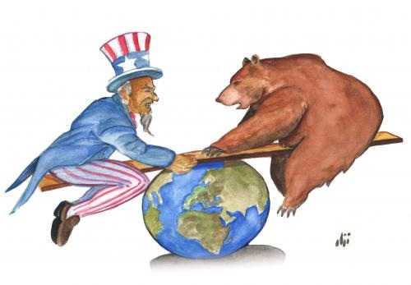
Containment
United States goal during the Cold War was to contain communism in the areas that it already existed and not have it spread to new territories

Slide 8
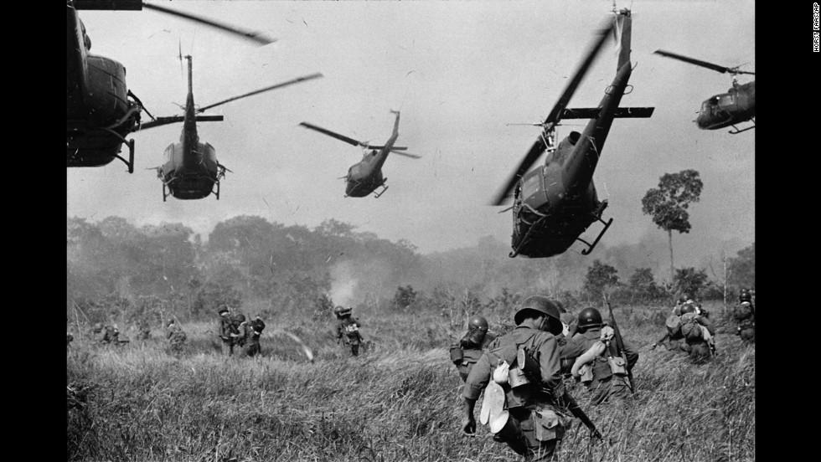
Korean and Vietnam War
-The Cold War spread beyond just tensions between the Soviet Union and the United States
-Korean War is the first time that the United Nations (U.N.) had to be called upon to stop aggressors.

Slide 9
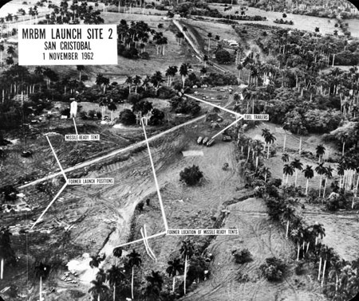
Cuban Missile Crisis
Put the two superpowers, United States and Soviet Union, on the brink of war

Slide 10
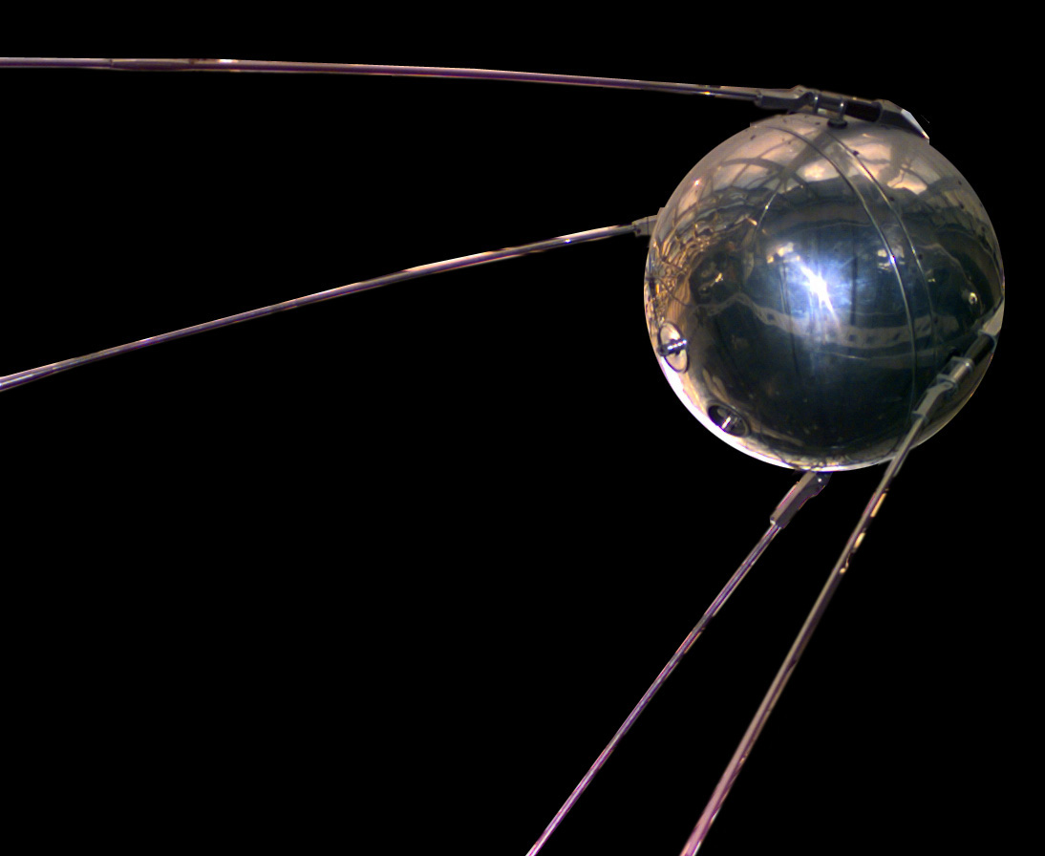
Technology
Sputnik
Soviet Union launched the first satellite into space
U.S. Reaction to Sputnik
Increase federal spending on math and science education
U.S. was afraid that the Soviet’s had better technology than the U.S.
Atomic Bomb
After the Soviet Union gained the capability to make the Atomic Bomb both United States and Soviet Union were hesitant to go to war with one another because of the potential of a nuclear war

Slide 11
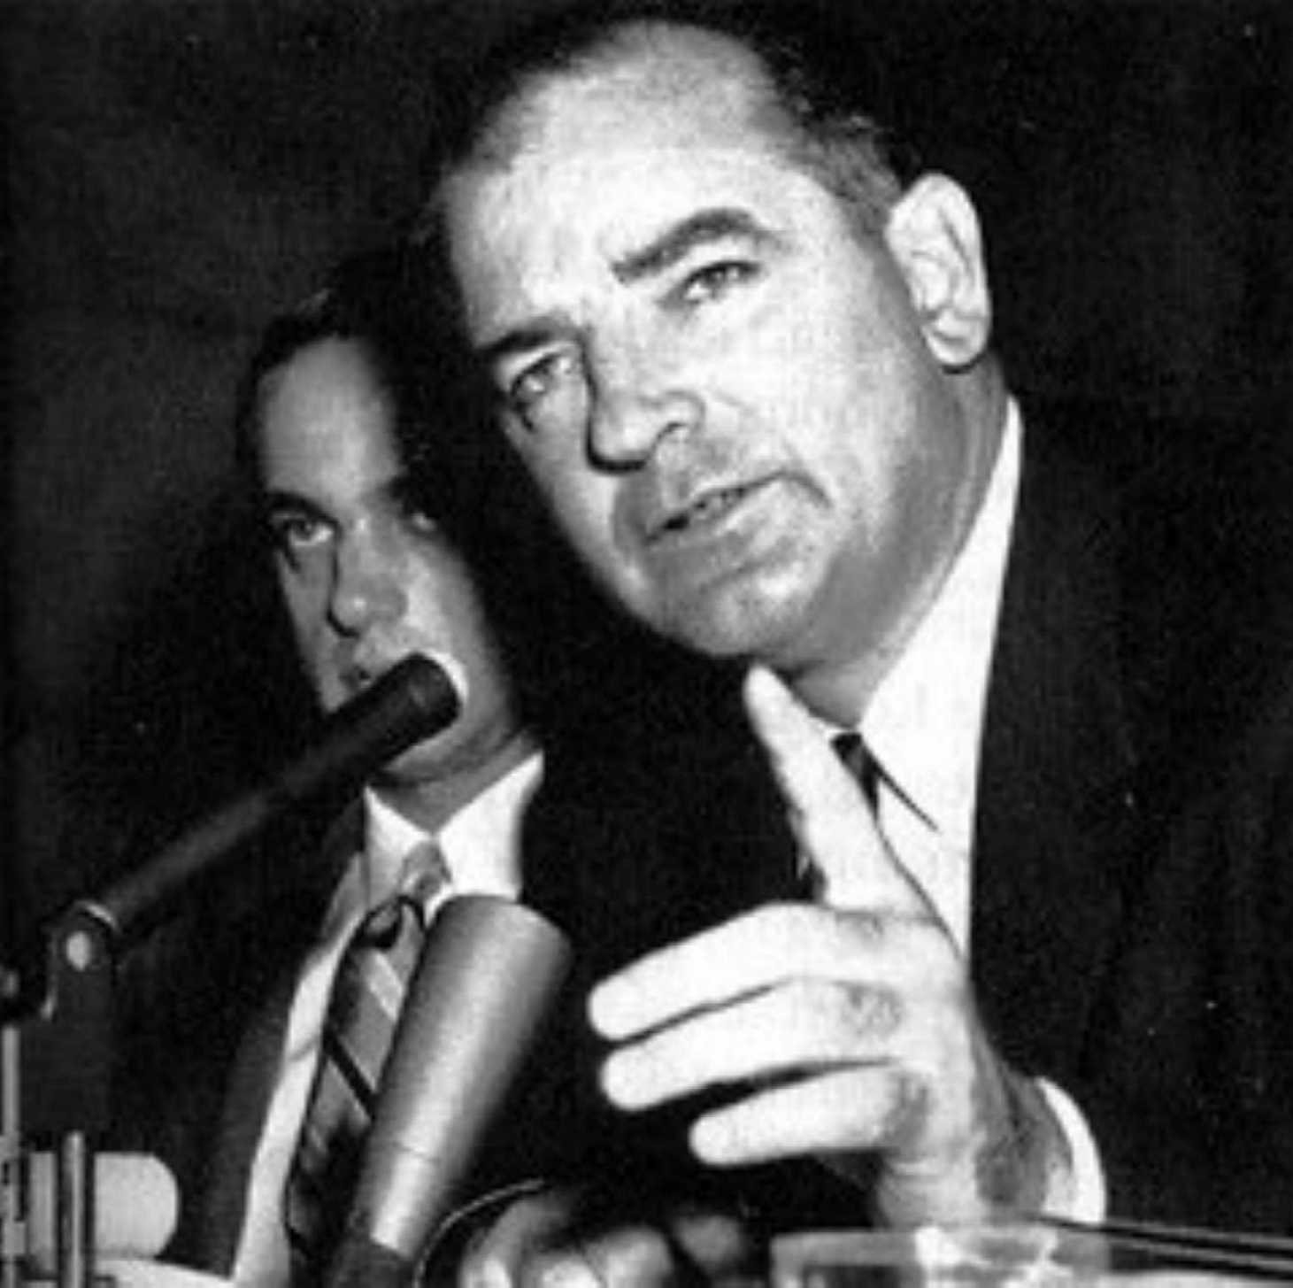
Communist Scare
Senator Joe McCarthy
Goal was to identify and expose communist that were working within the United States Government and living in the U.S.
McCarthy’s claims lead to a limit of civil liberties of some Americans

Slide 12
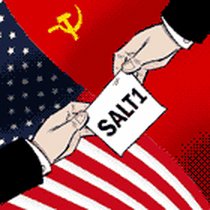
Soviet and U.S. Relations
Detente
Easing of tension between the United States and Soviet Union by limiting nuclear arms
Strategic Arms Limitation Talks (SALT)
Both United States and Soviet Union would reduce the amount of nuclear weapons they possessed

Slide 13
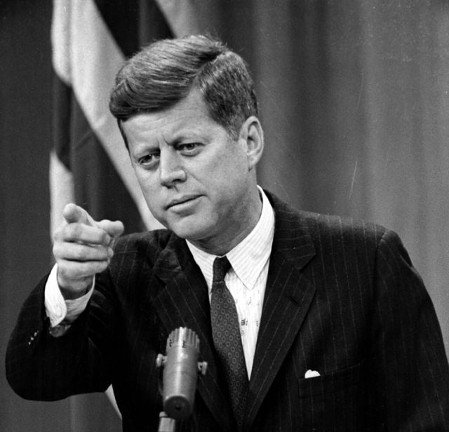
President John F Kennedy
Peace Corp
President Kennedy Sent volunteers to developing nations as teachers, health workers and technicians.
Alliance for Progress
Promote “peaceful revolutions” in Latin American Countries
Goal was to have these countries Ally with United States and not the Soviet Union

Slide 14
Civil Rights Movement
24th Amendment
Eliminate poll tax for African Americans
Brown v Board of Education
Desegregate schools, whites and blacks go to the same school where as before they went to separate schools because of their race.
President Eisenhower/Little Rock Arkansas
President Eisenhower sent in federal troops to enforce the desegregation of school after 9 African Americans were not allowed to enter a school
Civil Rights Act 1964
Eliminates discrimination based on race, sex or religion in public places
Voting Rights Act 1965
Federal officials could help register African Americans when local officials refused
Eliminate literacy test

Slide 15
Dr. Martin Luther King Jr
- Civil Rights leader
- Helped run the Montgomery, Alabama bus boycott which started because Rosa Parks refused to move from her seat on the bus
- “I Have a Dream” Speech at the March on Washington to support Civil Rights Bill presented by President Kennedy.
Sit-Ins
Peaceful protest of segregation laws by sitting at restaurant counters where blacks were not allowed
Freedom Riders
Group that tried to protest interstate bus segregation

