Slide 1
Constitution

Slide 2
Early America and Road to Revolution Answers
D 11. B 21. B
C 12. C 22. C
A 13. C 23. A
A 14. B 24. C
C 15. B 25. B
D 16. C
C 17. C
A 18. A
B 19. B
B 20. C

Slide 3
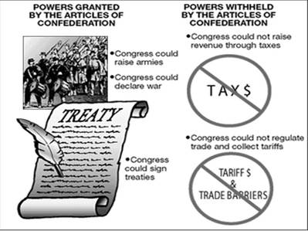
Articles of Confederation
More power was given to the State Government than to the Federal (National) Government, which made the Federal Government weak
Did Allow for new States to join Union

Slide 4
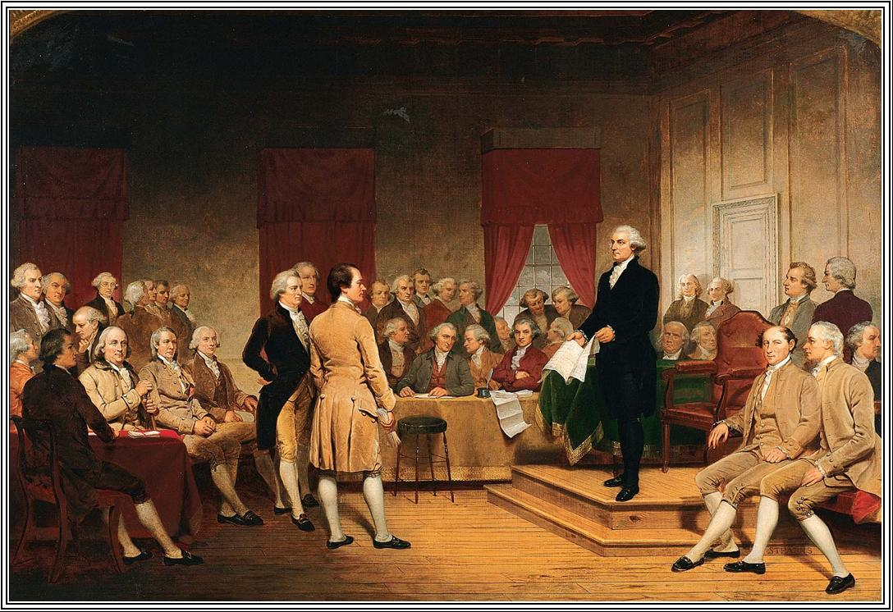
Constitutional Convention
Fix the Articles of Confederation, give more power to the Federal Government

Slide 5
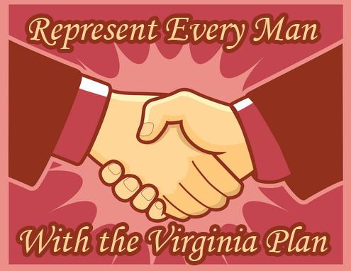
Virginia Plan
Supported by the big states that called for three branches of government (Executive, Legislative and Judicial).
Legislative Branch would be one house and representation would be based on the number of people living in the state (population)

Slide 6
New Jersey Plan
Supported by the small states that called for three branches of government (Executive, Legislative, and Judicial).
Legislative Branch would be one house and representation would be equal (2 representatives from each state)

Slide 7
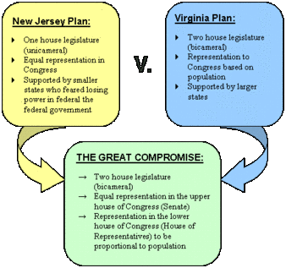
Great Compromise
Deal reached that would make the government three branches (Executive, Legislative and Judicial).
Legislative Branch would be a two house (bicameral) Congress.
Senate where representation would be equal for each state
House of Representatives where representation would be based on the state's population

Slide 8
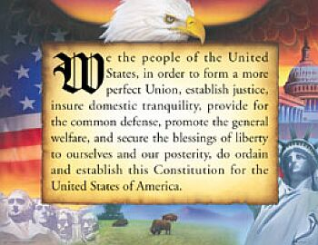
Preamble
“We the PEOPLE” Shows the power belongs to the people

Slide 9
Federalist Anti-Federalist
Those who supported the Constitution
Federalist Papers
Written to gain support for Ratifying (Approving) the Constitution
Wanted more power in the Federal Government
Those who did not support the Constitution
Bill of Rights
Antifederalist would not ratify the Constitution unless a Bill of Rights were included to protect the people from Government power
Wanted more power in the States

Slide 10
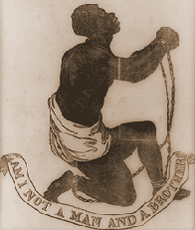
Slavery and the Constitution
Slavery was continued under the new Constitution because without it the Southern States would not have agreed to ratify the constitution
Three Fifths agreement
3 out of every 5 slaves would be counted toward representation
Help out southern states

Slide 11
Federalism- Power Divided between State and Federal Government
Reserved Powers
Power that only the states have the right to control
Marriage, driving laws, education
Delegated Powers
Powers that only the National government have the right to control
Declare war, sign treaties

Slide 12
Concurrent
Powers that BOTH the National and State government have the right to control
Collect Taxes, set up courts

Slide 13
Elastic Clause
Allows for congress to add laws to the Constitution to changing circumstances in history. Constitution is a living document, never finalized
“Necessary and Proper”

Slide 14
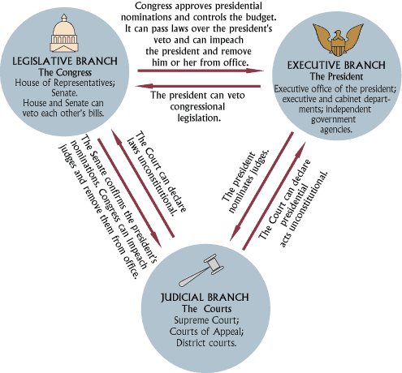
Checks and Balances
Power is not within one branch of the government.
Each Branch checks on one another so that not one branch becomes too powerful.
Example
Congress (Legislative Branch) passes a Bill, Bill gets sent to the President (Executive Branch) for his approval or veto (deny of law), then to the Supreme Court (Judicial Branch) to make sure the Law in constitutional

