Slide 1
Creoles

Slide 2
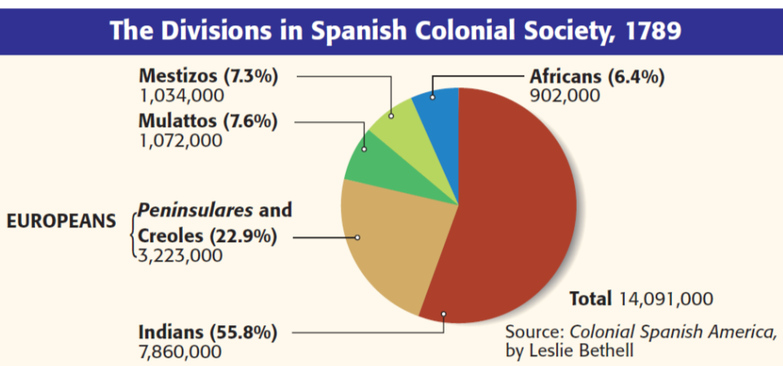
Title
White Europeans were at the top of society
One major impact of European colonization was the unequal social hierarchy in Latin America
Text
Spanish colonists living in America were called creoles; They had land & wealth but had no political power

Slide 3
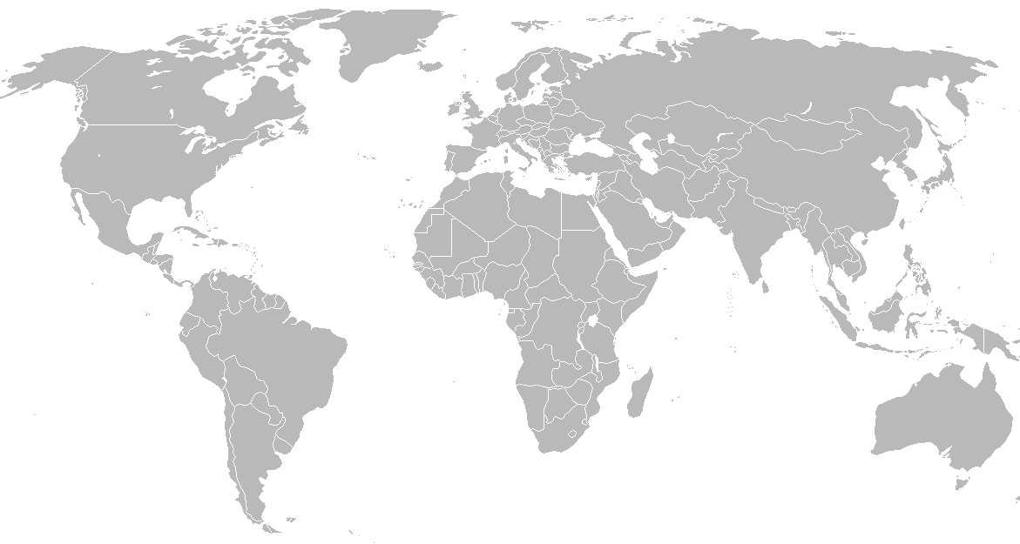
Who was next in social order?
CREOLES
Descendents of Portuguese or Spanish settlers born in the colonies
The peninsulares looked down on the creoles, and the creoles resented it

