Slide 1
Cultural Diffusion

Slide 2
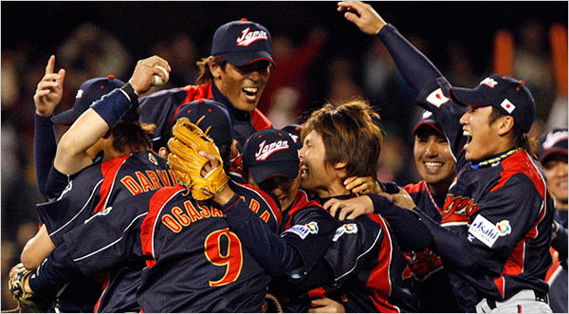
Cultural Diffusion
Exchange of ideas from one group of people to another group of people
Cultural Diffusion can occur during trade and war

Slide 3
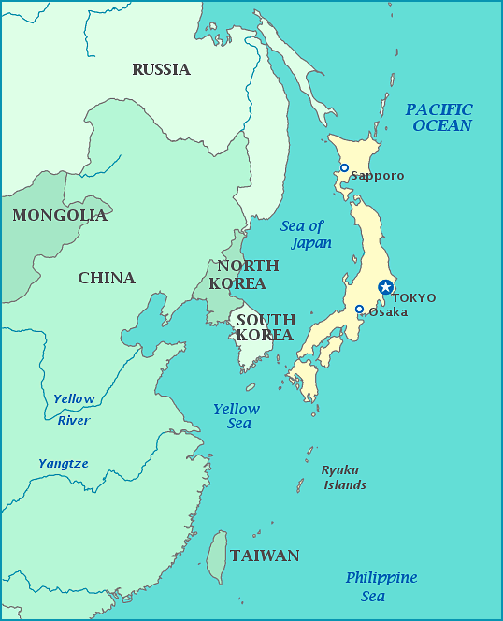
Korea Influence on Japan and China
Korea is known as the bridge between Japan and China because of its location. Korea adapted ideas and ways of life from both Japan and China.

Slide 4
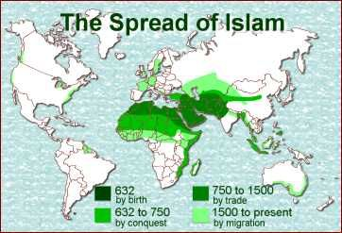
Mansa Musa and Islam in Northern Africa
Mansa Musa from Mali went to Mecca and brought back Islam to Northern Africa. Mali was part of the Gold Salt trade so the idea of Islam spread throughout the trade route.
Today many Northern African Nations are predominantly islam

Slide 5
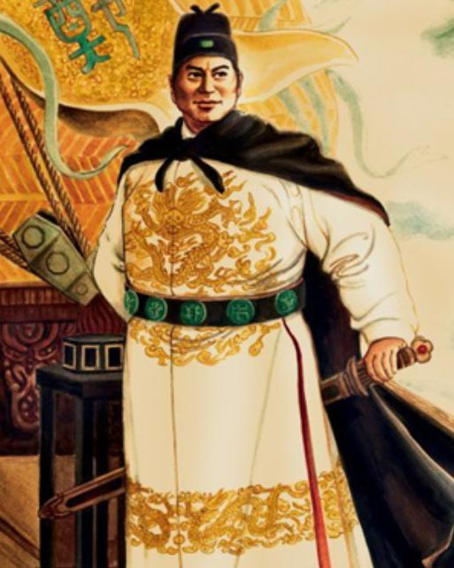
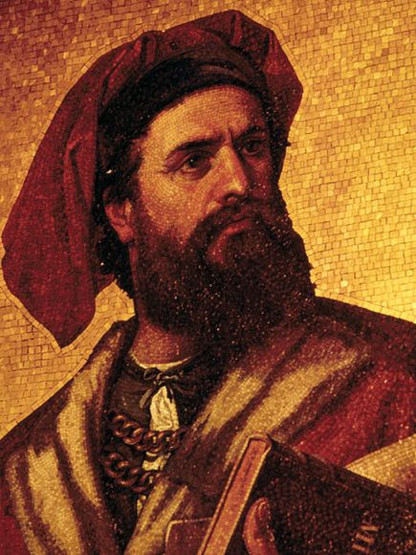
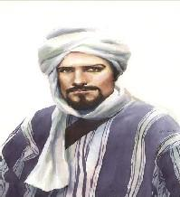
Zheng He, Marco Polo, and Ibn Battuta
Explorers and traders who wrote down what they saw along their journeys which people read and went to these places to trade for the goods written about.

Slide 6
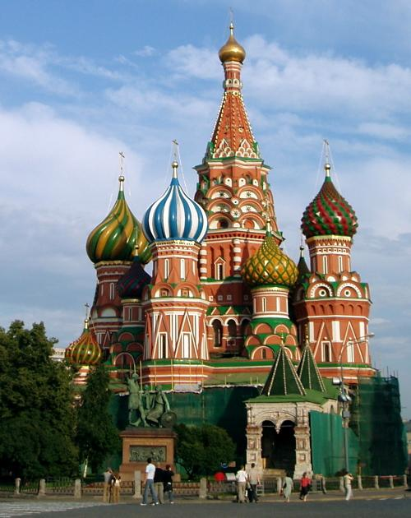
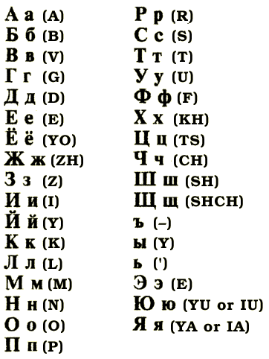
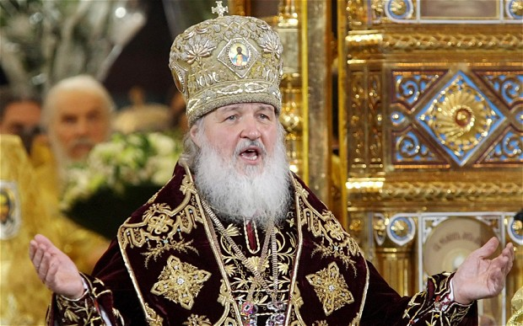
Byzantine Empire on Russia
Russia adapted Byzantine ‘s Cyrillic Alphabet
Russia adapted Byzantine Orthodox Christianity
Russia adapted the dome structured buildings

Slide 7
Kemel Ataturk and Reza Pahlavi Westernization
Kemel Ataturk-Turkey
Westernized Turkey, separated religion from government.
New European law code not Islamic Religious Law Code
Replaced Arabic script with Latin Alphabet like the west
Women gained more freedom; no veils, right to vote and to hold jobs
Reza Pahlavi- Iran
Westernized Iran, attempted to separate religion law from government law
Granted women rights
Built new roads and industry from the wealth of oil found in Iran

Slide 8
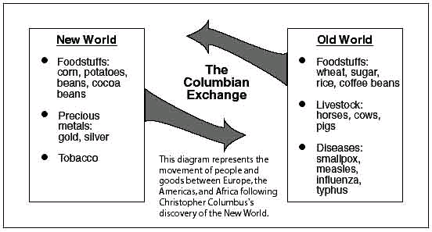
Columbian Exchange

Slide 9
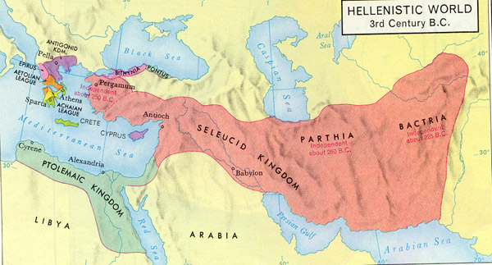
Hellenism (Alexander the Great)
A Blend of Greek, Persian, Egyptian and Indian Culture
Women gained more rights during the Hellenistic period
New advancements in science and mathematics, Pythagoras (theorem), Aristarchus (Earth rotate on axis) and Hippocrates (Studied cause of illness, looked for cures)

Slide 10
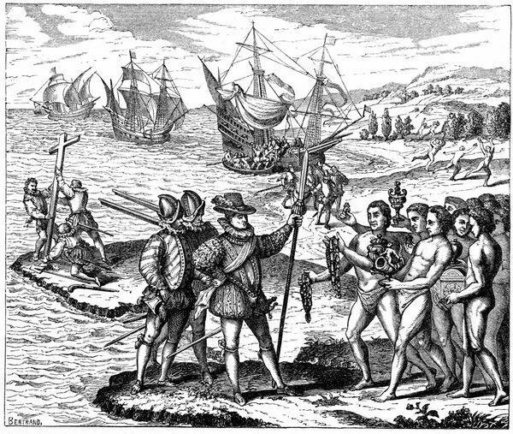
The Encounter
Period when Europeans met the natives in Latin America.
Began with Christopher Columbus finding the “New World”
Europeans brought illness that killed natives
Natives and Latin America had diseases Europeans
Were not immuned to and died

Slide 11
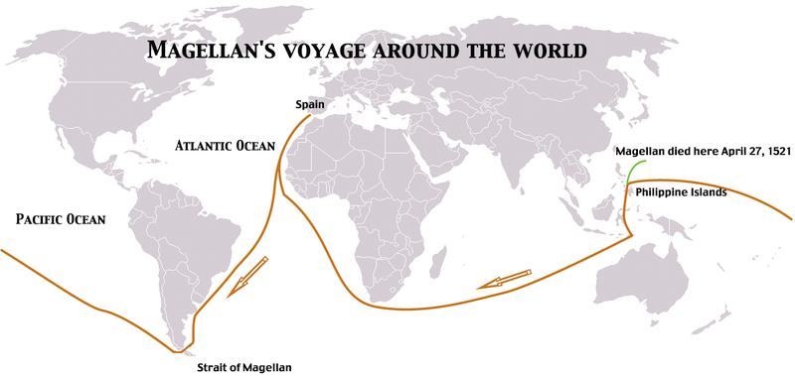
Ferdinand Magellan
He and his crew sailed from Atlantic Ocean to Pacific Ocean and back
Spread Christianity along his stops
Died before ship made it back to Spain

Slide 12
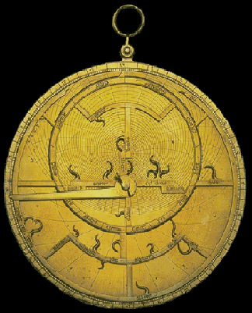
Astrolabe
A device used to measure the angles of the sun and stars above the horizon
Helped figure out directions while out at sea

