Slide 1
Early America

Slide 2
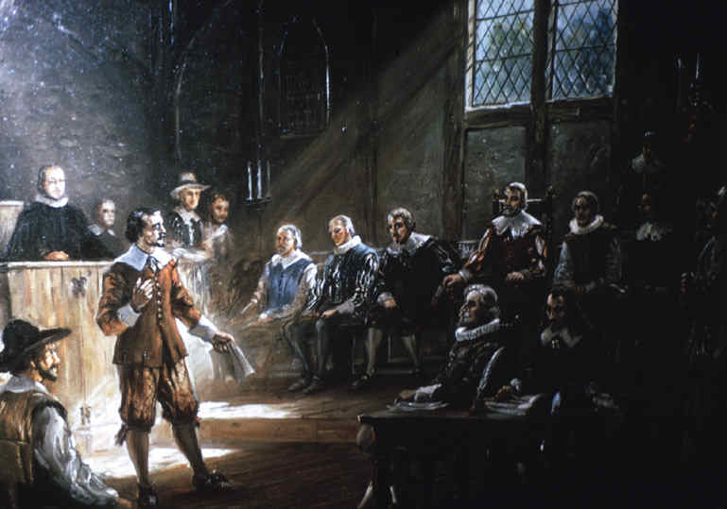
Self-Representation/Democracy
House of Burgesses
-Virginia
- Settlers were representatives in the law making practices

Slide 3
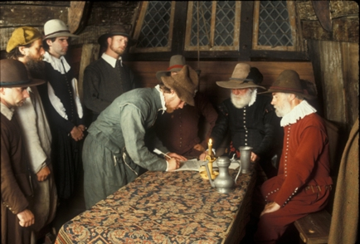
Self-Representation/Democracy
Mayflower Compact
New England/Plymouth
On Voyage from Europe, drew up laws in which each of the settlers would have to live by along with punishments if the laws were broken

Slide 4
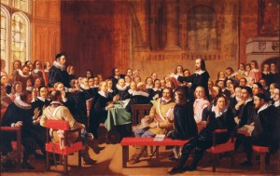
Self-Representation/Democracy
Town Hall Meetings
New England
Meetings for settlers to voice problems and offer suggestions to things that are going on in the colony

Slide 5
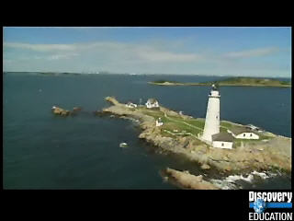
Geography
New England
Rocky soil, Forest for timber (wood), Fishing along coast
Both warm and Cold Seasons

Slide 6
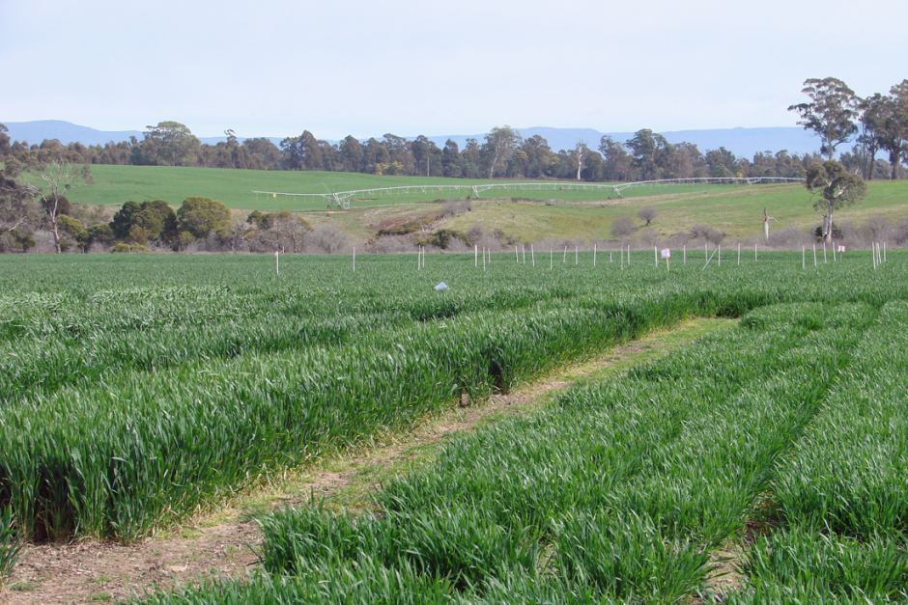
Geography
South
Rich soil, wet season,warm climate good for farming

Slide 7
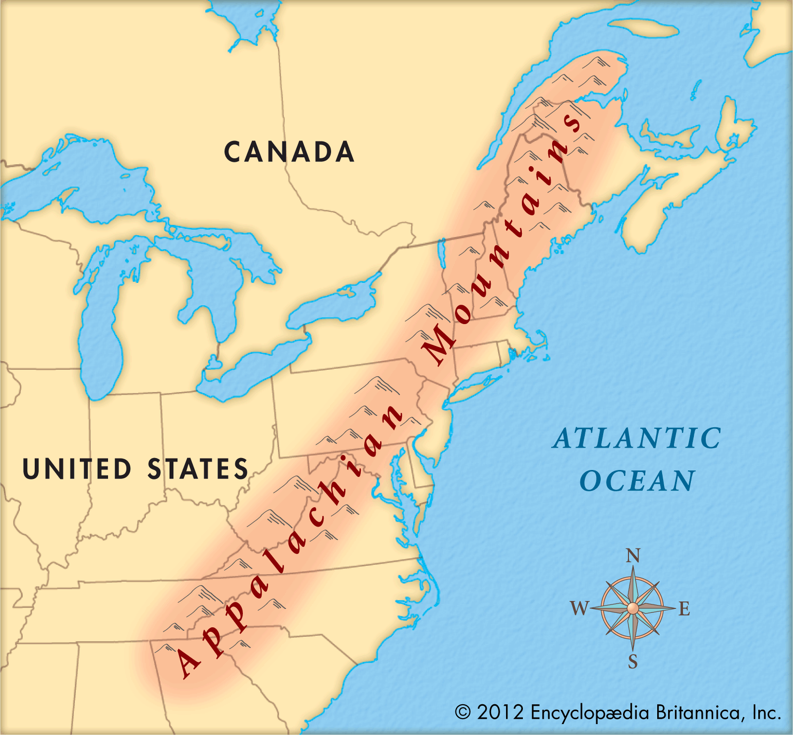
Geography
Appalachian Mountain
Western Border of the colonies, prevented colonist from moving out west

Slide 8
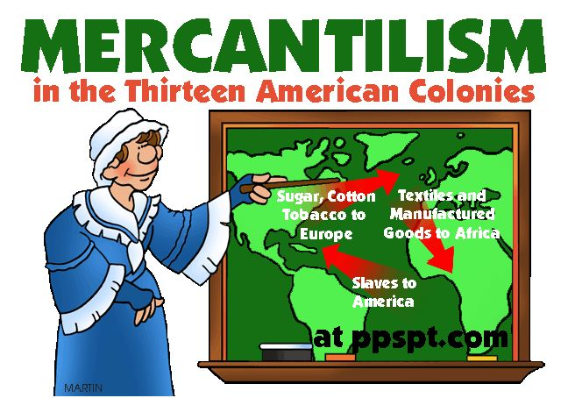
Mercantilism
The American colonies were only allowed to trade natural resources and raw materials to England

