Slide 1
Economic Systems

Slide 2
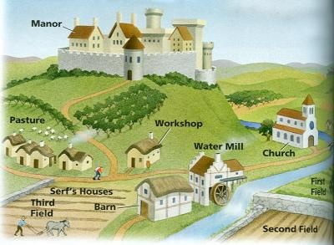
Feudalism/Manorialism
Feudalism
A political and economic system of Europe and Japan.
Manorialism
Based on the exchange of land (Lord) for services (military service or farming)

Slide 3
European Feudalism
King or Queen
Lords
Vassals
Knights
Serfs and Freemen
Feudalism was a political system based on the exchange of land for services.
Kings relied on service from his nobles (war) or serfs (farming) in exchange for land (manors or fiefs)

Slide 4
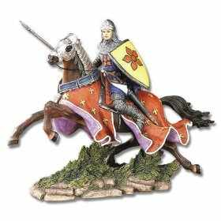
European Code of Chivalry
Military excellence
Justice
Courtesy
Godliness
Honor

Slide 5
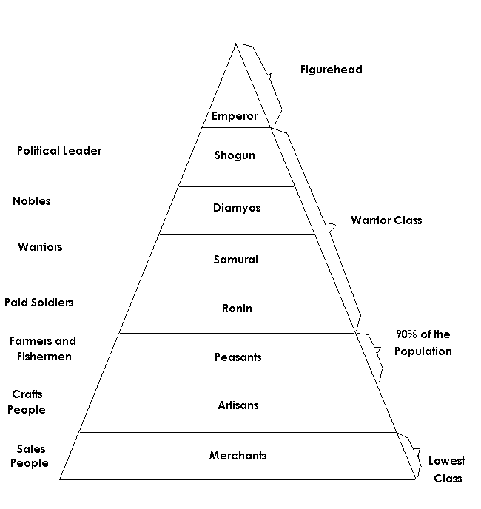
Japanese Feudalism
Emperors at the top of the social pyramid
Shoguns had the REAL power
Was an exchange of land for services

Slide 6
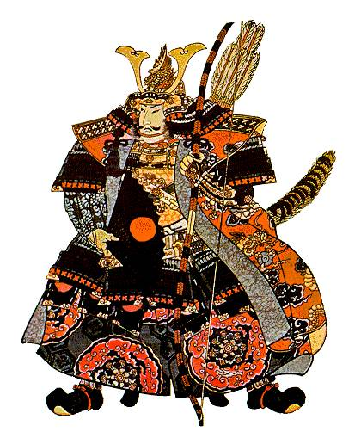
Japanese Code of Bushido
Fidelity
Politeness
Virility
Simplicity

Slide 7
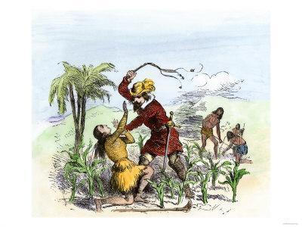
A system of production in Spain’s New World (Americas) possessions which granted permission to conquistadors to enslave as many people needed to work a plantation.

Slide 8
Latin American Social Structure
Born in Europe
Of European descent but born in Americas
Mixed Race-
European and Native American or European and African
Native Americans
And Africans

Slide 9
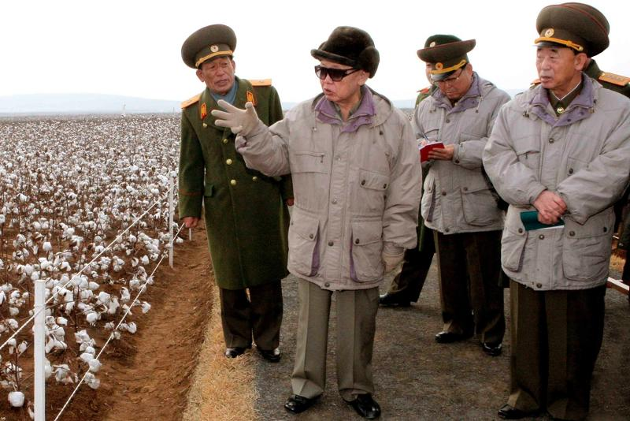
Command Economy
Government has control of the means of production
Decides what and how many goods that need to be produced
Quota system
Example
Stalin in the Soviet Union
North Korea

Slide 10
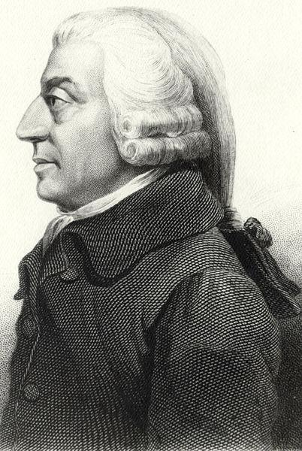
Key thinker: Adam Smith wrote The Wealth of Nations
“Laissez Faire” economics- government keeps its “hands off”
Seen in capitalistic societies

Slide 11
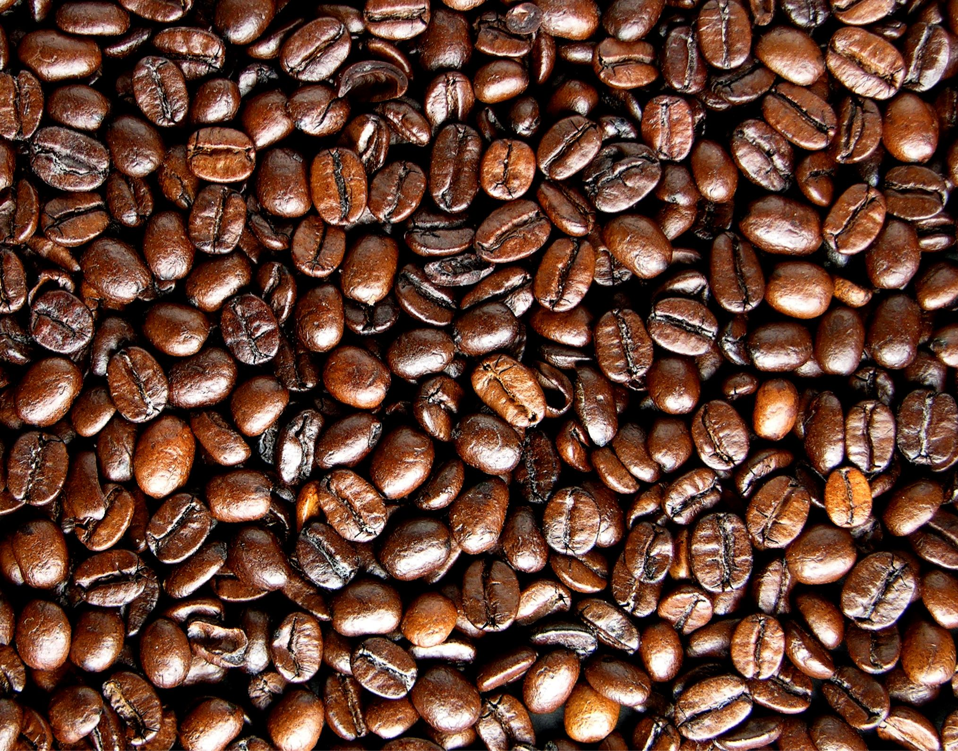
Cash Crop
Country is dependent on one or a few crops
Crops are grown and sold off to Industrialized countries that need the raw material to make finished goods
Latin America sent sugar, cotton and coffee to Europe
Problem if there is a drought, crop failure or price of goods decrease

Slide 12
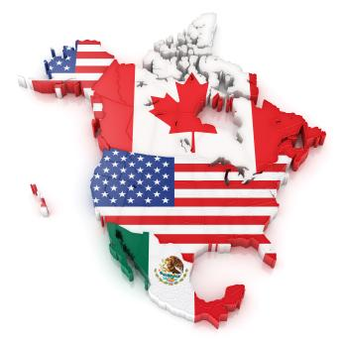
North American Free Trade Agreement (NAFTA)
North American Free Trade Agreement (NAFTA)
its goal is to promote trade free of tariffs (Tax on traded goods)
Canada
United States
Mexico

Slide 13
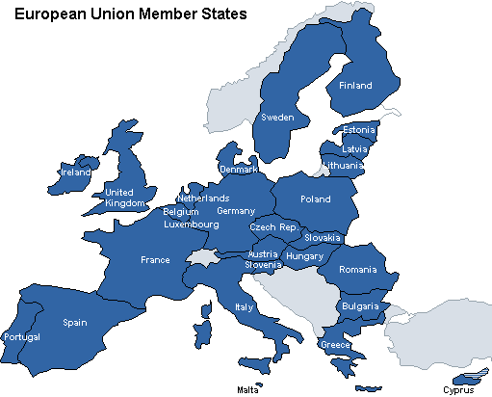
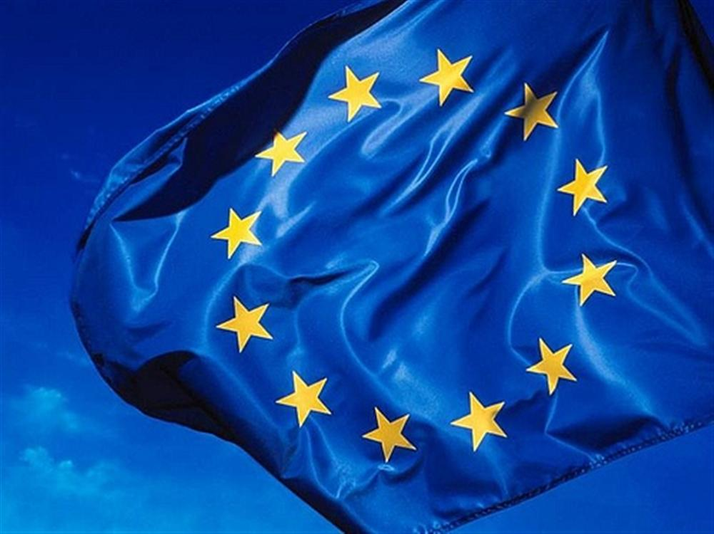
European Union (E.U.)
Expanded out of the European Community, which ended tariffs and allowed labor and capital to move freely across European borders.
E.U. hope is to bolster Europe's trade position and political and economic power
Created a new currency called the Euro but not all of the E.U. members use this currency

Slide 14
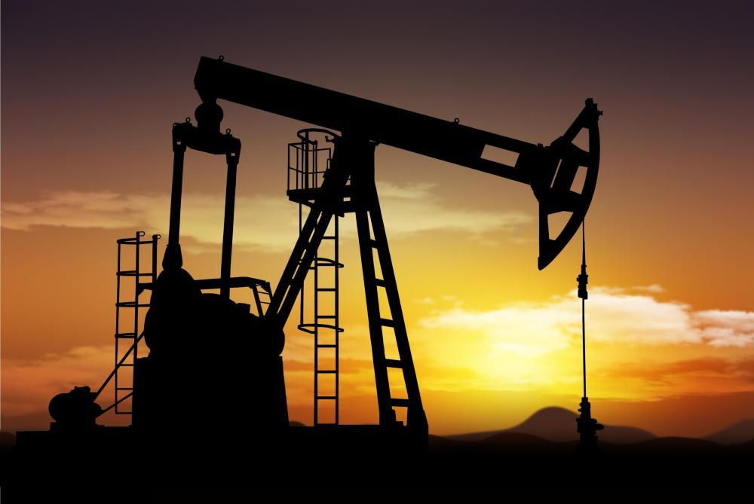
Scarcity
Goods that are not renewable
Goods that can run out of if overused

Slide 15
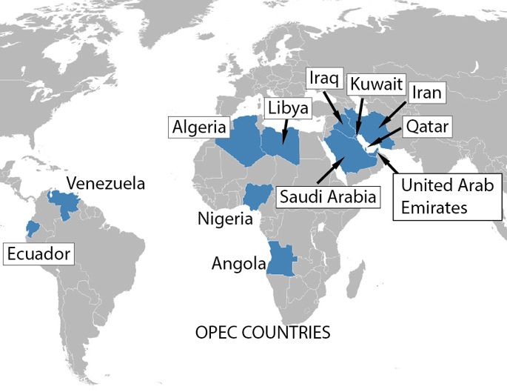
Organization of Petroleum Exporting Countries (OPEC)
OPEC: (Organization of Petroleum Exporting Countries) Its goal is to control the oil industry by setting production levels and prices.
Many Members are from the Middle East

