Slide 1
Empires and Kingdoms: Achievements

Slide 2
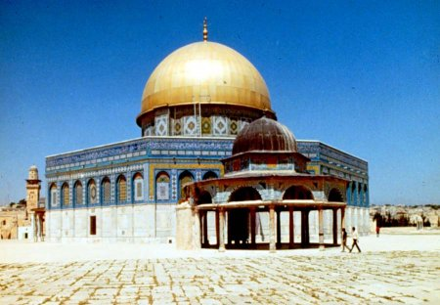
Abbasid and Umayyad
Ruled over the Middle East and Northern part of Africa
Islamic Golden Age
Developed Algebra
Calligraphy
Mosques

Slide 3
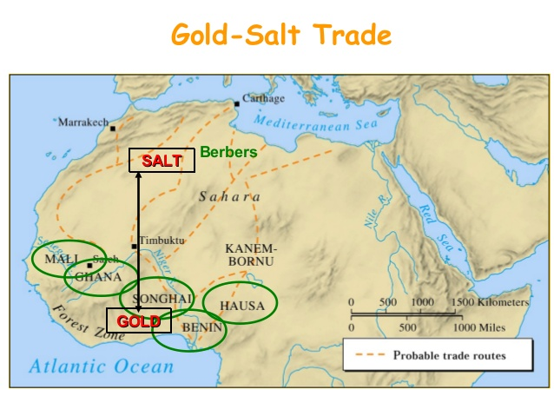
Ghana, Mali and Songhai
Part of the West African Gold for Salt Trade Kingdoms
Cultural Diffusion spread on trade routes

Slide 4
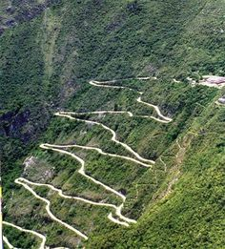
Inca Empire
Developed Road systems to increase trade through mountain region

Slide 5
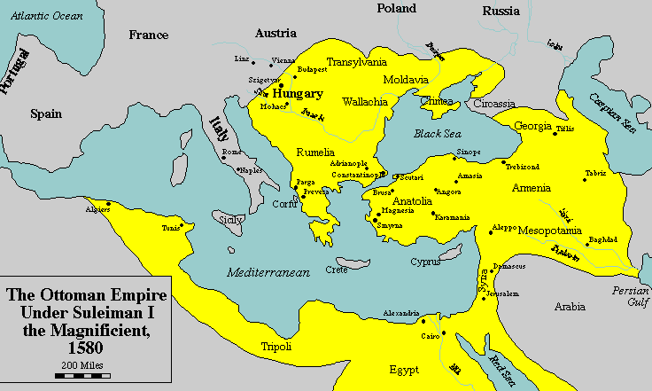
Ottoman Turks
Blended Byzantine and Muslim Cultures in social life, architecture and government
Suleiman the Magnificent ruled during the Golden Age of Islam, improve system of law and modernized the army

Slide 6
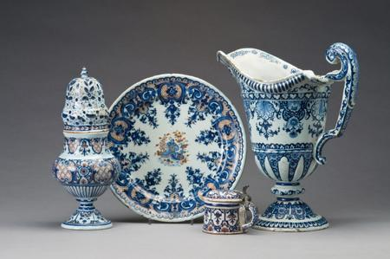
Tang/Song Dynasty
Ruling Family in China
Revised the Civil Service Exam for Government Jobs
Society based on duty, rank and social behavior
Increased trade
Experts in making porcelain, shiny hard pottery

Slide 7
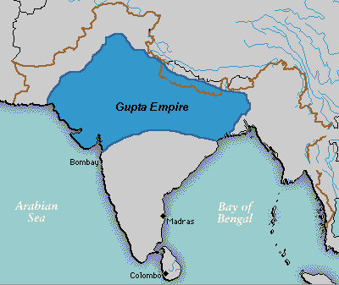
Gupta Empire
Located in India
Concept of Zero
Decimal System
Arabic Numerals

Slide 8
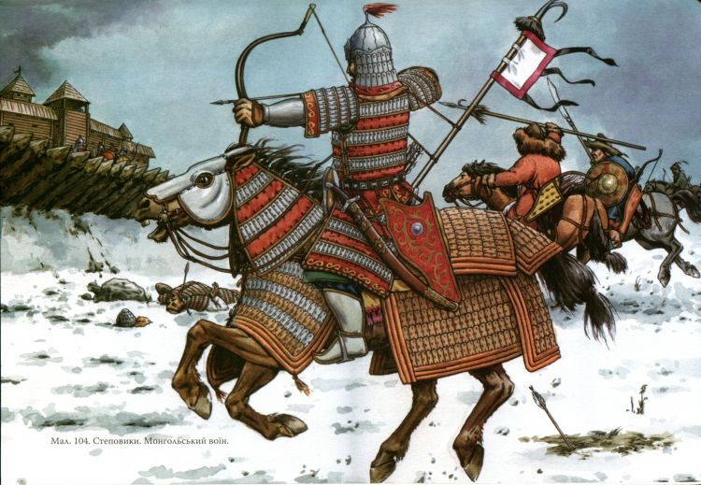
Mongols
Lead by Genghis Khan
Pax Mongolia, period of peace and prosperity
Protected the Silk Road which linked trade from Asia to Europe
Tolerant of other cultures that they conquered
Invention of the stirrup so they can stand and shot bow and arrow while on horses
Psychological Warfare

Slide 9
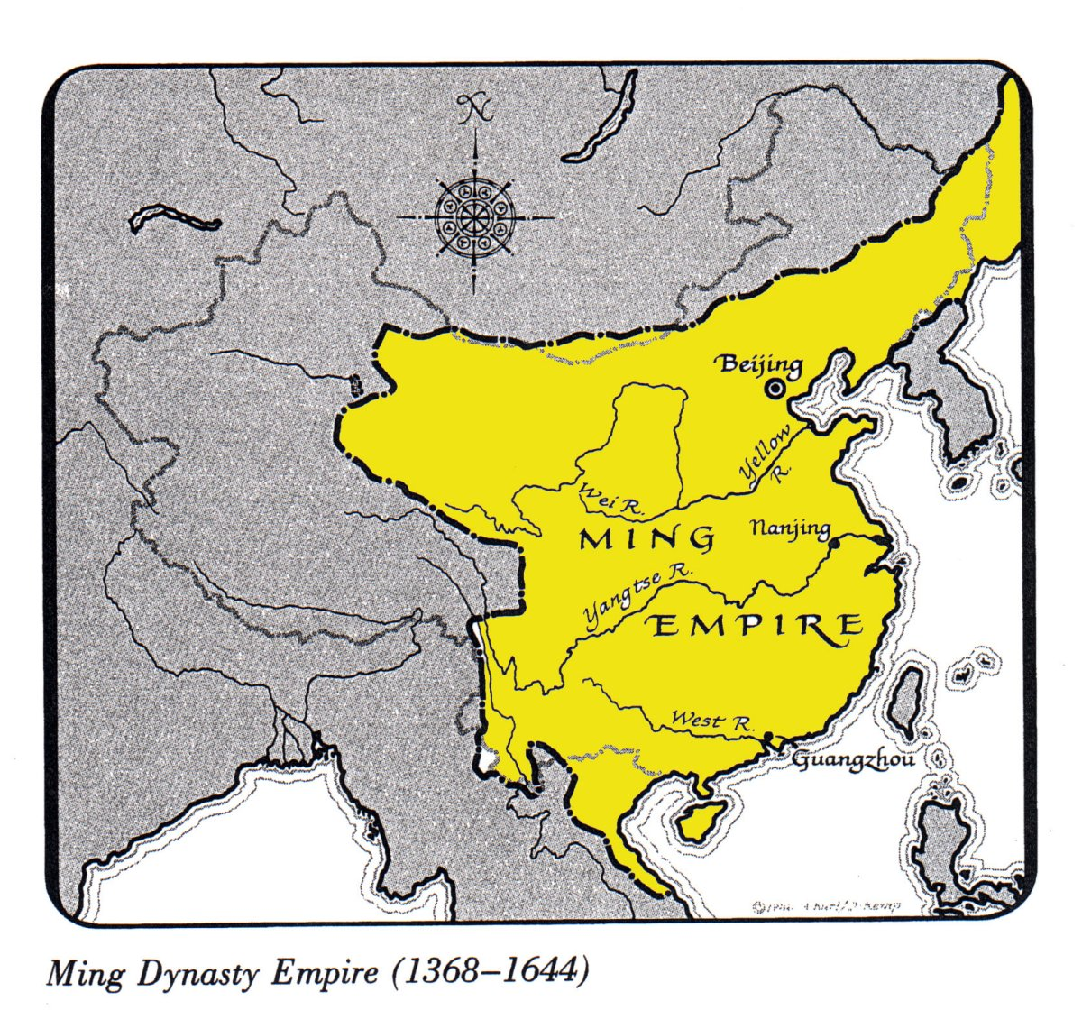
Ming Dynasty
Restablished Chinese Rule after Mongols ruling China
Civil Service restored
Zheng He helped increase trade

Slide 10
Geography and Ancient India
Indus River Valley in modern day Pakistan
Remains of first planned cities (Harappa-Mohenjo Daro)

Slide 11
River Valley Civilizations
3 of 14
Nile River in Egypt- Cities rose from farming settlements in the river valley
The earliest cities uncovered so far lie in the valley between the Tigris and Euphrates Rivers (c. 3500 B.C.) in present-day Iraq.
Cities also arose in the Indus River valley (c. 2500 B.C.) in India.
The first urban communities in China appeared in the Huang He valley (c. 1500 B.C.).

Slide 12
Geography and Ancient Egypt
Nile River was center of Egyptian life.
Flooding of Nile brought fertile soil
Irrigation, trade, travel
Polytheistic Religion, belief in more than one god
Hieroglyphics- writing system

Slide 13
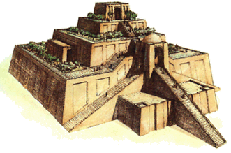
Geography and Sumer (Fertile Crescent, Mesopotamia)
Architecture: ziggurats- stepped temples
Cuneiform: written language
Code of Hammurabi: law code based on principle of “an eye for an eye”
Land in between the Tigris and
Eurphrates River

Slide 14
Geography and China
Dynasties ruled by emperors governed China for over 3000 years
Huang He River, “River of Sorrows”, because it floods at different times which causes deatha nd destruction
Mandate of Heaven- the right to rule given to the dynasty by the Gods
Dynastic Cycle- rise and fall of dynasties based on the Mandate of Heaven

Slide 16
Key Achievements during Greece's Golden Age
Democracy
Art
Architecture
Philosophy
Theater
History
Math
Medicine

Slide 17
Early Roman Government
Republic- indirect democracy
government officials are elected to represent the people
Executive
Called the Consul
Enacted and enforced laws
2 branches
Legislative
Called the Senate
Made laws

