Slide 1
Environmental Issues through Imperialism

Slide 2
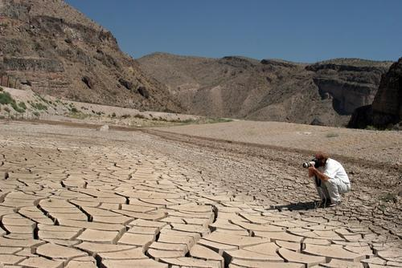
Global Concern
Desertification: arable land turning to desert
Sahel region of Sahara Desert in Africa
Causes: overgrazing, cutting down forests
Effects: Sahara Desert grows 50 miles/yr, famine
Solutions: education, planting trees to reduce soil erosion, crop rotation, international aid

Slide 3
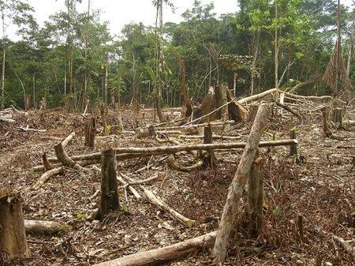
Global Concern
Deforestation: destruction of forests
Brazil, India, Indonesia
Cause: developing nations looking to sell lumber or clear land to grow crops, graze cattle or build homes
Effects: Losing 50 million acres of tropic forest each year, greenhouse effect, soil erosion, extinction of certain plants and animals
Solutions: education, planting trees, population control, economic development

Slide 4
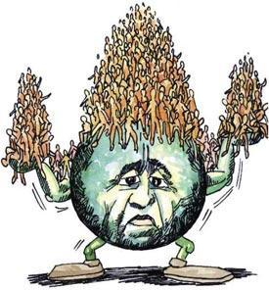
Global Concern
Overpopulation (too many people for the available resources)
Causes: traditional values, laborers, lack of birth control
China, India, Bangladesh
Effects: World population of 6.2 billion and growing, drain on resources (including energy, education, food, farmland and water)
Solutions: education, family planning, China’s “one-child” policy

Slide 5
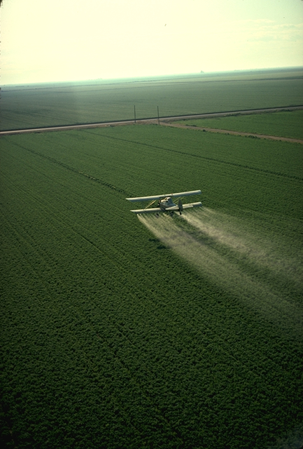
Green Revolution
Through the use of new technologies and science, the improvement of crop growth occurred during this period
Pesticides
Herbicides
New Fertilization

Slide 6
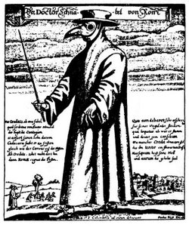
Black Death/Bubonic Plague
Spread of disease caused millions of people to die in Europe
Believed spread through trade from Asia to Europe
The work force decreased during this period

Slide 7
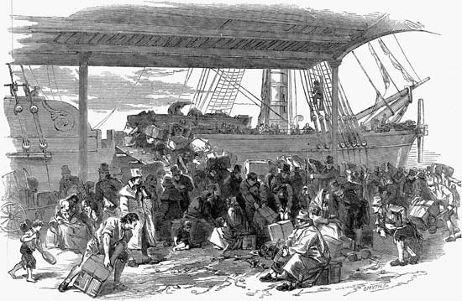
Ireland-Potato Famine
The inability to grow potatoes forced many Irish to leave Ireland in search of new economic opportunities

Slide 8
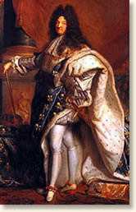
Suleiman the Magnificent and King Louis XIV
View on Government
Both Centralized Power

Slide 9
Suleiman the Magnificent
Modernized the military
Islam became major religion in Balkans do to westward expansion of Suleiman
Religious Tolerance

Slide 10
Asoka and Akbar the Great
Toleration of other religions

Slide 11
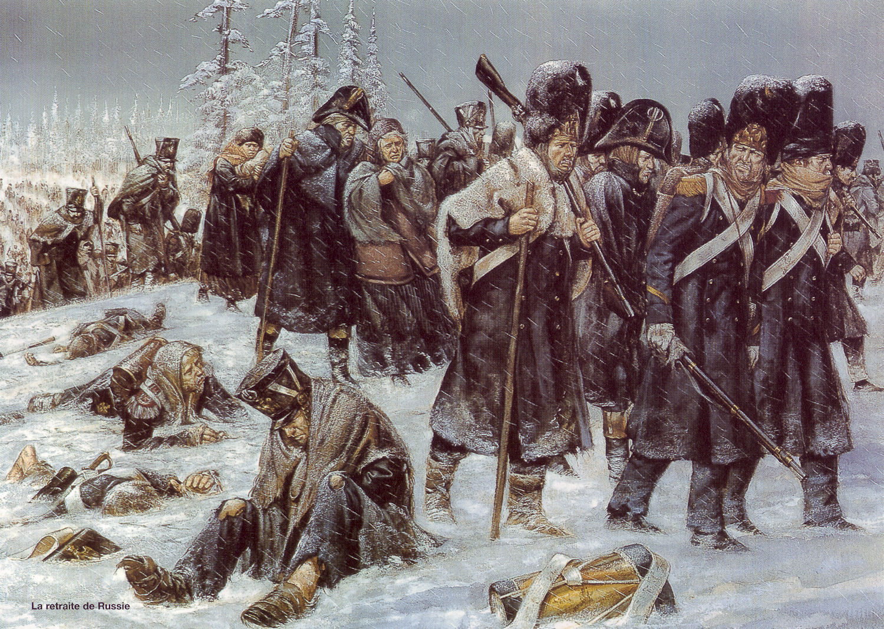
Napoleon and Russia
Napoleon tried to invade Russia during the winter time
Cold weather and large terrain helped defeat Napoleon

Slide 12
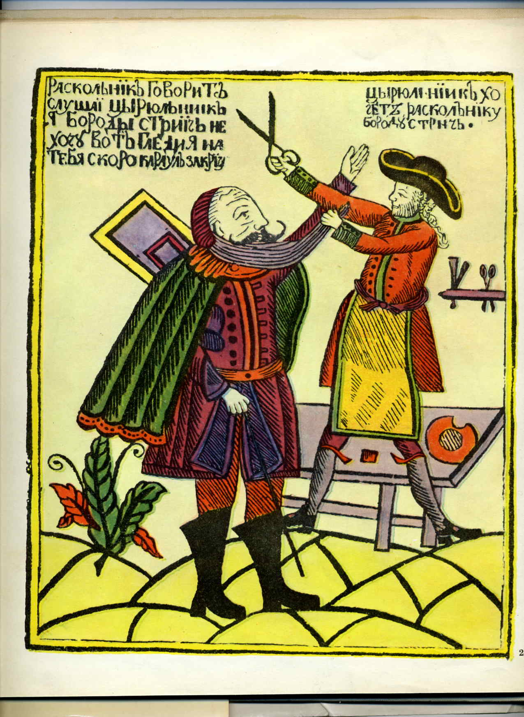
Peter the Great-Westernization
Improved the military by modernizing
Removed beards

Slide 13
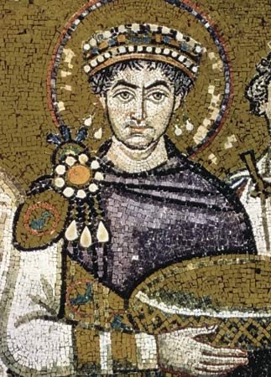
Justinian Code- Byzantine Empire
Collected law codes and determined which laws would best fit his rule.
The collection of laws set the foundation for future law codes

Slide 14
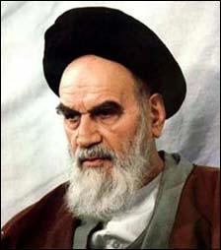
Ayatollah Khomeini
Wanted to bring back fundamental ideas back to law code and government of Iran

Slide 15
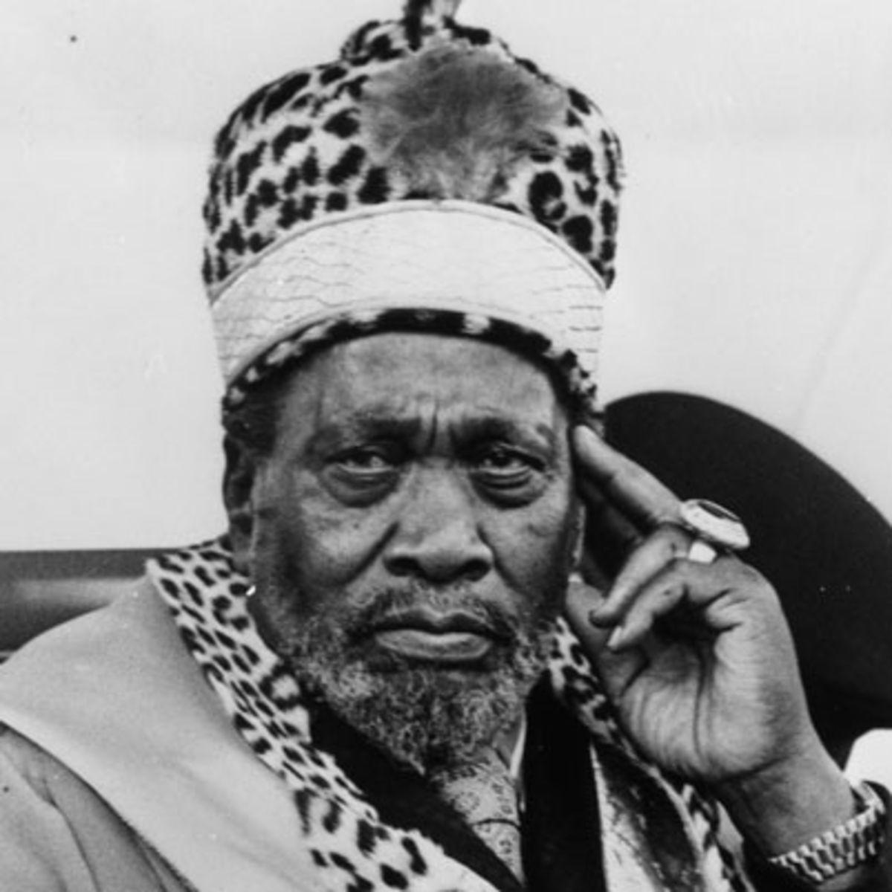
Jomo Kenyatta
Nationalist and Independence leader of Kenya

Slide 16
Niccolo Machiavelli
Wrote the book “The Prince”
Outlined how a Prince should rule his people and run government
“Ends justify the means”
‘Better to be feared than loved”

Slide 17
Deng Xiaoping
Allowed for some private ownership into Communist China

Slide 18
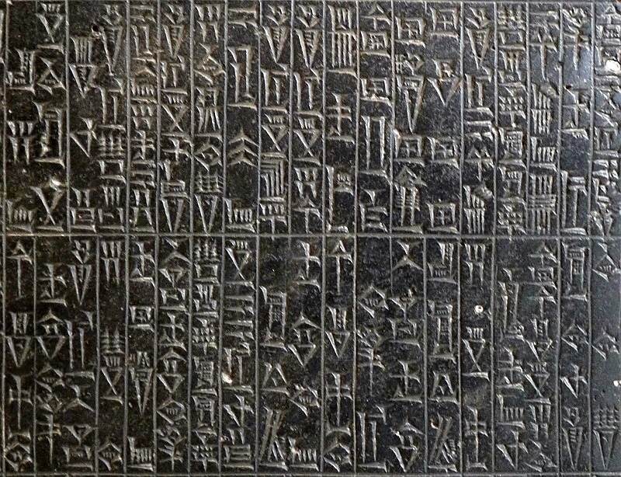
Hammurabi
Created a law code which he wrote down so the people knew what the laws were
“Eye for an Eye” if the person was of the same social class
If a higher ranking person strikes a lower ranking person, they have to pay a fine not be inflicted with the same strike as they dealt

Slide 20
Totalitarian State
A one party dictatorship attempts to regulate every aspect of the lives of its citizens
To ensure obedience Stalin used secret police, censorship and terror
Propaganda was used to show how communism was successful and capitalism was not
1. How would censorship and propaganda be hard to control today?

Slide 21
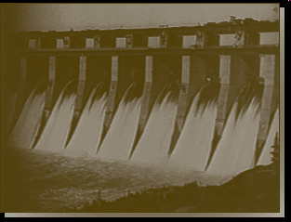
First Five Year Plan
Improve the Russian economy
Build heavy industry, improve transportation and increase farm output
Factories, hydroelectric power stations and railroads were built during the five year plan

Slide 22
Ukrainian Famine
Joseph Stalin cut off grain supply to the Ukraine killing over a million people

Slide 23
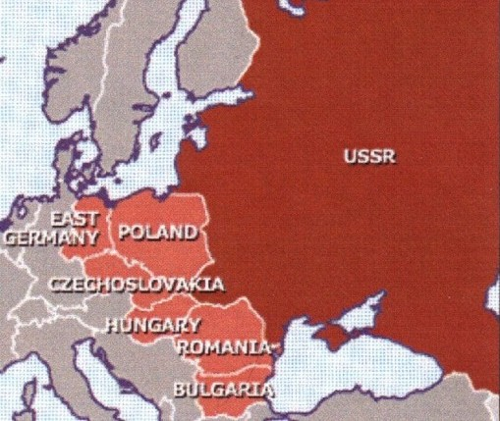
Spread of Communism
East Germany, Poland, Czechoslovakia, Hungary, Romania, and Bulgaria had communist government. These countries were called Soviet Satellites States because they were countries that were under the control of the USSR (Union of Soviet Socialist Republics).

Slide 24
Cold War Division
Korea
38th Parallel
Divided North and South Vietnam
Divided Communism from Democracy
Vietnam
17th Parallel
Divided North and South Vietnam
Divided Communism from Democracy

Slide 25
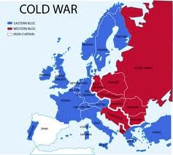
NATO- North Atlantic Treaty Organization
Democratic Countries that vowed to help one another out in the event of being attacked by a Communist country

Slide 26
Warsaw Pact
Communist countries that vowed to help one another out in the event of being attacked by a Democratic country

Slide 27
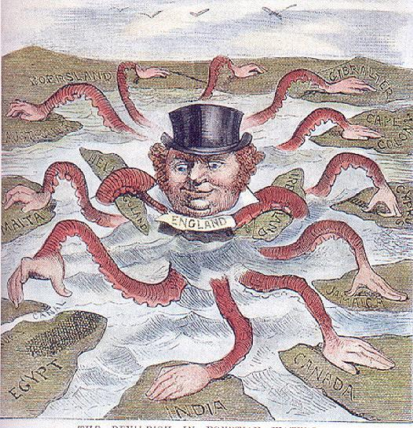
Causes
Economy- need for natural resources and new markets
Military- need for bases, protection of global empires
Social- Social Darwinism
“Survival of the the fittest” applied to nations
Religious- missionary desire to spread Christianity
Nationalism- aggressive pride in one’s nation
“My country is better than yours!”

Slide 28
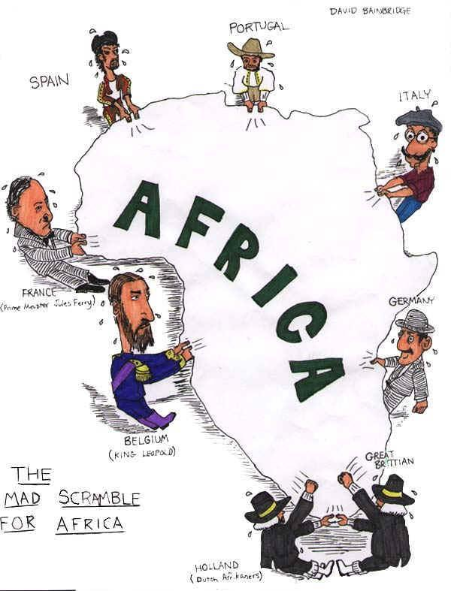
Causes
Berlin Conference 1884
Scramble for Africa
European nations divided up Africa without regard for the African people

Slide 29
Short Term
African and Asian economies dependent on Europeans
Western culture spreads
Traditional governments destroyed
Famines (cash crops)
Long Term
Transportation, education and medical care improved
Nationalist movements in Asia and Africa
Dependence on cash crops
Cultural diffusion
War!

Slide 30
Opium War
British merchants discovered that they could make a large profit for trading a drug called opium for Chinese tea
Chinese became addicted to the drug
Chinese outlawed the drug and ordered Britain to stop selling the drug but the British refused
Chinese war ships fought with British ships over the trade of Opium
The British defeated the Chinese easily because the Industrialized nation of Great Britain had the latest weapons and China, the non-industrialized nation had outdated weapons

Slide 31
Treaty of Nanjing and Extraterritoriality
Treaty of Nanjing
China paid British war cost, open ports to Britain and gave up Hong Kong
Extraterritoriality
Rights to live under their own laws and be tried in their British courts

Slide 32
Empire of Japan
Japanese started to colonize the Pacific Ocean in search of Natural resources that they did not have on their island

