Slide 1
Geography

Slide 2
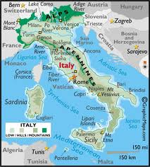
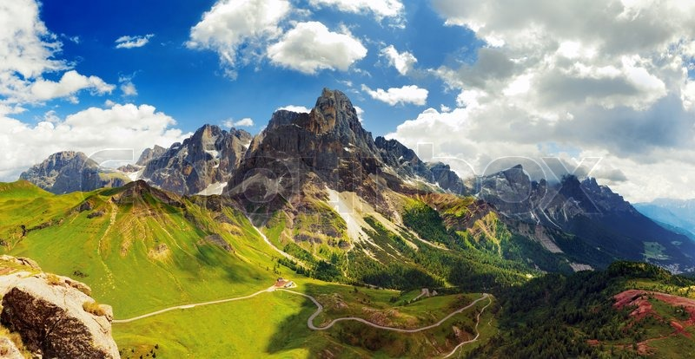
Romans-Peninsula and Mountains
- Peninsula land surrounded on three sides by water
- Made Italy the center of Trade because of all the ports
- Mountains were Natural Barriers
-Roman’s had to build a road system to make trade and troop travel easier

Slide 3
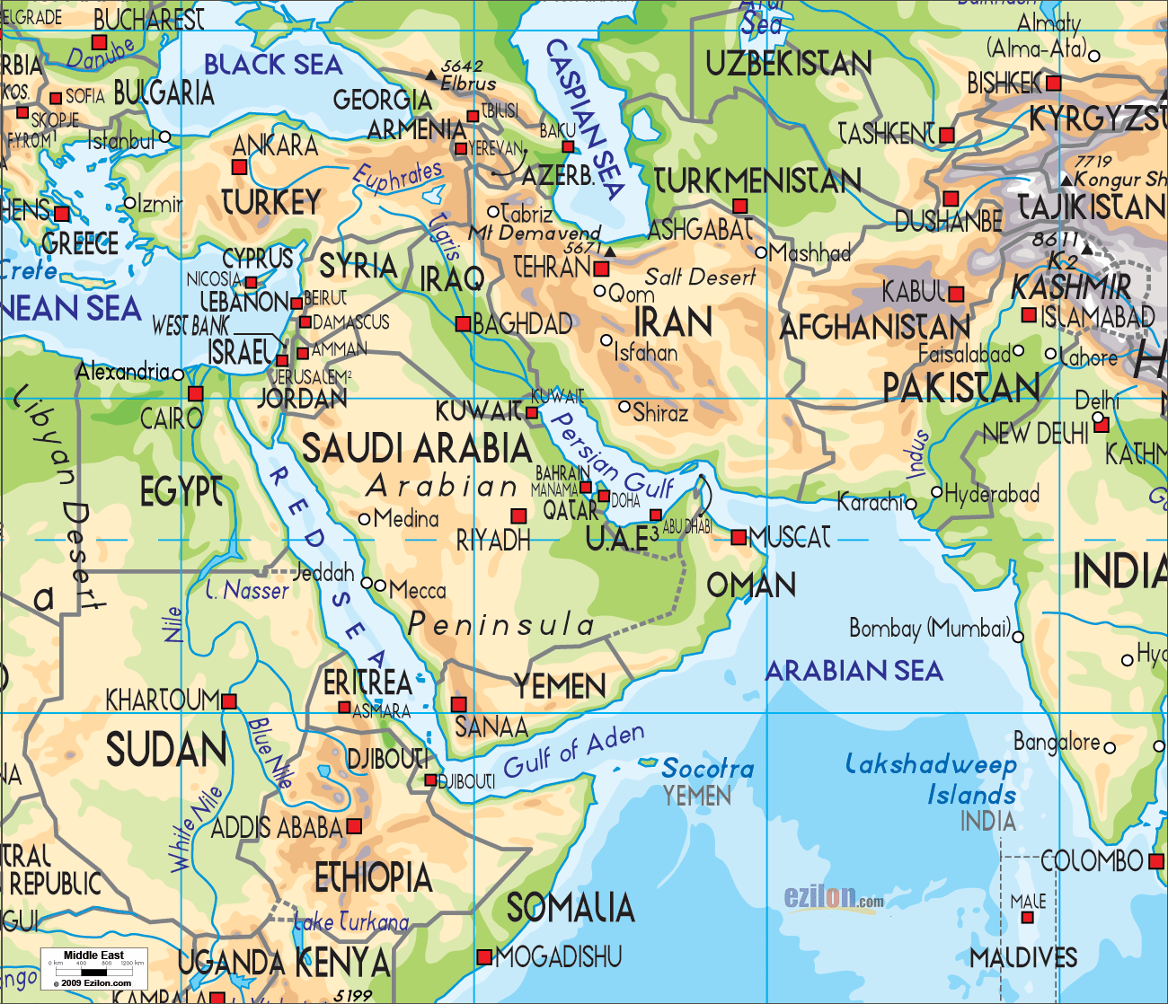
Middle East- Desert
- Deserts are used as Natural Barriers
- Difficulty of flying helicopters during the Persian Gulf war because of sandstorms

Slide 4
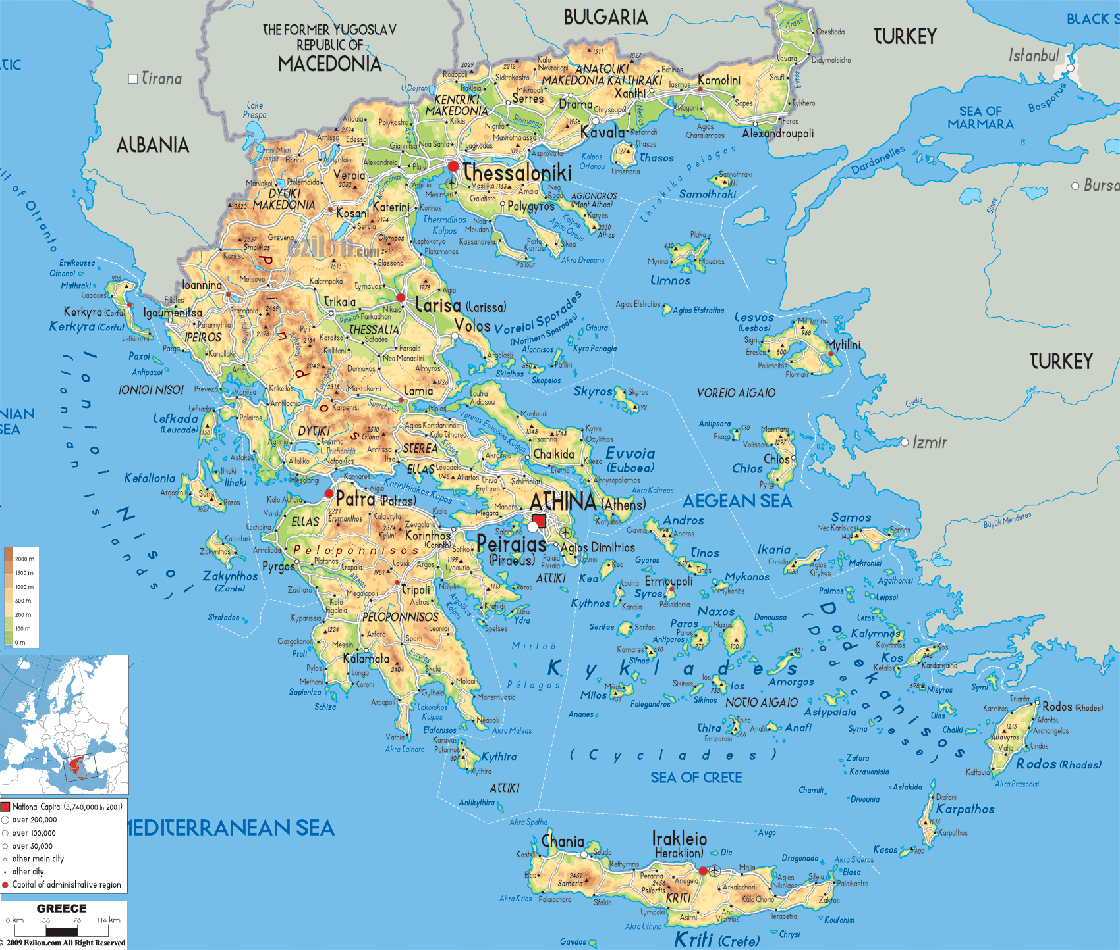
Greece- Mountains
Mountains were used as Natural barriers
Made unifying Greece very difficult, reason why Greece was divided into city-states during Ancient times

Slide 5
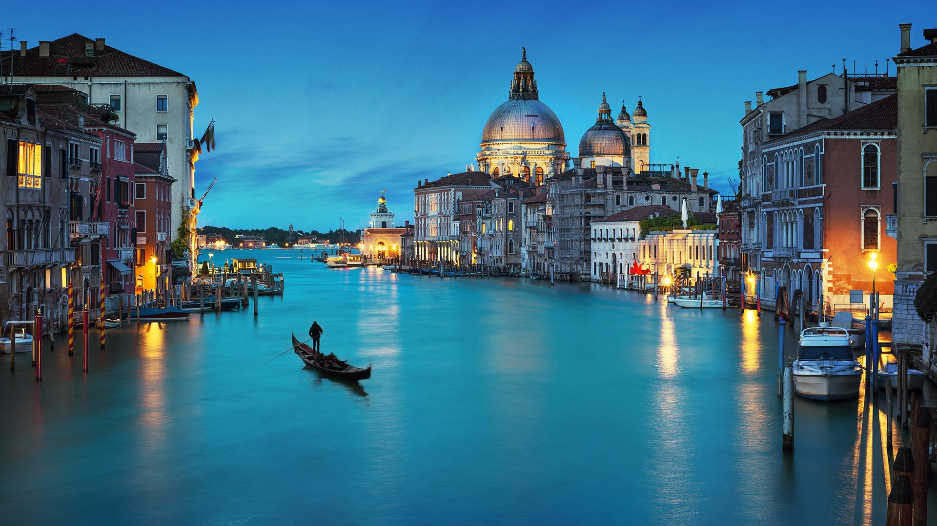
Venice- Coastal City
- Coastal City in Northern Italy
- Trading Center because of being located on the cost
- Fishing

Slide 6
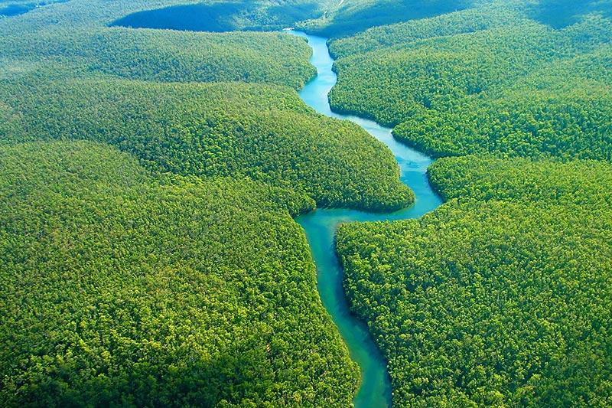
Latin America- Amazon River
- Located mostly in Brazil in South America
- Used as trade route
- Amazon River Valley, rich in lumber

Slide 7
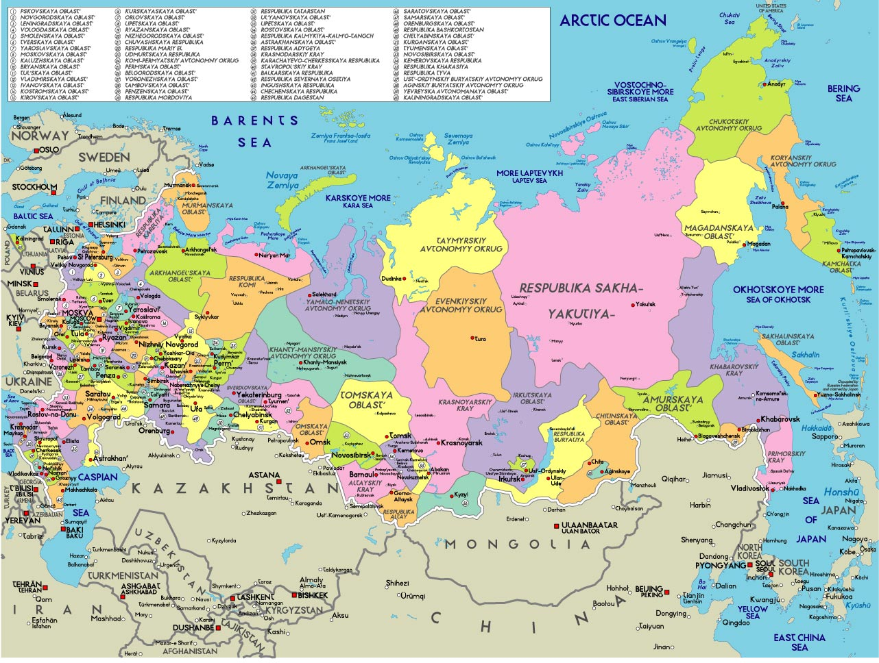
Russia- No Warm Water Ports
- Peter the Great was in search of a Warm Water Port to increase Russian trade and to become more Westernized

Slide 8
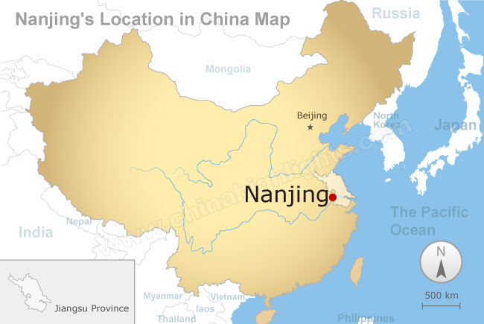
Nanjing- Coastal City
- Coastal City in China
- Center of trade

Slide 9
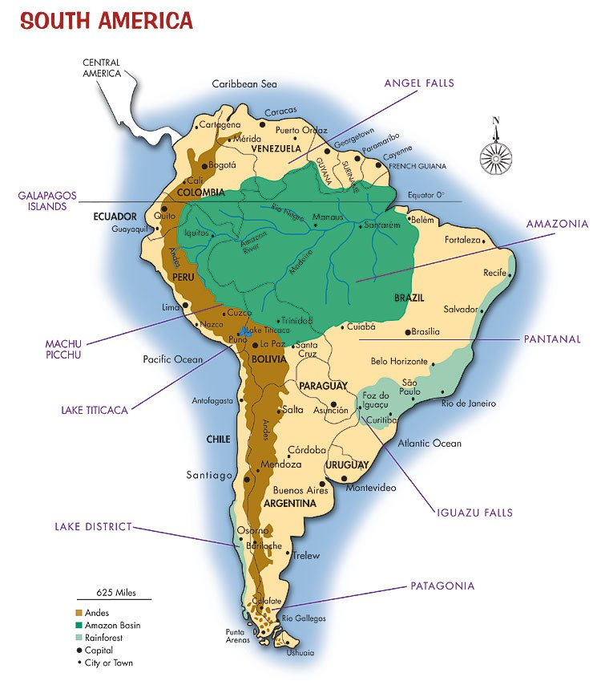
Latin America- Andes Mountains
- Mountain Range in South America
- Made difficult to Unify South American countries after gaining independence from Spain and European countries

Slide 10
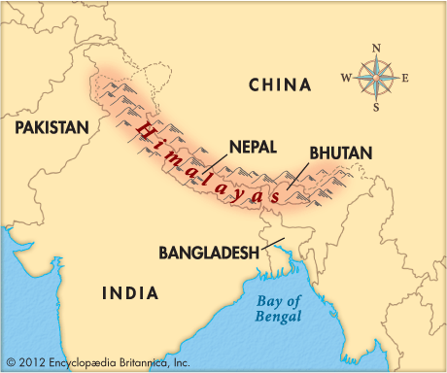
Himalayan Mountains- India and China
- Mountain Range in between India and China
- Natural Barrier for India and China
- China used Terrace Farming , cutting into land to make flat land to farm

Slide 11
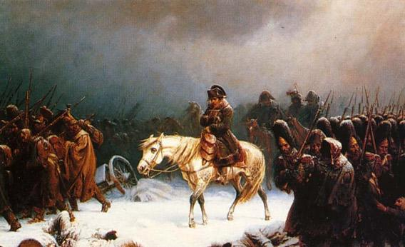
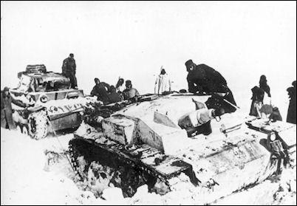
Russian Geography and Winter
- Harsh winters and large terrain protect Russia
- Help defeat both Napoleon and Hitler when they tried to invade Russia

