Slide 1
Immigration Through 1920’s

Slide 2
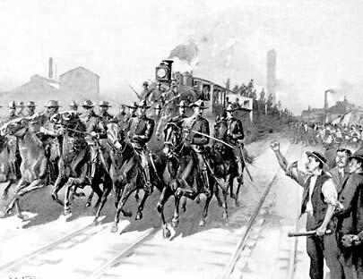
Labor Unions and Strikes
Labor Unions
American Federation of Labor (AFL)
Goal was to collectively bargain wages and work hours
Samuel Gompers was the leader of the AFL
Railroad and Pullman Strike
The Federal government used force against workers to put down the strike.

Slide 3
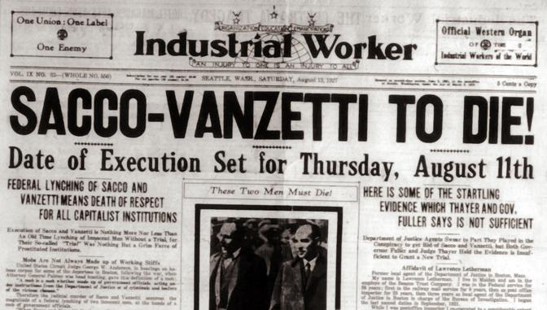
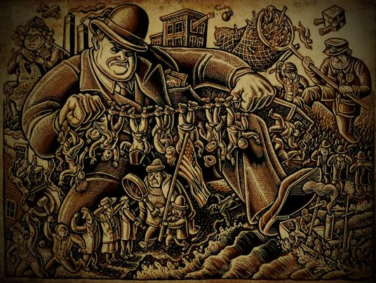
Immigration
Immigration
Immigrants would take less money to do the same work as Americans, cost Americans jobs
Nativist
American people who did not want Americans to come into the United States
Sacco and Vanzetti/KKK/Palmer Raids
All examples of the United States not trusting foreigners

Slide 4
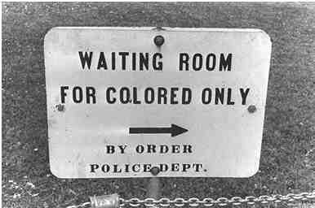
Plessy v Ferguson
Supreme Court case that states racial segregation in public facilities was legal
“Separate but equal” facilities

Slide 5
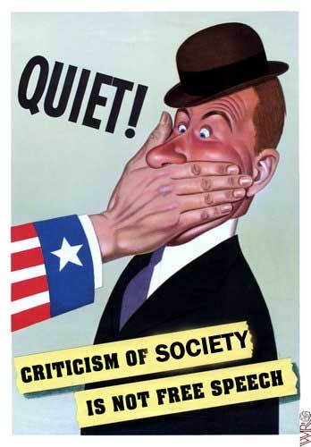
Schenck v United States
Civil Liberties can be limited and restricted on constitutional rights
During the time of “Clear and Present Danger”
Limit Freedom of Speech

Slide 6
W.E.B Du Bois and Booker T Washington
W.E.B Du Bois
Believed that racial equality can be met through education
Traditional Academic Education
Leader of NAACP
Booker T Washington
Believed that racial equality can be met through education
Trade school

Slide 7
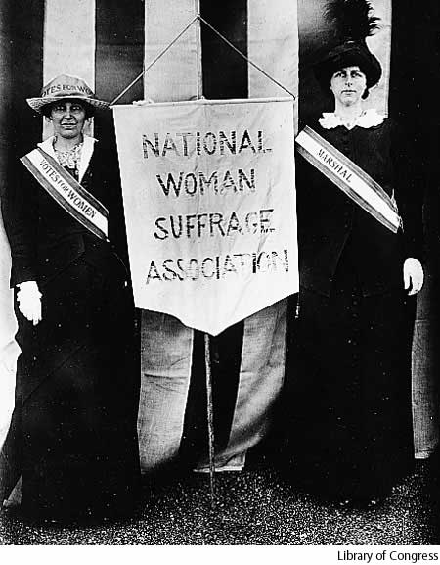
Suffrage
19th Amendment
Gave women the right to vote
Seneca Falls Convention
Elizabeth Cady Stanton, Susan B Anthony gathered women for support of women’s right to vote
Declaration of Sentiments outlined the complaints that women had about being treated unequal
Suffrage Movement
Movement towards women gaining the right to vote, developed popular support

Slide 8
Spanish American War
U.S.S. Maine
Sunk in Cuban Harbor, believed to be by Spain
Yellow Journalism
Built up support in the United States to go to war against Spain
Result of the War
United States became a Colonial Power gaining Puerto Rico, Guam and Philippines

Slide 9
WWI
Lusitania
British ship attacked by German submarine that killed Americans on board
Caused the United States to get involved in WWI
Treaty of Versailles
Treaty to end WWI
Dealt with with keeping peace in the world after WWI
Creation of the League of Nations, which the United States did not join
Fourteen Points
Created by United States President Woodrow Wilson to create world peace after WWI
Reasons for Not Joining the League of Nations
Congress did not want the United States to be drawn into European conflicts
African Americans
Moved to the North to work in the factories during the war

Slide 10
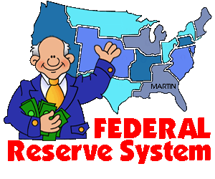
Federal Reserve System
Regulates the banking system
Lowers interest Rates on loans to member banks
Regulate the amount of money in circulation

Slide 11
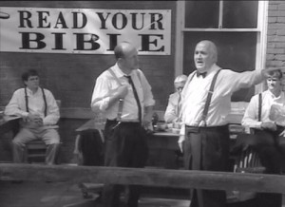
Scopes Trial
Should Evolution be taught in schools
Traditional Values vs changing lifestyles
Science vs Religion

Slide 12
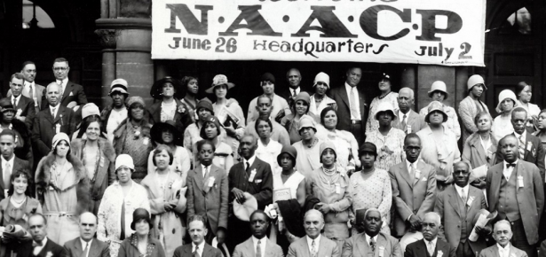
NAACP
National Association for the Advancement of Colored People
Respond to racism and prejudice
Help African Americans participate in higher education, politics and continued support of civil rights

