Slide 1
New Government

Slide 2
Answers to Constitution Review
B 11. C 21. A
B 12. C 22. D
B 13. C 23. C
A 14. B 24. C
D 15. A 25. C
D 16. B
C 17. C
D 18. C
B 19. D
B 20. D

Slide 3
President George Washington
Cabinet
-Washington created a Cabinet to advise him when making decision
-Washington set a precedent (Started a trend that other President will follow in the future) by creating the Cabinet of adviser
- “Unwritten Constitution”
Policy of Neutrality
-Washington followed a policy of Neutrality (Not getting involved in European conflicts/issues)
-Washington wanted to increase foreign trade so by taking sides in European conflicts it would limit who he could trade with

Slide 4
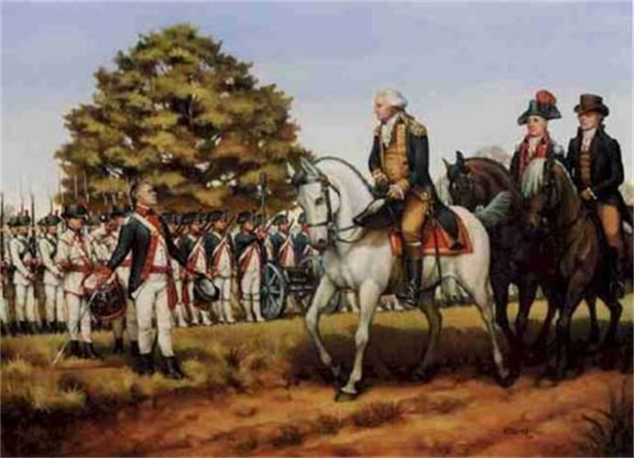
Whiskey Rebellion
Whiskey Tax
-To help pay off the debt that the United States collected because of the American Revolution the government passed a law to tax whiskey
-Pennsylvania Corn Farmers would not pay tax because the tax hurt their business
Washington Enforced Law
-Washington sent federal troops to Pennsylvania to make sure that the farmers paid taxes
-Important because it showed that the Government would make sure that laws that are passed would be enforced

Slide 5
Alexander Hamilton
First Secretary of Treasury, which dealt with the Country’s Economic decisions
Had a Loose Interpretation of the Constitution
Hamilton thought that things could be added to the United States Government even if it did not clearly state this in the Constitution
Supported Industry and Manufacturing by passing protective tariffs
Bank of the United States
-Hamilton created National Bank
-Took all the debts that each state carried from the American Revolution
-Paid off the debts a little at a time (Think like a credit card or car loan) this ensured that the foreign countries and wealthy businessmen would want the United States to be successful because they wanted to get their money back
-Bank helped ensure economic stability

Slide 6
Political Parties- People who share the same beliefs on what actions government should take
Federalist
- Alexander Hamilton
- Wanted more Government involvement
- Loose interpretation of the Constitution
Anti-Federalist
- Thomas Jefferson
- Wanted less government involvement in the lives of the people
- Strict Interpretation of the Constitution, only do what the constitution says

Slide 7
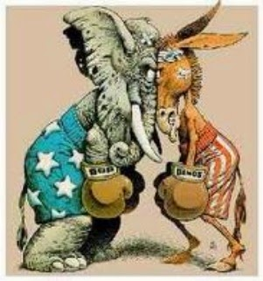
Birth of Political Parties
-Hamilton and Jefferson debated over creating the National Bank and Tariffs
-These two issues caused some people to support Hamilton’s ideas on government and other people to support Jefferson’s ideas

