Slide 1
Peninsular

Slide 2
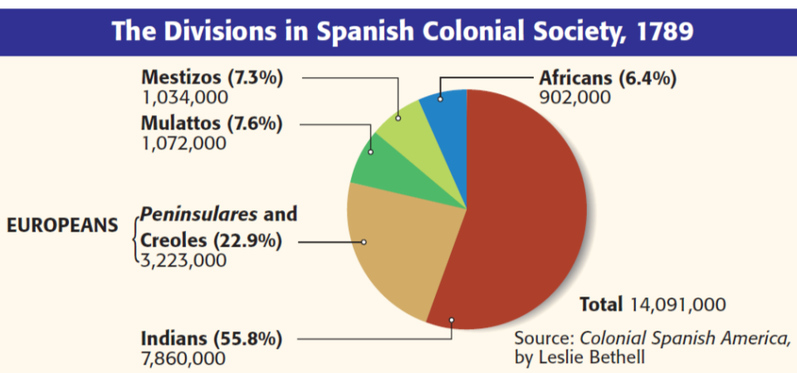
White Europeans were at the top of society
One major impact of European colonization was the unequal social hierarchy in Latin America
Text
Peninsulares were royal governors sent by the king to enforce mercantilism & maintain order in the colony

Slide 3
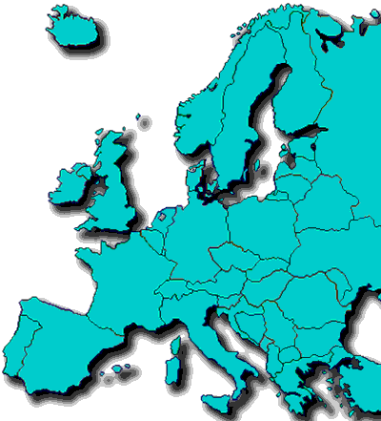
Who was at the top of society?
PENINSULARES
Born in Spain or Portugal (the Iberian Peninsula)
Colonial leaders
These people were at the top of government and society in Latin America

