Slide 1
Protestant Reformation

Slide 2
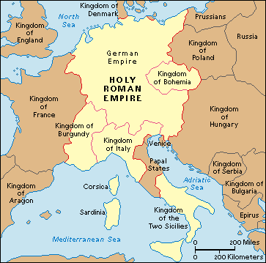
Holy Roman Empire in 1500
Located in modern day Germany
Not a united nation but a patchwork of independent states
Each State had its own Prince
The Ruler of the Holy Roman Empire was Charles V (Catholic)
Notes:
2

Slide 3
The Catholic Church in 1500
The Catholic Church was the most powerful institution in Europe
Held the monopoly on information and education and owned a great deal of property
People resented the wealth of the Church
The Church and Clergy did not pay taxes
The Church was corrupt!
Notes:
3

Slide 4
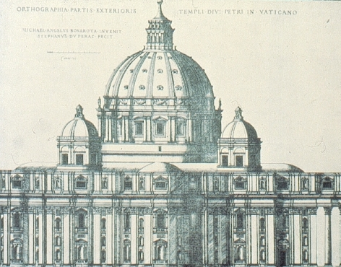
The Catholic Church Headquarters = Rome
Power of the Pope:
Head of the Catholic Church
Occupies God’s position on earth (above any earthly power)
Infallible
Notes:
4

Slide 5
What Catholics Believe
The Seven Sacraments:
Baptism
Eucharist (mass/communion)
Confirmation
Confession
Anointing of the Sick – Last rites
Holy Orders – men to become priests
Marriage

Slide 6
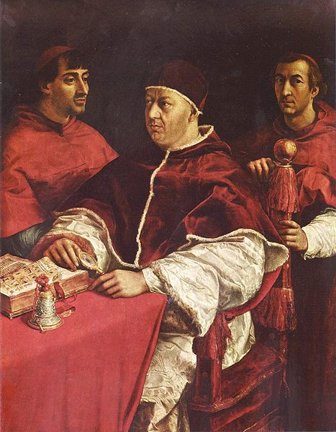
Height of Papal Corruption
Who?
Pope Leo X 1513-1521
What did he do?
Depleted Papal coffers
Money needed for
St. Peter’s reconstruction
Solution:
Sale of Church offices
Sale of indulgences
Pope Leo X with cardinals Giulio de' Medici and Luigi de' Rossi by Raphael

Slide 7
Prior to the Reformation all Christians were Roman Catholic
The Reformation was an attempt to REFORM the Catholic Church
Martin Luther and others wanted to get rid of the corruption and restore people’s faith in the church, not start a separate church

Slide 8
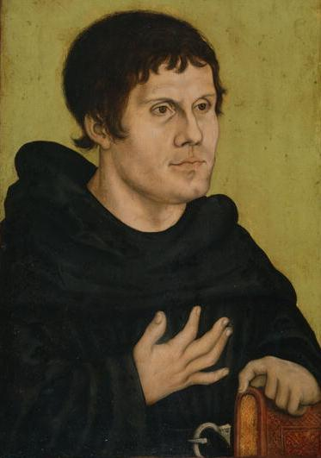
Martin Luther 1483-1546
Born in 1483 in Eisleben, Germany
Became a monk in 1505
Moved to Wittenberg, Germany in 1511
Troubled by the sale of indulgences
Notes:
8
Luther came to the decision to be a monk when he traveled one night during a lightning storm. He was so frightened that he made a vow that if he survived the storm, he would enter a monastery. His decision to become a monk was a disappointment to his father.

Slide 9
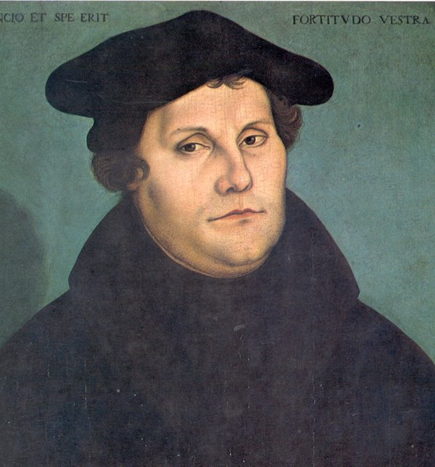
Luther’s Issues with the Catholic Church
Luther had two major problems with the Catholic Church:
Indulgences
Justification
Luther believed that the Bible was the ultimate authority - not the pope or clergy
Of the seven sacraments only Baptism and Holy Communion were found in the Bible
He also came to believe in justification through faith alone not faith and good works
Notes:
9
Indulgences:
Indulgences are ways to get out of punishment in Purgatory. In the Catholic Church, even after going to the priest for absolution at confession, people enter Purgatory after they die. Purgatory is neither Heaven nor Hell, but a place of temporary punishment where souls go before entering Heaven. Indulgences were suppose to shorten that time in Purgatory by prayers or good works. However, by 1500, indulgences were abused and turned into cash donations to the Church. Rich people gave lots of money for forgiveness of past and future sins. Basically, indulgences became a fundraising activity for the Catholic Church. John Tetzel, a notorious priest who offered
Indulgences had a slogan: “As soon as a coin in the coffer rings, a soul from Purgatory springs.”
Justification:
The Catholic Church believes that in order to be saved, i.e., go to Heaven, a person had to do good works, go through the seven sacraments, etc. However, Luther came to the conclusion that because God is perfect, nothing we do can ever be good enough for God. So, instead, he came to the conclusion that it was not by good works that we earn God’s favor, but by believing and trusting in God.
Communion: Transubstantiation vs. Consubstantiation
The Catholic Church believes that during communion, which recreates the Last Supper, the bread and wine become the body and blood of Jesus Christ, made possible by the priest.
Protestants believe in consubstantiation, that Jesus is present during communion, but the bread and wine are only symbolic of the Last Supper.

Slide 10
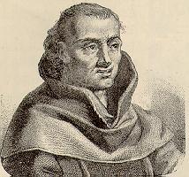
What was an Indulgence?
A Papal pardon for sins
A lessening of the time a soul would have to spend in purgatory
Purgatory = a place where souls too impure to enter heaven atoned for sins committed during their lifetime
According to Luther, indulgences had no basis in the Bible and the Pope had no authority to release souls from purgatory

Slide 11
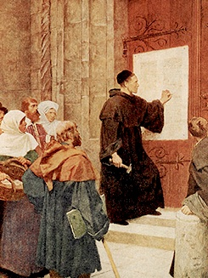
Martin Luther’s Actions
Luther posted his 95 Theses on the door of the castle church in Wittenberg, Germany on October 31, 1517
His intent was to reform the Catholic Church, not create a separate one

Slide 12
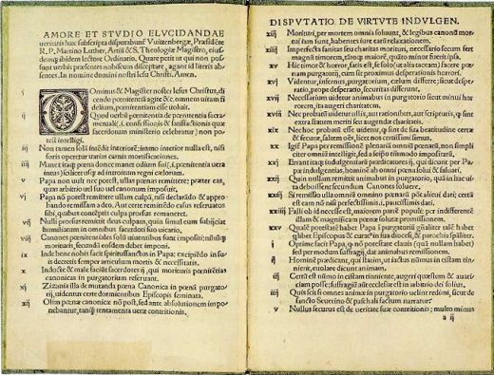
How Did Word Spread So Quickly?
Gutenberg’s Printing Press made it possible for Luther to spread his beliefs
Copy of Luther’s 95 Theses from Gutenberg's Press

Slide 13
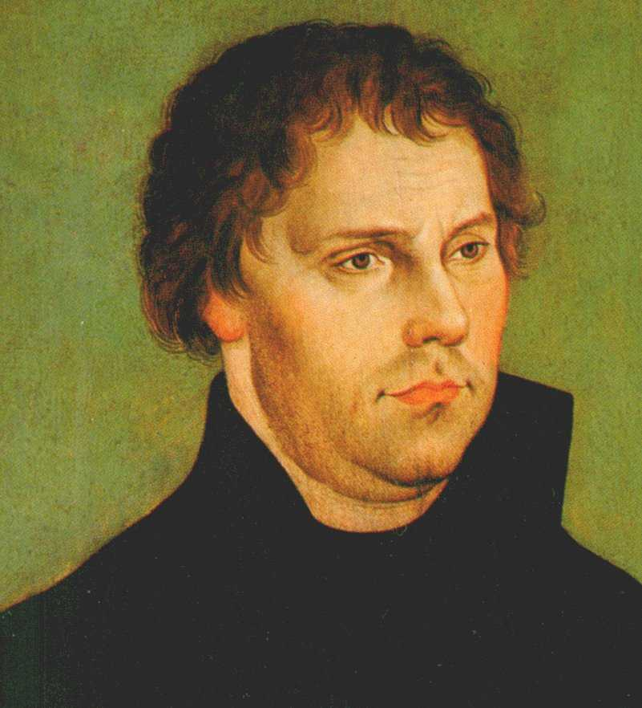
Reaction To Luther
Gained support from people (including the princes in the HRE)
Gained criticism from Church
Millions converted

Slide 14
Branches of Christianity
CHRISTIANITY
Roman
Catholicism
Protestant
Lutheran
Martin
Luther
Anglican
Henry VIII
Calvinist
John
Calvin
Eastern
Orthodox
Puritan
Huguenots
Presbyterian

Slide 15
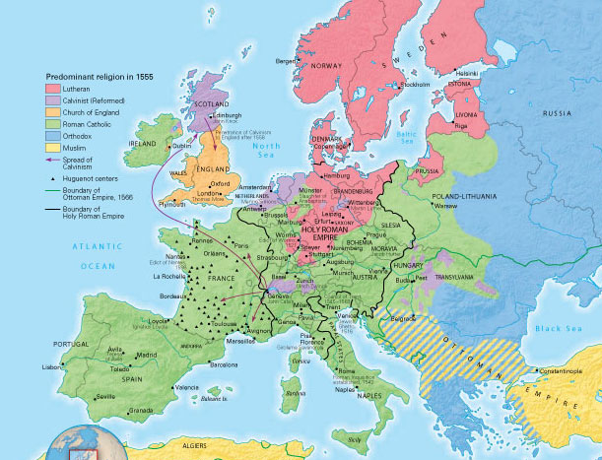
The Protestant Reformation Map

Slide 16
Results
In the end reformers like Luther established their own non-Catholic traditions
The Reformation caused a permanent split in Christianity with the formation of new Protestant faiths
The Roman Catholic Church lost many members of the church as well as power in Europe

