Slide 1
From Colonial Rule to Independence

Slide 2
What European empire ruled India for many years?
What do you know about the movement for independence in India?
Who led the movement for independence in India?

Slide 3
Which statement best expresses the Western perspective regarding Rudyard Kipling’s “white man’s burden”?
Europeans should preserve traditional cultures in Africa and Asia
Europeans must protect existing African and Asian economies
Europeans suffered great hardships in exploring new trade routes to Asia
Europeans had a duty to introduce the benefits of their civilization to non-European peoples.

Slide 4
In 1884, at the request of Portugal, all the major western powers came together to negotiate questions and end confusion over the control of Africa.
At the Berlin Conference, European powers “scrambled” to gain control of the interior of Africa.
A result of the Berlin Conference was that the European nations reached an agreement on how Africa should be divided.
Africa was divided into about 50 irregular countries.
This new map divided groups and merged together groups who did not get along with one another. The European powers disregarded the cultural and linguistic boundaries already established by the different groups in the African population.

Slide 5
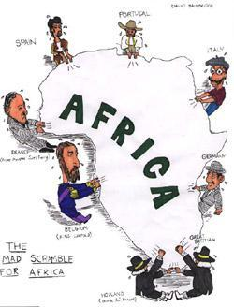
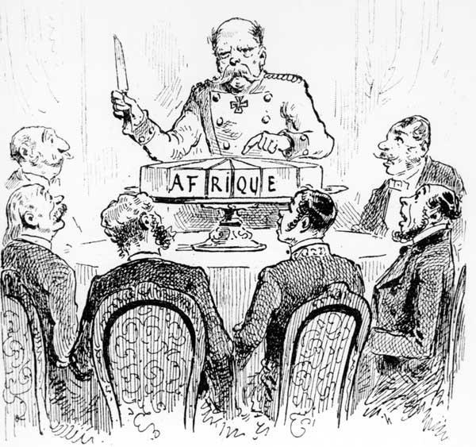
1. According to the cartoons, which European countries were fighting for a position in Africa?
2. How did the Berlin Conference lead to the situation shown in these cartoons?

Slide 6
Pan-Africanism
2. World War II
3. Nationalism

Slide 7
A movement whose goal is to create a politically and economically unified African. The goals of pan-Africanism are to improve economic, political, and social conditions for all Africans.

Slide 8
Many Africans had fought in the war on the side of their colonial rulers. They resented coming home to second-class citizenship.
Winston Churchill and Franklin Roosevelt signed the Atlantic Charter that set the stage for self-determination for all nations.
After the war, Europeans struggled to repair their own economies, industries, and societies. They could not afford a prolonged struggle in Africa, so they began to prepare their colonies for independence.

Slide 9
For Africans, nationalism meant that they wanted to rule themselves and to decide what form that rule would take. During WWII, many Africans moved to cities to work in defense industries, which is where they learned nationalist ideas. They began to transfer their loyalties from traditional groups and authority to these new nationalist groups and the idea of a modern nation state.

Slide 10
Ghana
Kenya
Algeria
South Africa
Tanzania

Slide 11
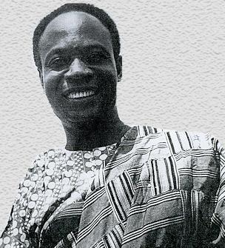
Kwame Nkrumah
Inspired by Gandhi
Used non-violent tactics such as strikes and boycotts
In 1957, the British granted independence.
Nkrumah became Ghana’s prime minister.
Created the Organization of African Unity, or the OAU which promoted Pan-Africanism and the end of colonialism in Africa.

Slide 12
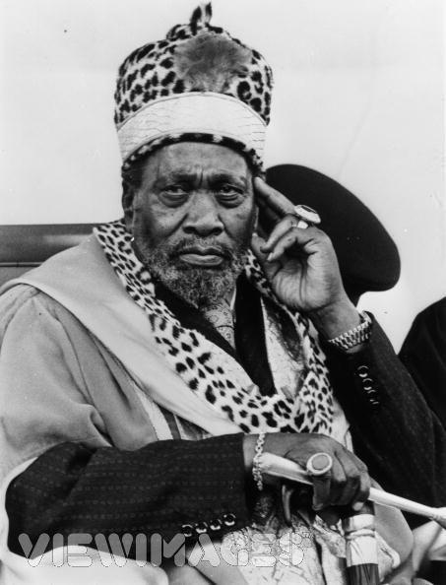
Jomo Kenyatta
He was a spokesman for the Kikuyu people
His goals were to regain control of the land lost to Europeans, to halt exploitation of Africans by Europeans, and to gain basic civil rights for Africans.
First prime minister of an independent Kenya in 1963

Slide 13
The leaders of the independence movement in Algeria were Muslim Nationalists.
Fighting between the French army and Algerian nationalists resulted in the deaths of thousands of people between 1954 and 1962.
After realizing that fighting colonial wars was not benefiting France, the French granted Algeria independence in 1962.

Slide 14
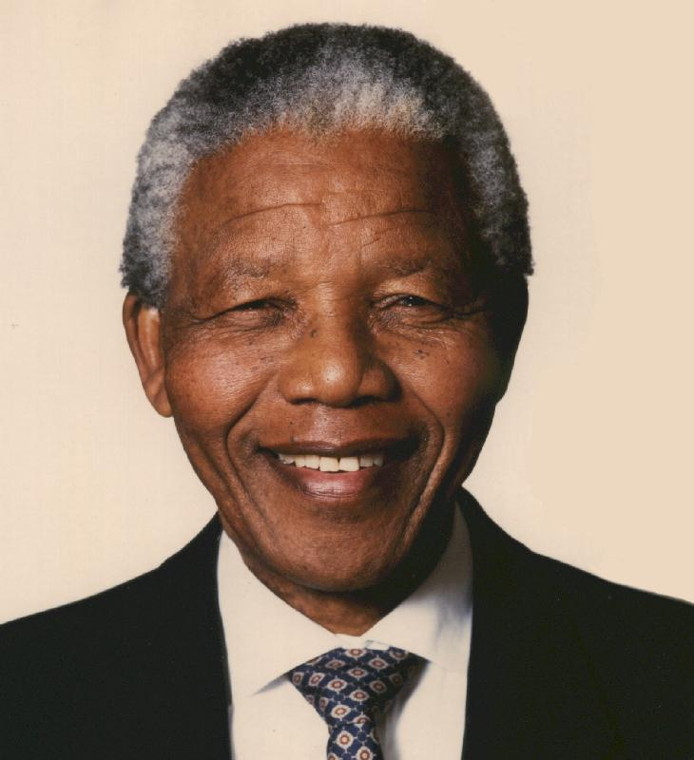
South Africa
Won its independence from Britain in 1910, its white citizens alone held political power and instituted the system of apartheid, or separation of races.
Nelson Mandela was leader of the African National Congress which launched boycotts and practiced nonviolent civil disobedience.
In 1964, he was jailed for 27 years by the government.
After he was released, he became President of South Africa in 1994.

Slide 15
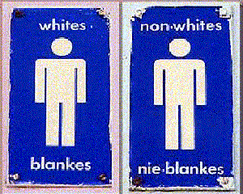
The official system of Apartheid was established in 1948:
Africans had to live in designated zones, use different trains, schools, and other public facilities..
Interracial marriages were banned.
SOCIETY
Whites
Blacks
Asians
Coloureds

Slide 16
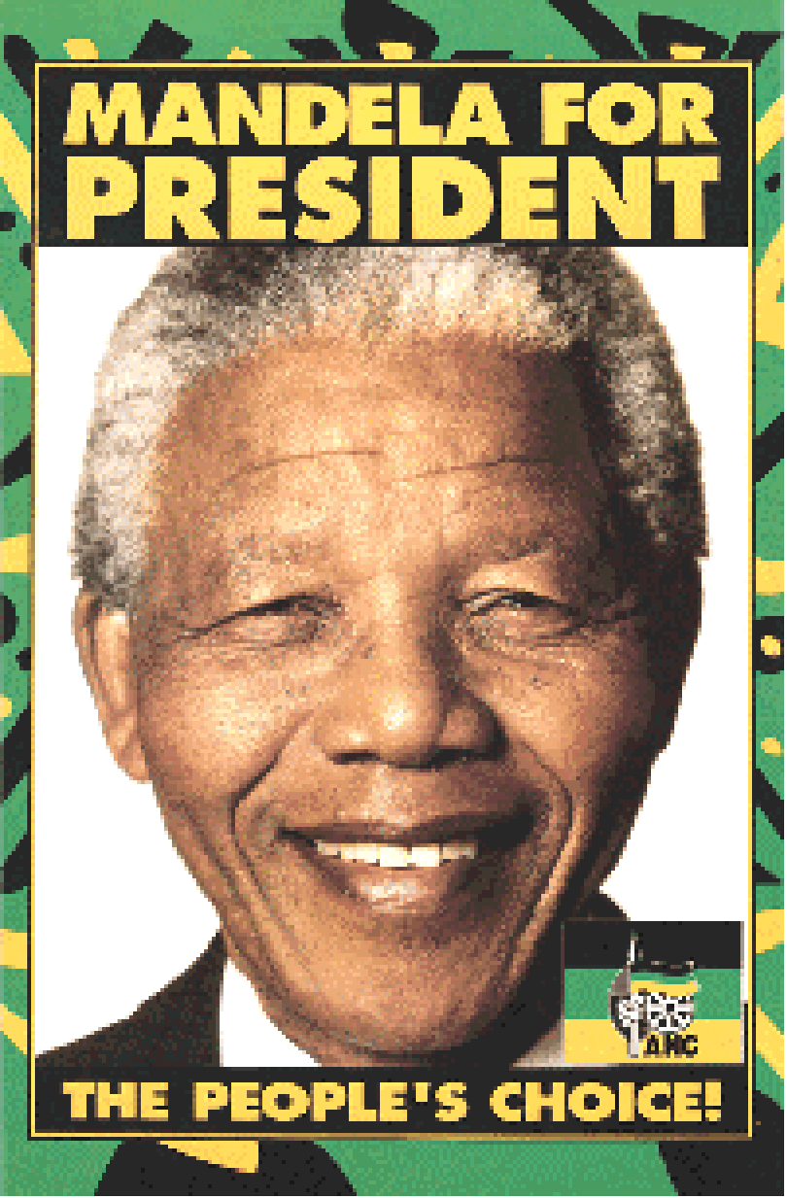
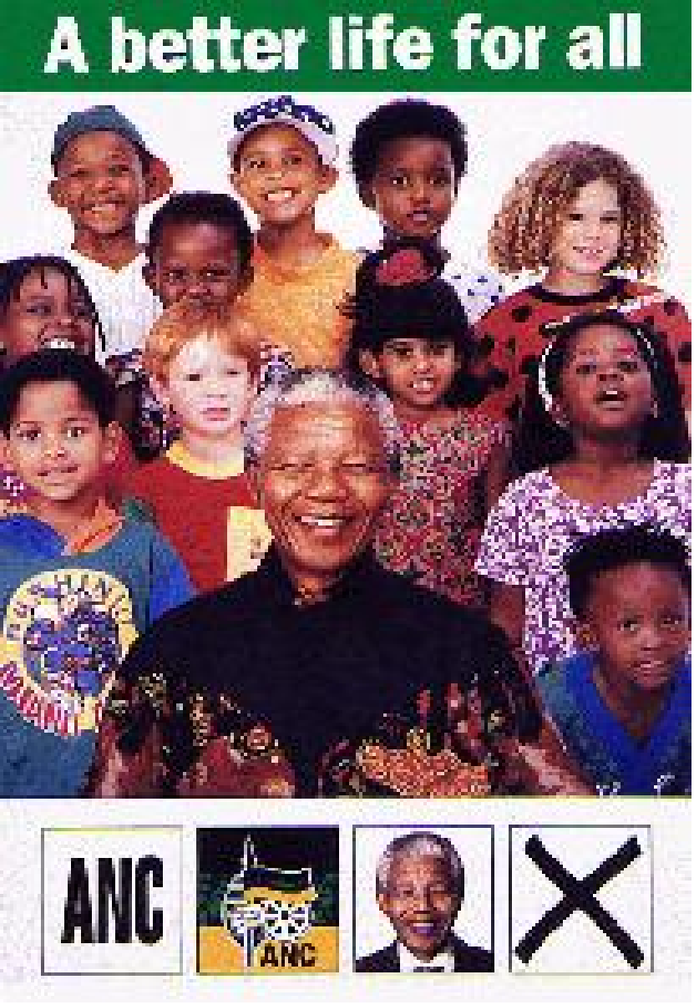

Slide 17
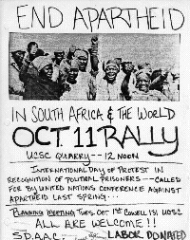
Scaffolding Practice
Why is the rally
being held?
Who is the rally
officially recognizing?
What international
organization is
mentioned?
What would the
U.S. Policy towards this
movement be?

Slide 18
Desmund Tutu: black Anglican bishop and civil rights leader.
Led the anti-Apartheid movement in South Africa.
1980’s economic sanctions imposed on South Africa by many nations of the world
In 1994, President F.W. de Klerk, caving into pressure, legalized the ANC, ended segregation and released Mandela from Jail.

Slide 19
1994
1990
1980s
1964
1960
1948

Slide 20
Steps to End Apartheid
1994
1990
1980s
1964
1960
1948
Policy of Apartheid is set up

Slide 21
Steps to End Apartheid
1994
1990
1980s
1964
1960
Police kill 69 at protest. Gov’t outlaws ANC
1948
Policy of Apartheid is set up

Slide 22
Steps to End Apartheid
1994
1990
1980s
1964
Nelson Mandela sentenced to life in prison.
1960
Police kill 69 at protest. Gov’t outlaws ANC
1948
Policy of Apartheid is set up

Slide 23
Steps to End Apartheid
1994
1990
1980s
US and other nations place economic
sanctions on South Africa
1964
Nelson Mandela sentenced to life in prison.
1960
Police kill 69 at protest. Gov’t outlaws ANC
1948
Policy of Apartheid is set up

Slide 24
Steps to End Apartheid
1994
1990
1980s
US and other nations place economic
sanctions on South Africa
1964
Nelson Mandela sentenced to life in prison.
1960
Police kill 69 at protest. Gov’t outlaws ANC
1948
Policy of Apartheid is set up

Slide 25
Steps to End Apartheid
1994
de Klerk lifts ANC ban, ends
Apartheid, frees Nelson Mandela
1990
1980s
US and other nations place economic
sanctions on South Africa
1964
Nelson Mandela sentenced to life in prison.
1960
Police kill 69 at protest. Gov’t outlaws ANC
1948
Policy of Apartheid is set up

Slide 26
Steps to End Apartheid
Voters of all races elect
Nelson Mandela president
1994
de Klerk lifts ANC ban, ends
Apartheid, frees Nelson Mandela
1990
1980s
US and other nations place economic
sanctions on South Africa
1964
Nelson Mandela sentenced to life in prison.
1960
Police kill 69 at protest. Gov’t outlaws ANC
1948
Policy of Apartheid is set up

Slide 27
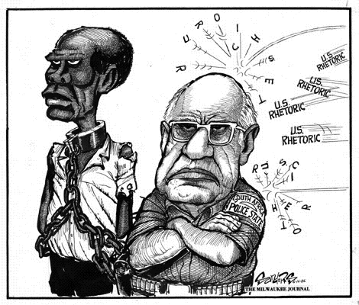

Slide 28
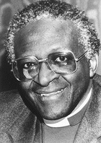
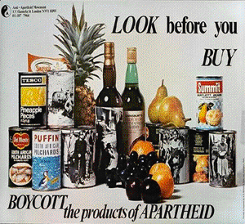
Desmund Tutu: black Anglican bishop and civil rights leader.
Led the anti-Apartheid movement in South Africa.
In 1994, President F.W. de Klerk, caving into pressure, legalized the ANC, ended segregation and released Mandela from Jail.

Slide 29
One way in which the caste system and apartheid were similar is that both
A. described specific religious practices and beliefs.
B. Were created by British colonial governments.
C. supported a rigid class structure
D. gave power to the lower classes in their respective societies.

Slide 30
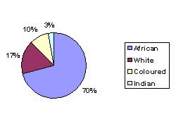
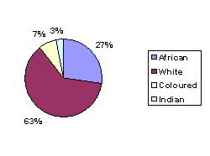
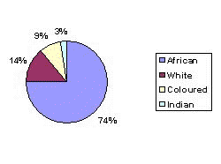
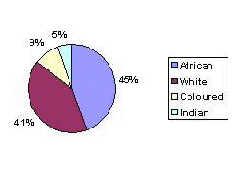
Racial Composition of South Africa 1975
Income Distribution by Race 1978
Racial Composition of South Africa 1993
Income Distribution by Race 1993

Slide 31
Why was Nelson Mandela such an important figure in the Anti-Apartheid movement? What other leaders can you compare him to?

Slide 32
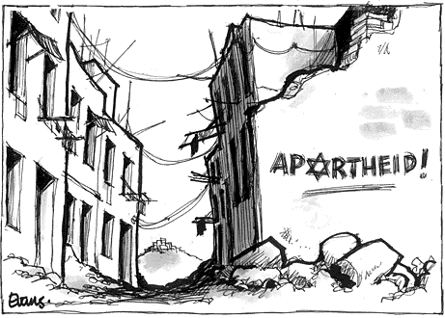
What were the results of the most recent S. African elections?
Why have comparison been drawn between S. African Apartheid
and the segregation of Palestinians and Israelis in parts of Israel?

Slide 33
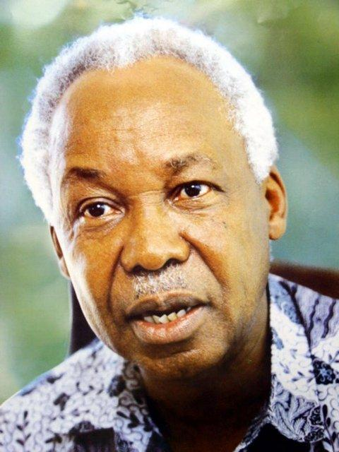
Julius Nyerere led independence movement.
Won independence from Germany in 1961.
Nyerere became President until 1985.
He practiced a system of economic socialism in his country.

Slide 34
Political instability
Economic disaster
Debt dependence

Slide 35
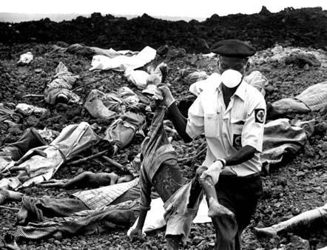
Border Disputes-The boundaries that were imposed in Africa by European rule cut across historical, ethnic, and cultural boundaries which still a cause of tensions and violence today.

Slide 36
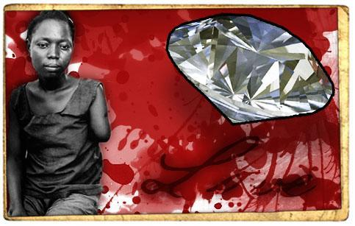
The African colonies were drained of natural resources by their European rulers. They also were forced to produce mostly cash crops such as cotton, cocoa, coffee, and peanuts instead of producing crops to feed their own people.

Slide 37
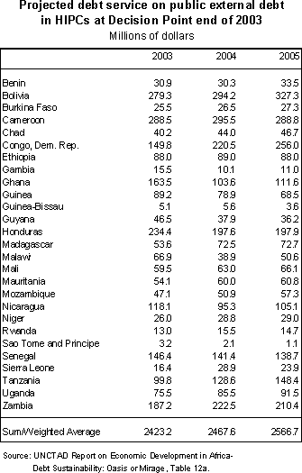
In order to feed, educate, and modernize its population, Africa borrowed large amounts of money from various nations.
However, the money did not stabilize the devastated economy because the money was misused by corrupt officials.

