Slide 1
Revolutions

Slide 2
Neolithic Revolution
Before the Neolithic Revolution people traveled from place to place in search of food, these people were called nomads
Neolithic Revolution:
Food
People learned to farm
Domesticated animals
No longer had to move around looking for food
2. Settlement
People had food, did not have to move around
Formed villages
Learned new skills and made new tools

Slide 3
Three Estates
Estates were classes that made up the French society under absolute rule.
The First Estate, the clergy, made up 1% of the French population and owned 10% of the land.
The Second Estate, the nobles, made up 2% of the French population and owned 20% of the land.
The Third Estate, middle class, peasants and city dwellers, made up 97% of the French population and owned 70% of the land

Slide 4
Financial Crisis
The French government had spent a lot of money in wars, such as the American Revolution.
A bad harvest caused food prices to soar and many peasants could not buy food.
A solution to the problem was to tax the First and Second Estate
The First and Second Estate pressured King Louis XVI to call a meeting of the Estates General, the French government body made up of representatives from the Three Estates to decide if the first and Second Estate would pay taxes.

Slide 5

Estates General/Tennis Court Oath
National Assembly represented all of the French citizens.
National Assembly found themselves locked out of the Estates General.
Believing the king locked them out, the National Assembly decided to form a constitution for France.
Vowing not to disband until they had drawn up a constitution for France this was called the Tennis Court Oath.

Slide 6
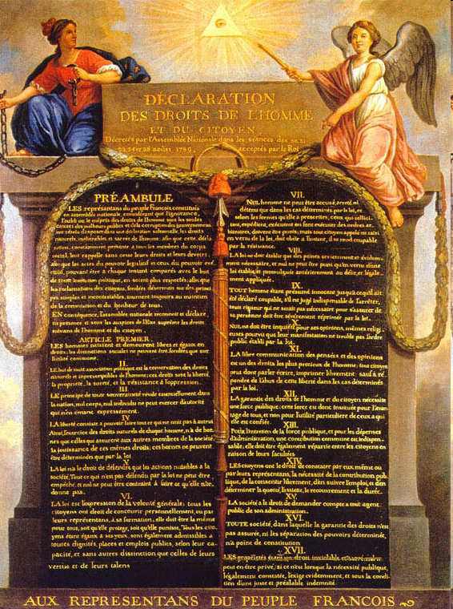
Declaration of the Rights of Man
All men are created equal and enjoy natural rights
Each man had the right to hold public office.
Freedom of religion and the call for taxes to be levied according to ability to pay.

Slide 7
Jacobins
A radical group called the Jacobins took control of France
Jacobins created the Committee of Public Safety to protect France from anti-Revolutionaries
Maximilien Robespierre was the leader of the Committee of Public Safety
During Robespierre’s run as leader he ordered the death of 40,000 people who he felt were anti-Revolution

Slide 8
Reign of Terror
Robespierre wanted to ensure the Revolutionary success so he had people who he felt were anti-revolutionary killed
Members of the Jacobins had “secret” members to see if people were planning to be traitors of France
Many of the 40,000 killed were falsely accused of being a traitor
The fear of death caused many people to stay in their homes

Slide 9
Lenin and Russian Revolution
Czar Nicholas denied the people of Russia freedom of speech, say in government and sent the Russian people off to war unprepared
Lenin teamed up with another Marxist idealist, Leon Trotsky and promised Russian people, “Peace, Land and Bread”.
In November Lenin’s forces, Red Guards, overthrew the government
The Bolsheviks gained support of the peasants because they promised to give them land of their own
Lenin set up a new form of government in Russia called communism
Communism is a classless society in which wealth and property would be owned by the all of the people, with no private ownership.
Russia name Changed to the Soviet Union as a result of Communist rule

Slide 10
New Economic Policy (NEP)
Lenin started to allow small amount of capitalism to move into Soviet Union in hopes of improving the economy

Slide 11
Communist Revolution in China
Mao Zedong
- Communism was successful in china because of Mao’s support by the peasants
- Mao wanted to improve China through the Great Leap Forward and Cultural Revolution
Great Leap:
-Improve Industry and agricultural output through setting up communes and quotas
Cultural Revolution
-Mao wanted to remove any non-Revolution people from China
-Required all Chinese to carry, “Little Red Book” of Mao teachings

Slide 12
Natural Resource
Britain is a small island that had good harbors
Britain had many coal mines throughout their country
Britain also had an abundance of iron
The coal was used to power steam engine and the iron was used to make new machines

Slide 13
Human Resources
A large number of people were needed to work the factories
The new agricultural revolution forced many people to look for new jobs by moving to cities
Cities were where the factories were located
The population boom increased the work force

Slide 14
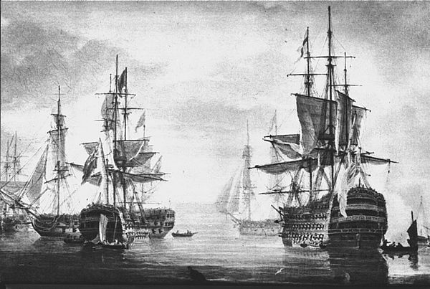
Stable Government
Britain had a government that supported economic growth
Britain built a strong navy to protect its empire and overseas trade
Businessmen developed great wealth which increased the amount of jobs

Slide 15
Economic Conditions
Britain had conquered land in the Americas which were full of natural resources that was turned into capital
Business class had money that they could invest in new enterprises like mines, railroads and factories
Many businessmen were willing to take risks in hopes of making a greater fortune
The population explosion increased the demand for goods and the people had money to purchase the items

Slide 16
Industrial Cities
Industrial Revolution brought rapid urbanization or movement of people to the cities
Need for workers in factories drew workers from rural areas
People would pack into tiny rooms in tenement buildings
The tenements had no running water, foul-smells and garbage rotted in the streets

Slide 17
Factory Workers
The average work day lasted between 12-16 hours
Machines had no safety device so many workers injured themselves
Coal dust from the machines destroyed lungs of workers

Slide 18
Unions
Unions work on behalf of the workers to improve working life
Unions help push governments to make working conditions better, limit work hours and improve safety conditions
Governments even set up programs for old-age pensions as well as disability insurance

Slide 19
Standard of Living
Wages increased with the formation of unions
Pay depended on your skill and your experience
Women were not paid the same as men were

Slide 20
Scientific Revolution
Scientific Revolution – new way of thinking about the natural world, based on careful observation.
  Logic and reason

Slide 21
Nicolaus Copernicus
Copernicus’ Heliocentric Theory held that the Earth and other planets revolve in circular paths around the Sun.

Slide 22
Galileo vs. The Church
Galileo supported Heliocentric Theory, and mocked the Pope for not believing in it.
The Church taught that the Earth was the center of the universe and the sun revolved around it
The Pope had Galileo tried by the Roman Inquisition.
Galileo had to recant (take back) what he had said.

Slide 23
Isaac Newton
English scientist
Law of Gravity – every object in the universe attracts other objects.
  Gravity is responsible for the movement of planets, moons, etc.
Laws of Motion

Slide 24
Latin American Social Structure
Before Independence
Peninsulares
Born in Europe
Creoles-
Of European descent but born in Americas
Mestizos
Mulattoes
Native Americans
And Africans

Slide 25
Simon Bolivar, Toussaint L’Ouverture and Jose San Martin
All Nationalist leaders that lead Independence movements in Latin America countries against European countries (Spain, France and Portugal)

Slide 26
Latin American Social Structure
After Independence
Creoles-
Of European descent but born in Americas
Mestizos
Mulattoes
Native Americans
And Africans

Slide 27
Name____________
Global 10
Role of the Catholic Church
Maintained privileged position
Controlled huge amounts of land
Barriers to Unity
1. Regionalism
2. Civil wars
3. Geography
Latin American
Problems
after Independence
Economic Conditions
1. Dependence
Exported raw materials
Imported more expensive finished goods
2. Significant influence of British and US.
The Colonial Legacy
*Caudillo- local strongmen assembled private armies to resist national gov’t
-gained national power- became dictators
*social structure-

Slide 28
Cuban Revolution
Fidel Castro lead a successful revolution against Cuban Dictator Fulgenico Batista
Castro took power and turned Cuba into a Communist Country
Took most land under government control but also distributed land to the peasants

Slide 29
Commercial Revolution
Banks and Insurance Companies
needed to protect the goods that were being shipped as well as the property and money that were being used during this time
Joint Stock Company
A person can buy stock in a company in hope that the company thrives and a profit can be made BUT if the company fails people could lose money

