Slide 1
Road to Revolution

Slide 2
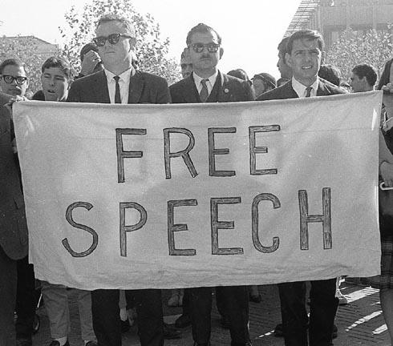
Zenger Trial
Protect the right of freedom of speech, freedom of the press
One of the first victories for American Colonist in gaining individual rights from England

Slide 3
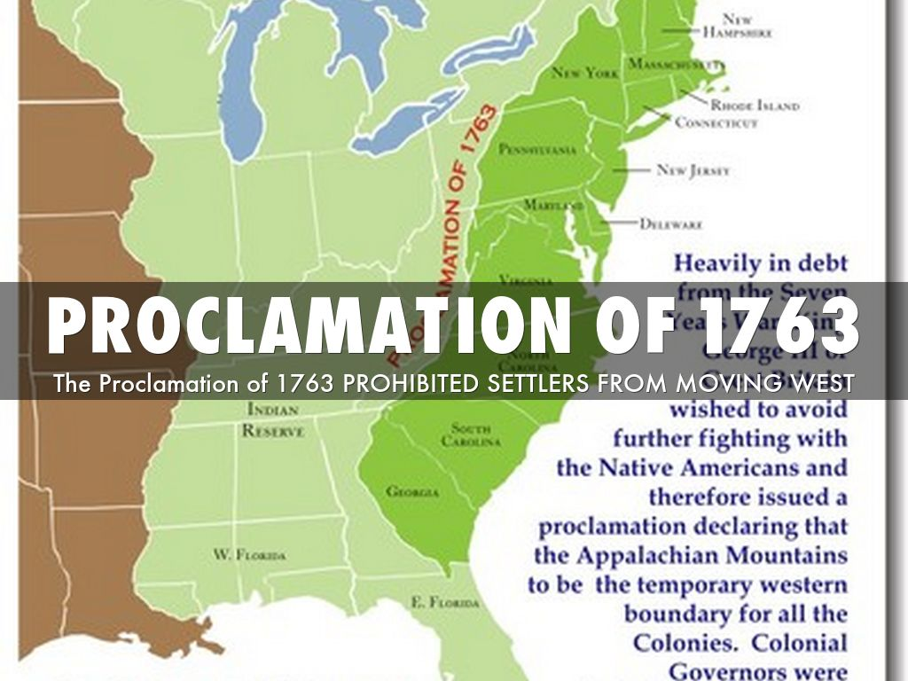
French and Indian War
Causes
Dispute over land in the Ohio River Valley Region
Result
-England and American Colonist the won war but England did not let the American Colonist settle in region that was disputed because of conflict with Native Americans.(Proclamation of 1763)
-American Colonist wanted to settle in region for the fertile land for agriculture
-British start to tax American Colonist on common used goods to pay for war and protection of Colonis

Slide 4
British Tax and Colonist Reaction
“No Taxation Without Representation”
-British taxed American Colonist, who had no voice(representation) in the legislature action
Stamp/Tea/Intolerable Acts
-British placed taxes on common day goods
Colonist Respond to Taxes
-American Colonist boycott British goods
-Boston Tea Party
British Response to American Colonist Actions
-British strictly enforce the laws which were passed by English Parliament
-Tries to maintain order in colonies

Slide 5
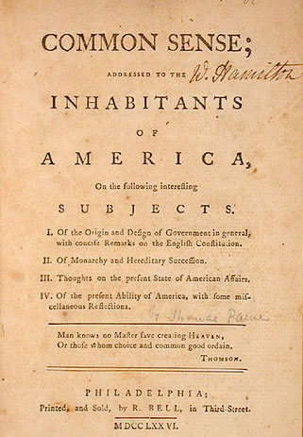
Thomas Paine- Common Sense
Wrote pamphlet on why the American Colonies should break away from England and become Independent
Try and Convince the colonist to break away from England

Slide 6
Declaration of Independence
Reasons
-Show grievances, complaint, against England
-Tell England they were becoming Independent
-Written by Thomas Jefferson
John Locke’s Ideas
-Power comes from the consent of the governed (people)
-Natural Rights
-If a government denies those natural rights then people can overthrow and create a new government
-Social Contract

