Slide 1
Scientific Revolution
Do Now:
Think about the world/universe around you and everything that you have been told.
What is something that you look at and question if it is/happened the way you have been taught?
Explain your answer

Slide 2
Do Now
Answer one of the following questions:
How is the Scientific Revolution a change in both science and thought?
What are the causes and consequences of the Scientific Revolution?

Slide 3
Impact
Who is impacted by the Scientific Revolution?
How are those people/groups impacted?

Slide 4
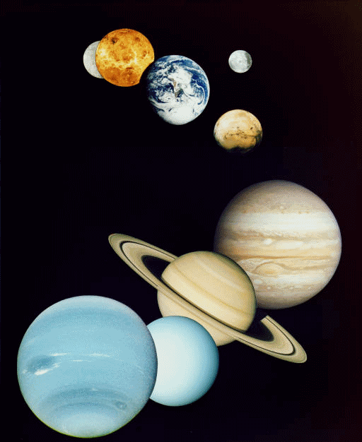
The Scientific Revolution
In the 1500s and 1600s the Scientific Revolution changed the way Europeans looked at the world.
People began to make conclusions based on experimentation and observation, instead of merely accepting traditional ideas.

Slide 5
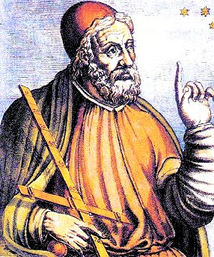
Before the Scientific Revolution…
Until the mid 1500’s, European scholars accepted and believed the teachings of Ptolemy, an ancient Greek astronomer.
Ptolemy
(87-140 A.D.)
Ptolemy taught that the Earth was the center of the universe.
People felt this was common sense, and the geocentric theory was supported by the Church.
It was not until some startling discoveries caused Europeans to change the way they viewed the physical world.

Slide 6
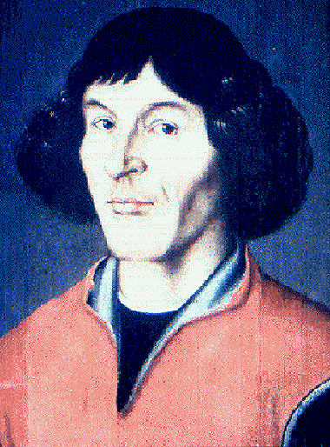
Nicolaus Copernicus
Copernicus was a Polish astronomer who studied in Italy.
In 1543 Copernicus published On the Revolutions of the Heavenly Spheres.
In his book, Copernicus made two conclusions:
The universe is heliocentric, or sun-centered.
The Earth is merely one of several planets revolving around the sun.

Slide 7
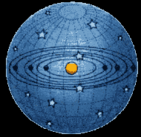
The Copernican Heliocentric Model

Slide 8
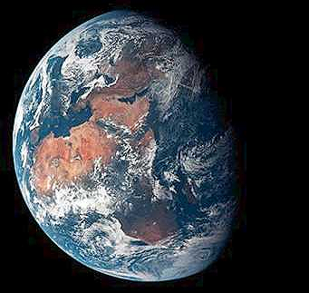
Reaction to Copernicus
Most scholars rejected his theory because it went against Ptolemy, the Church, and because it called for the Earth to rotate on its axis.
Many scientists of the time also felt that if Ptolemy’s reasoning about the planets was wrong, then the whole system of human knowledge could be wrong.

Slide 9
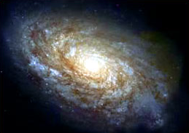
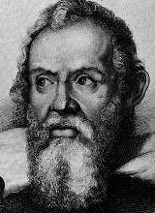
Galileo Galilei
Galileo Galilei was an Italian astronomer who built upon the scientific foundations laid by Copernicus and Kepler.
Galileo assembled the first telescope which allowed him to see mountains on the moon and fiery spots on the sun.
He also observed four moons rotating around Jupiter – exactly the way Copernicus said the Earth rotated around the sun.
Galileo also discovered that objects fall at the same speed regardless of weight.

Slide 10
Galileo Galilei
Galileo’s discoveries caused an uproar. Other scholars came against him because like Copernicus, Galileo was contradicting Ptolemy.
The Church came against Galileo because it claimed that the Earth was fixed and unmoving.
When threatened with death before the Inquisition in 1633, Galileo recanted his beliefs, even though he knew the Earth moved.
Galileo was put under house arrest, and was not allowed to publish his ideas.

Slide 11
The Scientific Method
By the early 1600s, a new approach to science had emerged, known as the Scientific Method.
Scientific Method – painstaking method used to confirm findings and to prove or disprove a hypothesis.
Scientists observed nature, made hypotheses, or educated guesses, and then tested these hypotheses through experiments.
Unlike earlier approaches, the scientific method did not rely on the classical thinkers or the Church, but depended upon a step-by-step process of observation and experimentation.

