Slide 1
Sectionalism

Slide 2
Sectionalism
North
Economy- Based on Manufacturing and trade. Production of goods
View on Slavery- Against Slavery
South
Economy- Farming and exporting cotton, tobacco
View on Slavery- In Favor

Slide 3
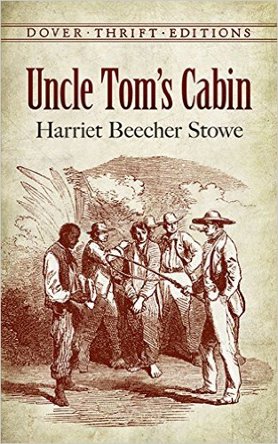
Uncle Tom’s Cabin
- Written by Harriet Beecher Stowe
- Exposed the cruel treatment of Slaves in the South
- Provided information to the people in the North about the reality of Slavery
- Increase the Abolitionist Movement to end Slavery
- Provided more of a divide between the North and the South
- Help lead toward the Civil War

