Slide 1
Social Scientist

Slide 2
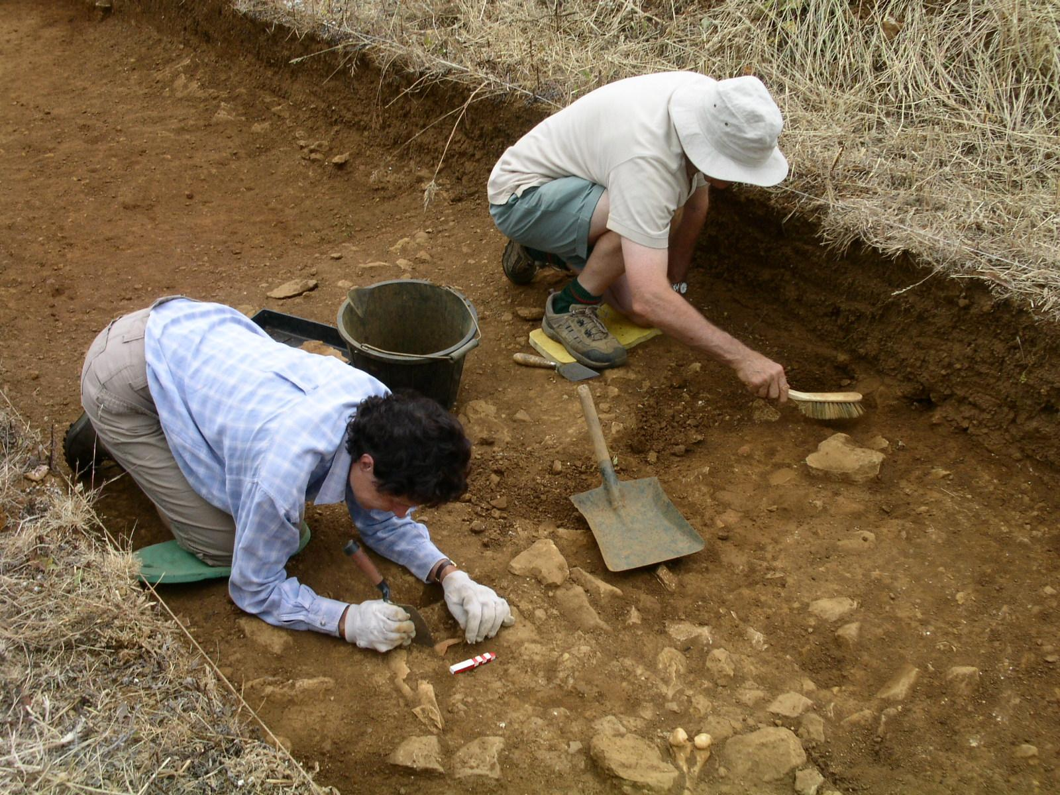
Archaeologist
Study of the ways of early peoples through the examination of physical remains
Study artifacts like pottery, jewelry and clothing

Slide 3
Historian
Study how people lived in the past through artifacts but also through written evidence and tax records

Slide 4
Economist
Study the scarcity of goods, resources, profits.
Study the buying, selling and trading of goods

Slide 5
Sociologist
Study of social behavior, how people interact with one another

Slide 6
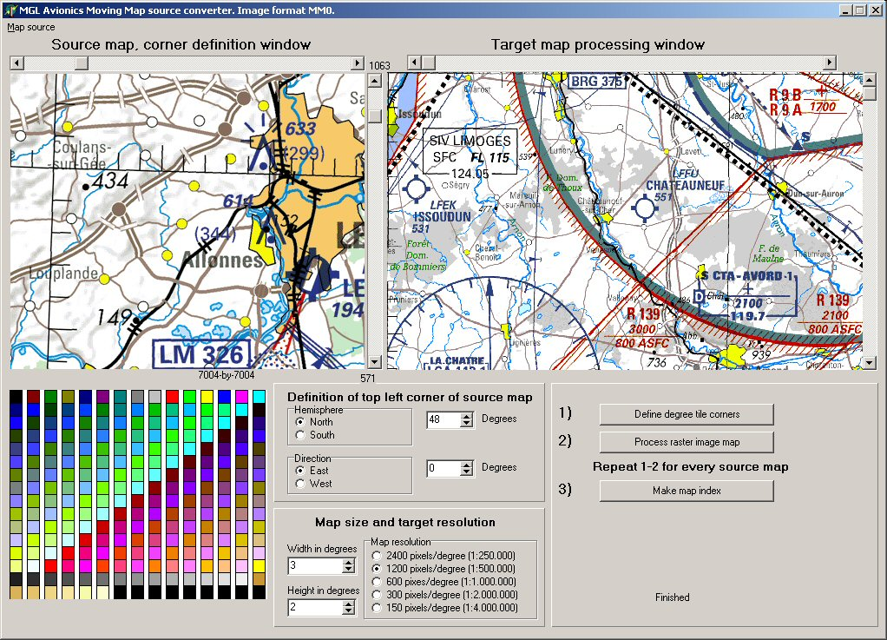
Geographer
Study of geography and the spatial data at different scales
Map Makers

Slide 7
Political Scientist
Study of government, political process and political issues

