Slide 1
Spread of Enlightenment Ideas
How has technology today impacted the spread of ideas and information?

Slide 2
How Did Enlightenment Ideas Spread?
Through the works of philosophers mentioned above.
The printing press made it easier to get new ideas and info.

Slide 3
How Did Enlightenment Ideas Spread? Cont’d
Pamphlets: small, cheap, easy to read
Coffeehouses and salons. Salons – informal gatherings of writers artists and philosophes. First only the nobility, then middle class was included.
Is Facebook the new coffeehouse/salon?

Slide 4
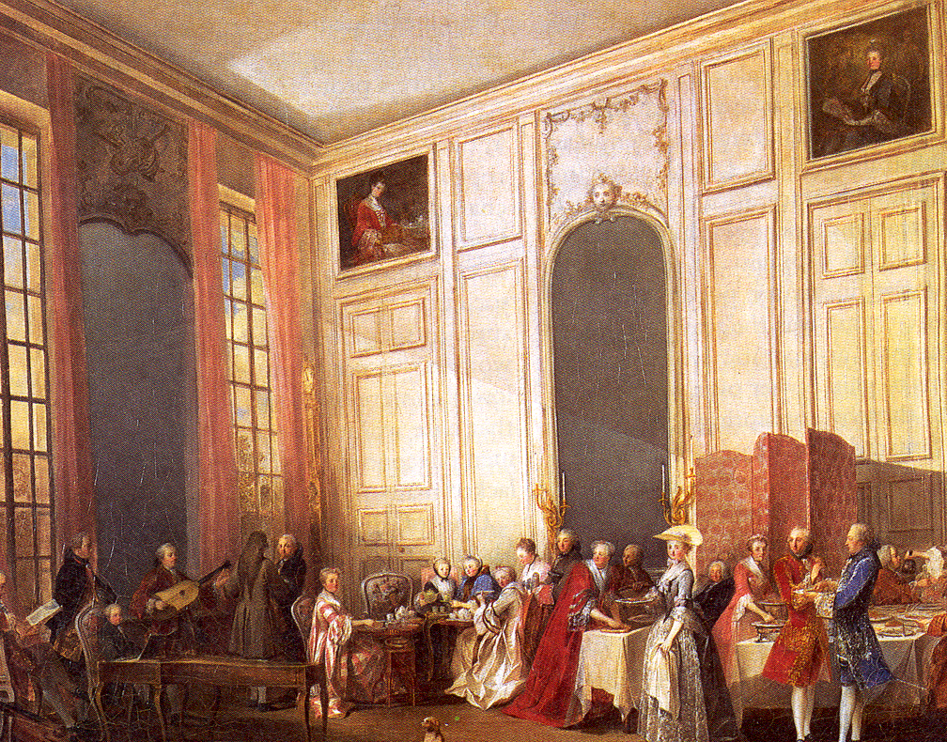
A Parisian Salon

Slide 5
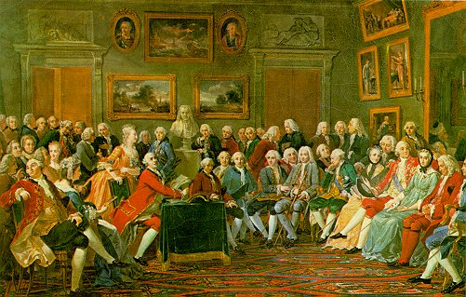
Madame Geoffrin’s Salon

Slide 6
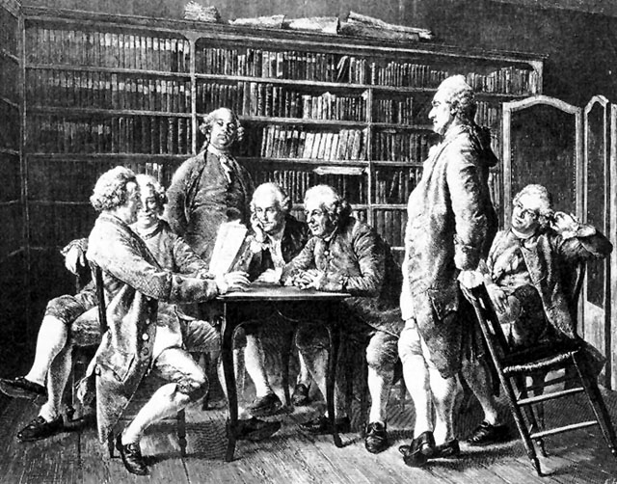
An Increase in Reading

Slide 7
Reading During the Enlightenment
Literacy:
80% for men; 60 % women.
Books were expensive (one day’s wages).
Many readers for each book (20 : 1)
novels, plays & other literature.
journals, memoirs, “private lives.”
philosophy, history, theology.
newspapers, political pamphlets.

Slide 8
Did the Church and Absolute Monarchs attempt to maintain control?
Absolutely, here’s how.
Censorship
Banning and/or burning of books
Threatened imprisonment, execution and excommunication
“Power tends to corrupt. Absolute power corrupts absolutely.”

Slide 9
Enlightened Despots
What were the goals of Enlightened Despots?
Enlightened despots were absolute rulers who used their power to bring about political and social change.
If the ruling class (nobility, rulers) could be enlightened, reform could be achieved.
Is this possible, or is the term Enlightened despot an oxymoron?

Slide 10
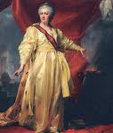
Who Were the Enlightened Rulers? And, Were They Truly Enlightened?
Frederick Catherine Joseph II
the Great the Great

Slide 11
Enlightened Despots
2
Enlightened despots were absolute rulers who used their power to bring about political and social change.
FREDERICK THE GREAT
CATHERINE THE GREAT
JOSEPH II
Exerted tight control over subjects, but saw himself as a “servant of the state.”
Tolerated religious differences.
Distributed seeds and tools to peasants.
Was interested in Enlightenment ideas but intended to give up no power.
Made some limited reforms in law and government.
Granted nobles a charter of rights.
Criticized the institution of serfdom.
Most radical of enlightened despots.
Granted toleration to Protestants and Jews.
Ended censorship and tried to control the Catholic Church.
Sold church property to build hospitals.
Abolished serfdom.

