Slide 1
Stock Market Crash Through WWII

Slide 2
Immigration Through WWII Answers
C 11. C 21. A
C 12. B 22. B
B 13. A 23. A
A 14. C 24. C
A 15. B 25. B
D 16. B 26. A
A 17. C 27. D
B 18. C 28. D
C 19. D 29. A
A 20. A 30. C

Slide 3
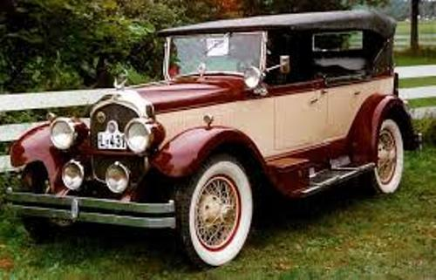
Automobiles
“ Boom Years”
Sign of the “Great” years in the 1920’s where people would increase their buying of goods, which included automobiles
Impact on Americans
People started to move to the suburbs
People went on vacation which increased the economy
Teens spent a lot of time together on long drives

Slide 4
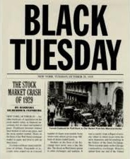
Stock market Crash
Cause
-Excessive speculation (buying stocks and investments)
-Buying on Margin (Think buying with a credit card but not having the money to pay back your purchases)
-Day of crash known as Black Tuesday, because BILLIONS of dollars were lost
Effect
- Lead to the Great Depression

Slide 5
FDR “New Deal”
Goal
Provide jobs to the massive unemployed
Created Government works jobs:
Infrastructure (Build bridges, roads, dams, hydroelectric power (Tennessee Valley Authority))
Nature ( Plant trees)
Help farmers by providing them assistance and financial aide
Policies
The New Deal increased the power of the Federal Government while trying to keep the idea of capitalism (Free Market run by citizens not by Government)
Opposition
Big Business leaders felt that the government was too involved in business and taking money/opportunity away from them.
SEC/FDIC
Protected people’s money to give more confidence in Bank and Stock Market
SEC-Oversaw the stock market
FDIC-Protected the money that people put in the bank

Slide 6
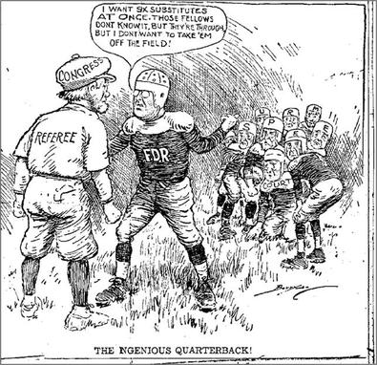
FDR Supreme Court Packing
-FDR wanted to increase the number of Supreme Court Justices because the current justices did not support his New Deal Ideas
-Wanted to pass more New Deal Ideas

Slide 7
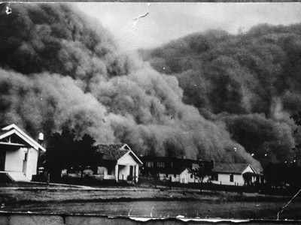
Dust Bowl
Location
Great Plains
Casues
Overfarming and severe drought
Geography Impact
This shows the impact that geography has on the lives of people
Grapes of Wrath
Book that detailed the hardships of the people/farmers impacted by the Dust Bowl
Impact
People Moved to California in search of jobs and food

Slide 8
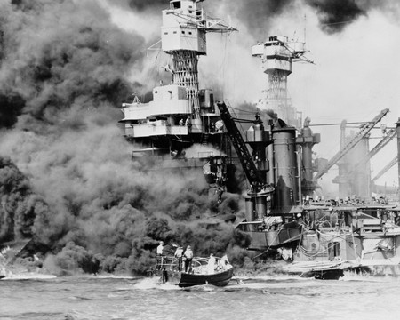
U.S. Enters WII
Bombing of Pearl Harbor
Japan bombed Pearl Harbor to weaken the U.S. Pacific Fleet.
U.S. had stopped selling Japan scrap metal and oil
December 7, 1941
FDR speech, ‘Date that will live in infamy”

Slide 9
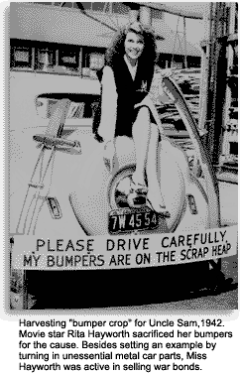
Policies
Lend Lease Act
United States supplied war materials (Ships)l to Allied Nations without declaring war.
Manhattan Project
United States had a group of scientist secretly develop the Atomic Bomb
Rationing
The United States government asked the American people to limit the amount of food, metal and gas/oil they used so that the military can use for war

Slide 10
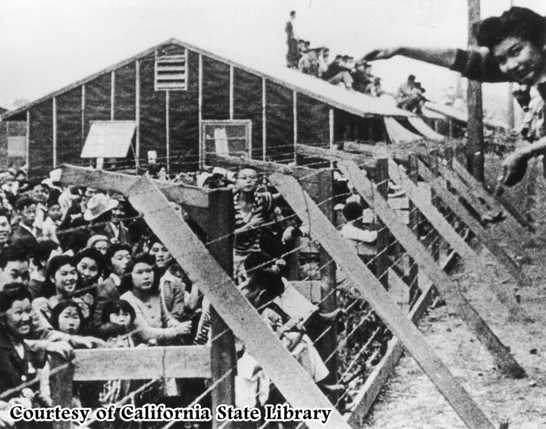
Japanese Internment Camps
Internment Camps
Japanese Americans on West Coast were relocated to camps because of the threat of National Security (They were spies for Japan)
Executive Order
President Roosevelt created these camps through the Presidential power of executive order which does not require approval of other branches of government
Korematsu v U.S
Supreme Court Case which, tried to end the internment camps because felt it was unconstitutional but was denied

Slide 11
End/Post WWII
G.I. Bill
Provided veterans of war college, home purchasing and other economic assistance
Suburbs
With Advantages of G.I. Bill veterans were moving to the suburbs to live so a lot of homes were built
Baby Boom
Soldiers came back from WWII started families which caused an increase of housing and schools that needed to be built
Yalta Conference
Meeting of USA, Britain and Soviet Union to prepare control of Germany after WWII
Nuremberg Trials
Punishment for crimes occurred during WWII
Human Right violations

Slide 12
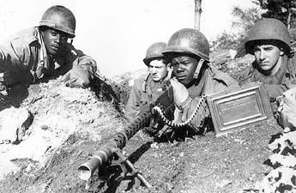
End of Segregation In the Military
Desegregation of Military
President Harry Truman desegregated the military so that whites and African Americans can serve in the same unit

