Slide 1
Terms

Slide 2
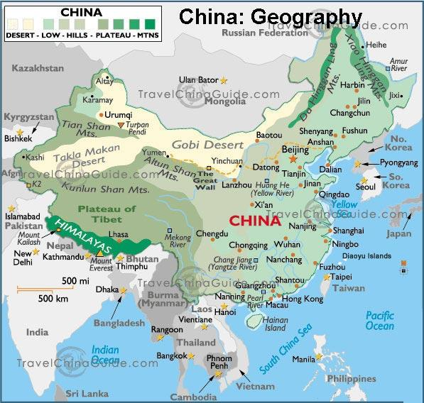
Ethnocentrism
Judging other cultures based upon your own. Feeling of being superior to other cultures normally because geography cuts culture off from others.
Example
China- Himalayan Mountains/Gobi Desert/Pacific Ocean
Japan- Island

Slide 3
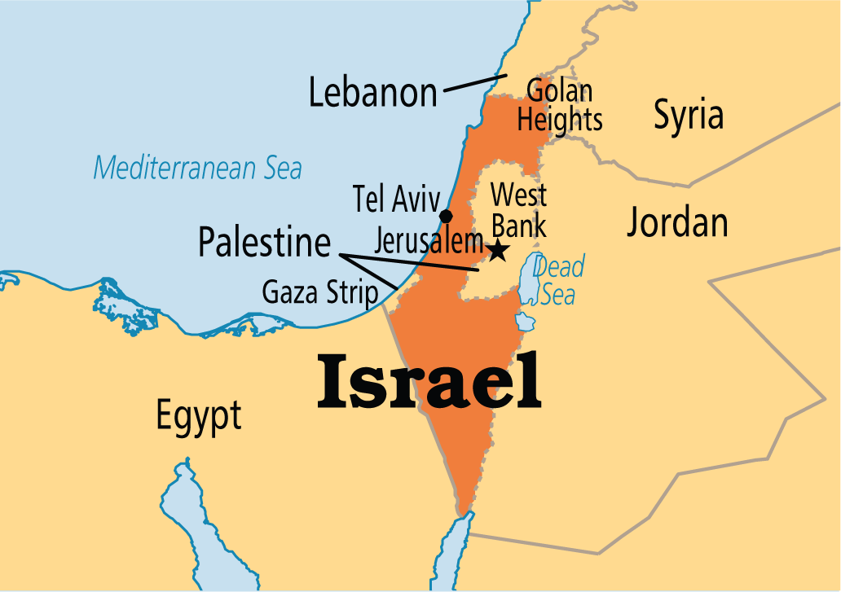
Zionism
Movement to create a Jewish State (Country) so the Jewish population of Europe could live.
Theodor Herzel was a reporter that pushed for a Jewish State.
After WWII Israel was created

Slide 4
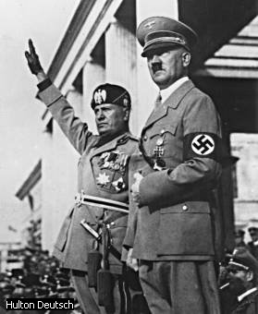
Fascism
Authoritarian Government that is not Communist
Used extreme nationalism, glorified actions, violence and discipline.
Believed in War, not to be in a peaceful state.
Benito Mussolini and Adolf Hitler were two Fascist leaders during WWII

Slide 5
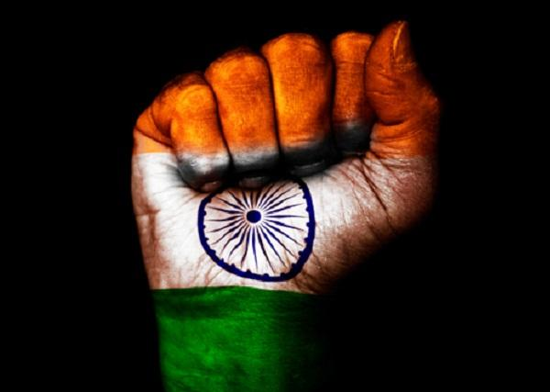
Nonalignment
Not to align with either side during a war
During the Cold War India, a new nation at the time, decided not to take sides. India followed a democratic government with a socialist economy

Slide 6
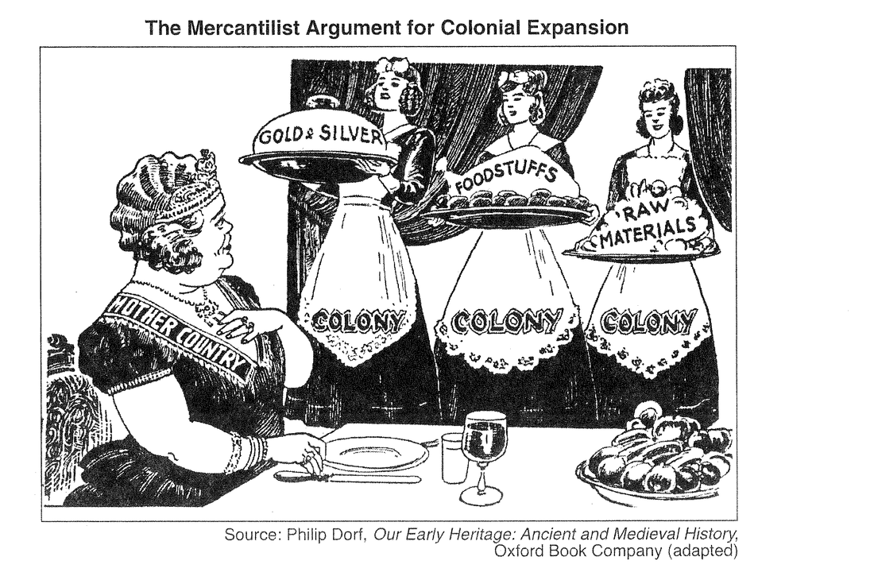
Mercantilism
Build up of gold and silver
Export more goods than is imported
Colonies were created by European powers to gain more resources and create new markets to sell goods

Slide 7
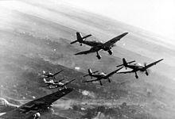
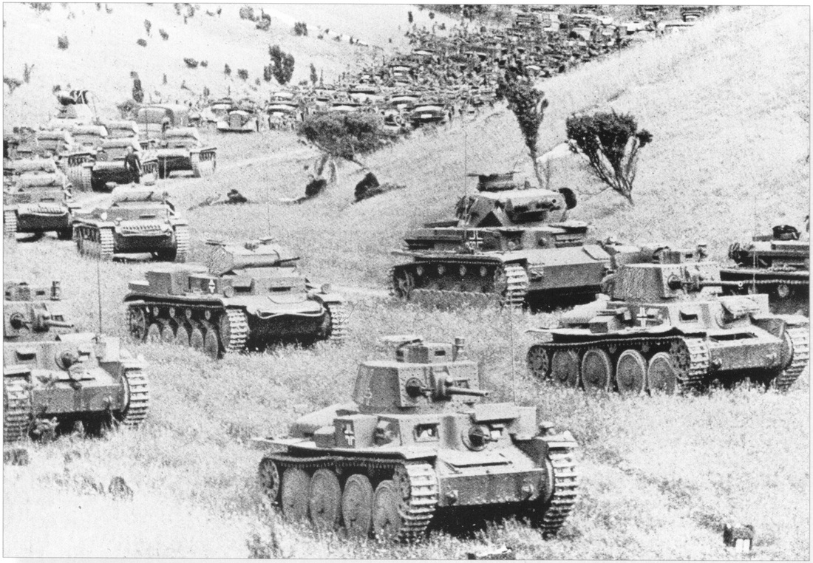
Blitzkrieg
“Lighting War”
Attack enemy from the air and land all at once to overwhelmed opponent
Germany used this practice during WWII to overwhelm their enemies

Slide 8
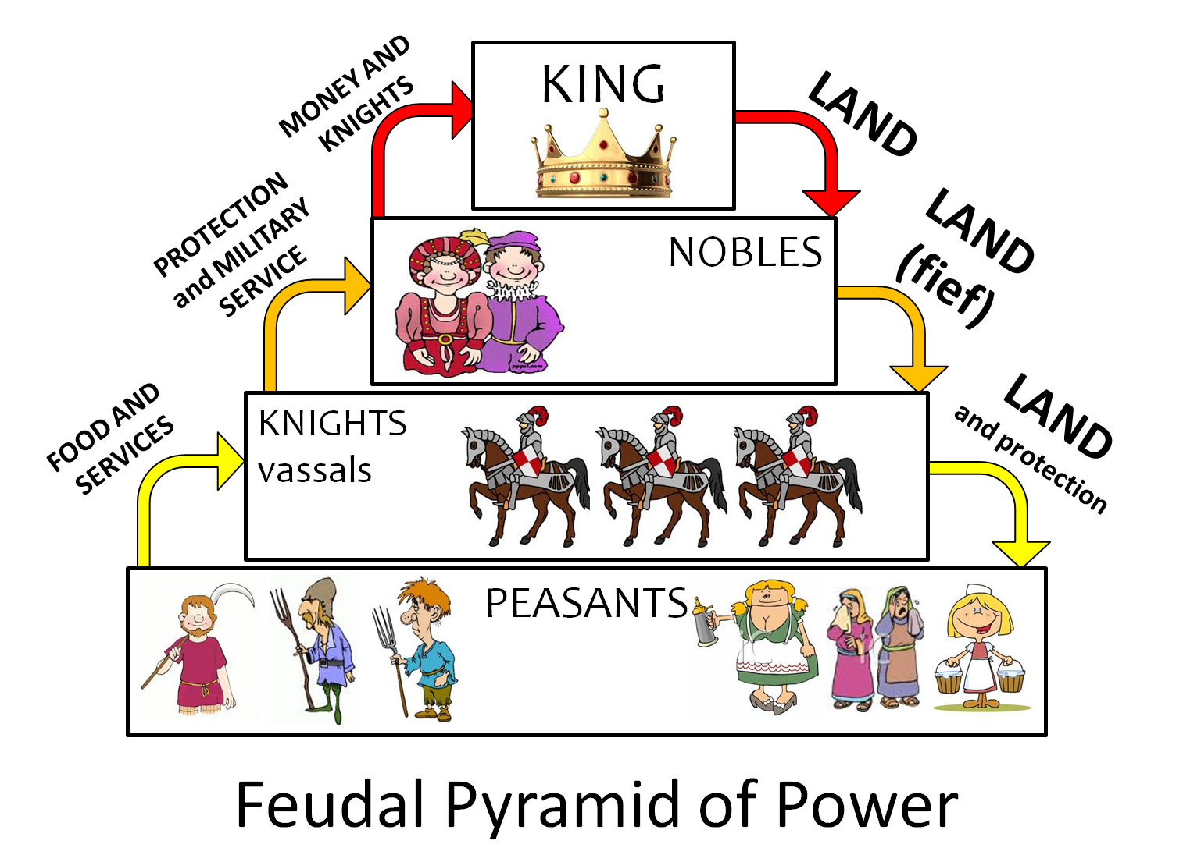
Feudalism
Loosely organized system of rule in which powerful local lords divided their large land among lesser lords
Idea was used in Europe after the Fall of the Roman Empire to Invaders
Also used in Japan

Slide 9
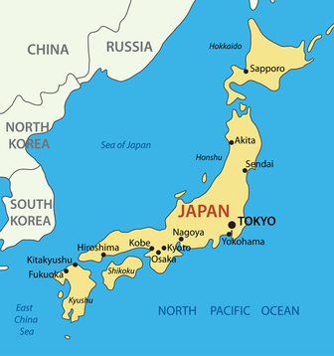
Archipelago
Chain of Islands
Japan is an archipelago

Slide 10
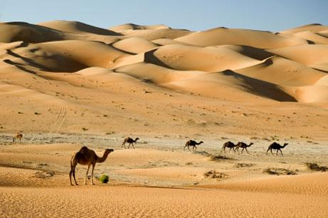
Natural Barriers
Mountains, Oceans, Deserts and Jungle that protect a certain area from Invasion
Deserts in Middle East
Large terrain in Russia
China Himalayan Mountains, Gobi Desert and Ocean

Slide 11
Golden Age
Period of Peace and prosperity (Wealth)
During this time new ideas were developed
Gupta Empire- Concept of zero

Slide 12
Self-Determination
The people of an area would decide how to form a government, not a single ruler telling the people the type of government.
Idea was used after WWI by President Wilson from United states at Paris Peace Conference

Slide 13
Geopolitics
The study of the effects of geography both human and physical on international politics and relations

Slide 14
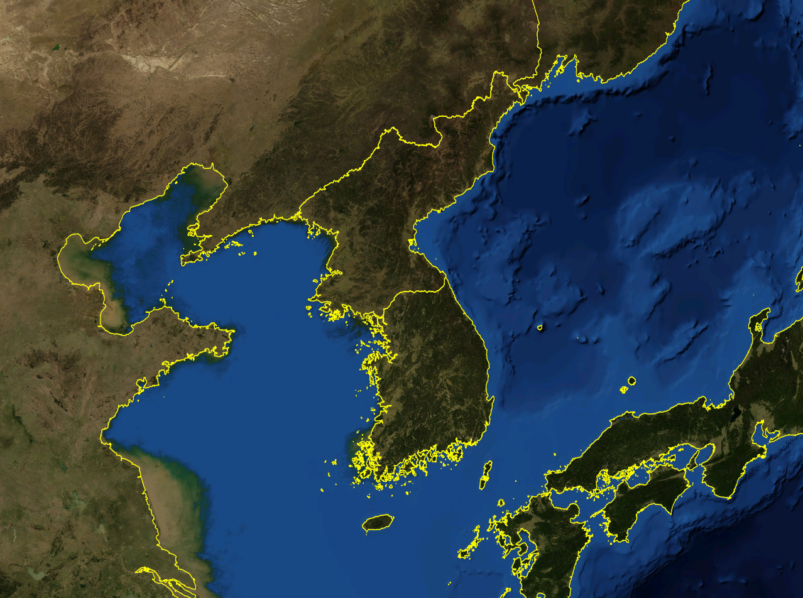
Peninsula
Land surrounded on three sides by water
Korea
Italy

Slide 15
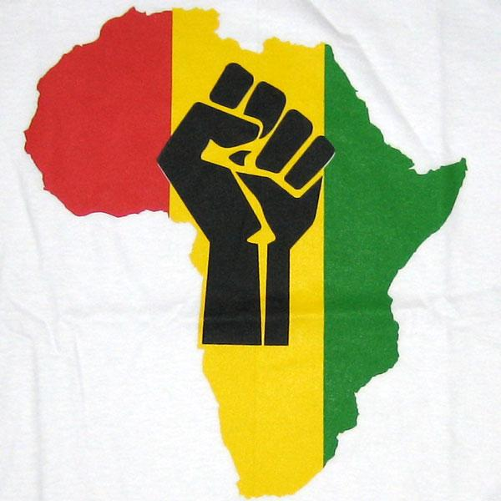
Pan-Africanism
Belief that unity is vital to the economic, social and political progress of African Nations
Difficult to accomplish because the geography in Africa and different political and economic interest of the different countries.

