Slide 1
Global History Unit 2 Review

Slide 2
Gupta India

Slide 3
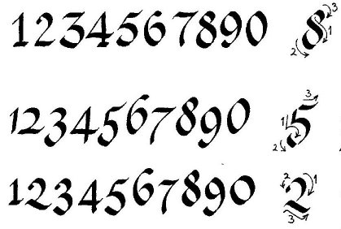
Achievements of Gupta India
Concept of Zero
Arabic Numerals

Slide 4
Indian Caste System
Brahmins
Kshatryias
Vaisyas
Sudras
Untouchables
Highest caste, Hindu priests
Warrior caste, also rulers/gov’t officals
Merchant caste
Servant/Laborer caste
Performed duties deemed “unpure” such as tanning leather and removing waste

Slide 5
Tang and song china

Slide 6
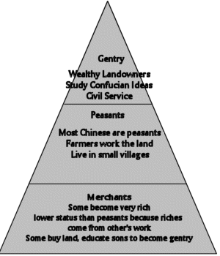
Tang Social Order
Society based on duty, rank and proper behavior

Slide 7
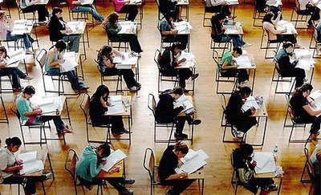
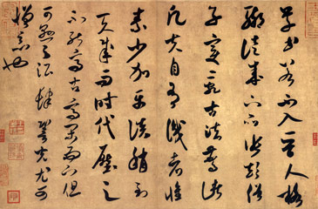
Tang and Song Achievements
Skilled Government based on Civil Service System
Increased trade
Calligraphy

Slide 8
Byzantine Empire and Russia

Slide 9
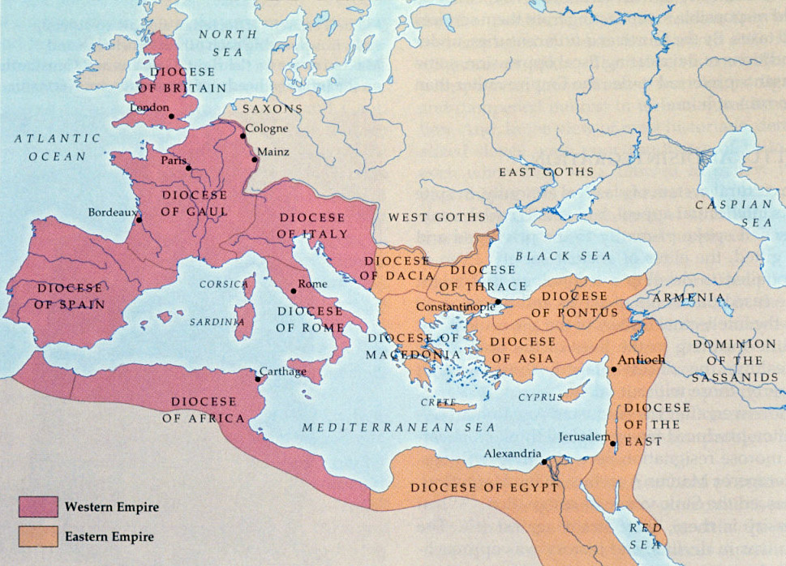
Byzantine Empire
After fall of Western Roman Empire, Eastern Roman Empire remains as the Byzantine Empire.

Slide 10
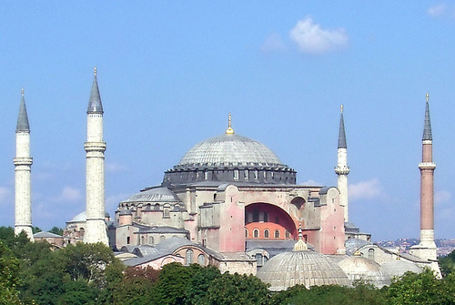
Achievements of the Byzantines
Preserved Greek and Roman learning
Justinian’s Law Code
Architecture- Church of Hagia Sophia
Rise of Eastern Orthodox Christianity
Constantinople – center of trade

Slide 11
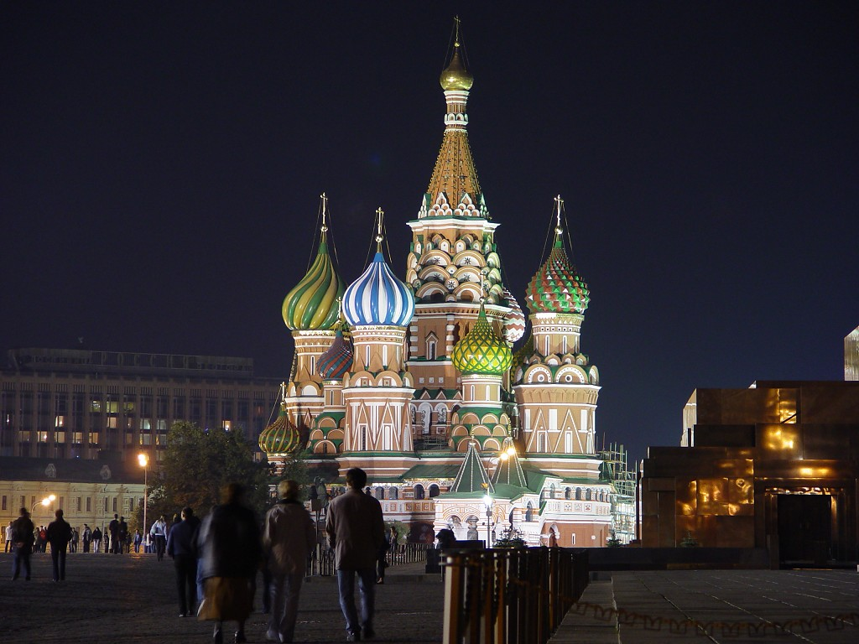
Rise of Russia
Introduction of Cyrillic alphabet
Autocratic gov’t led by czar

Slide 12
Golden age of islam

Slide 13
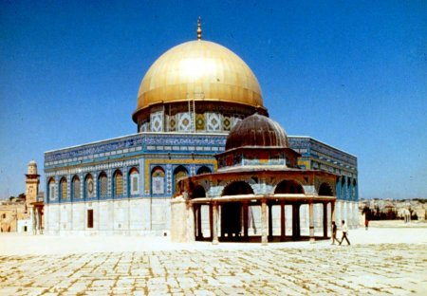
Muslim Civilization
Art- Calligraphy
Architecture- Mosques with domes and arches
Literature- Qur’an
Learning- translated Greek philosophers
Math- Algebra
Medicine- Set up hospitals and emergency rooms
The Dome of the Rock

Slide 14
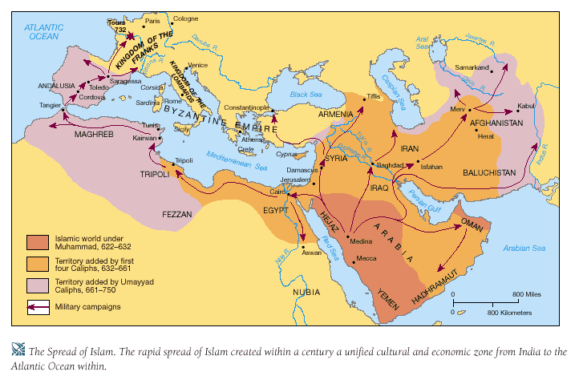
Spread of Islam and Trade
Islam moved from the Arabian Peninsula through the Middle East, Africa and into India and Europe (Spain)
Trade allowed for spread of religion, culture, and technology ***CULTURAL DIFFUSION***

Slide 15
Feudalism
Medieval European and Japanese

Slide 16
Feudalism
Definition
A political and economic system of Europe and Japan.
Based on the exchange of land (Lord) for services (military service or farming)

Slide 17
European Feudalism
King or Queen
Lords
Vassals
Knights
Serfs and Freemen
Feudalism was a political system based on the exchange of land for services.
Kings relied on service from his nobles (war) or serfs (farming) in exchange for land (manors or fiefs)

Slide 18
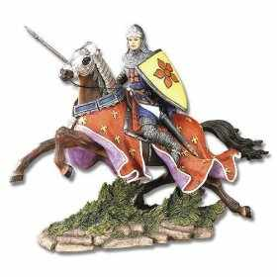
European Code of Chivalry
Military excellence
Justice
Courtesy
Godliness
Honor

Slide 19
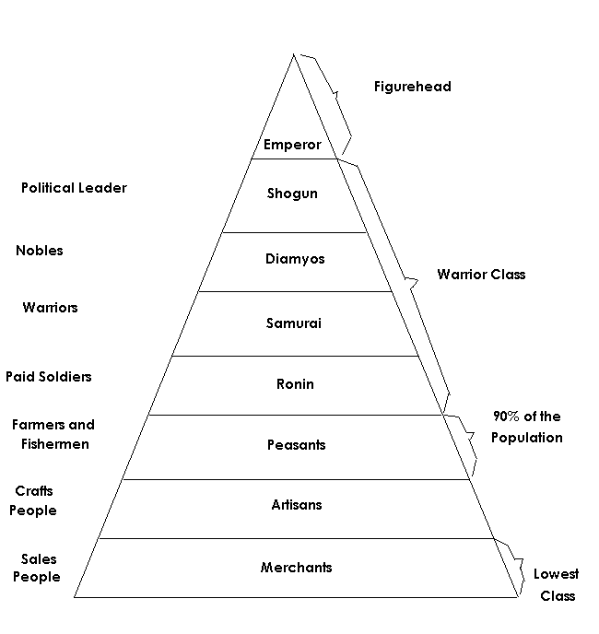
Japanese Feudalism
Emperors at the top of the social pyramid
Shoguns had the REAL power
Was an exchange of land for services

Slide 20
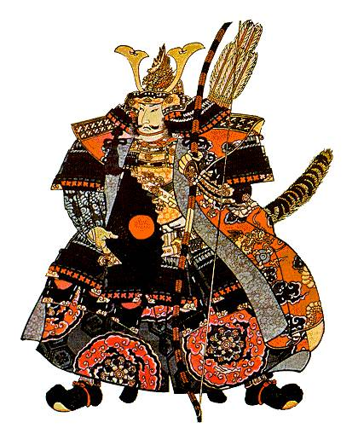
Japanese Code of Bushido
Fidelity
Politeness
Virility
Simplicity

Slide 21
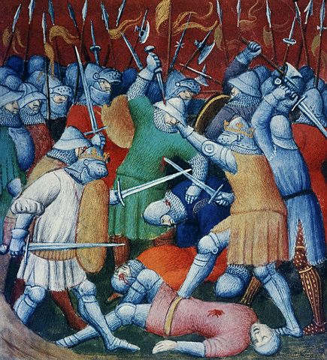
The Crusades
the Seljuk Turks take over of the Holy Lands from the Byzantine Empire in the early 11th century.
Pope Urban II Called on the Christian Knights of Europe to Take back the Holy land
increased trade resulted from the contact between Christian Europe and the Muslims
Returning crusaders brought back new spices, foods, perfumes, fabrics and ideas.
Led to the growth of wealth in Europe
Renaissance

Slide 22
Questions for Regents Practice- p. 64-65
1
3
2
3
1
3
3
4
1
3
2
2
2
4
2

