Slide 1
Global 10

Slide 2
1
4
1
1
3
1
4
2
4
1
4
3
2
4
1
Notes:
*

Slide 3
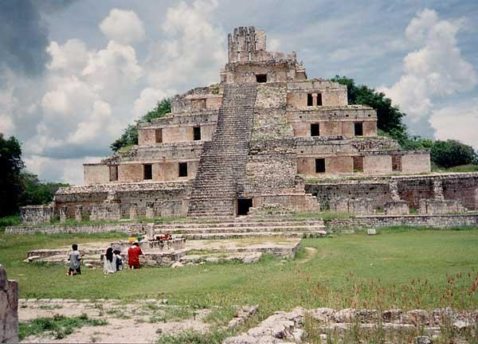
Progress in a written language and great literature
Great architectural achievements
Science
Roads (Inca)
Notes:
*

Slide 4
3 G’s
Gold
Glory
God

Slide 5
Mercantilism is the economic philosophy in which a nations power depended on its wealth in gold or silver
Mercantilism leads to colonialism
Colonies were the source of raw materials and became new markets for finished goods to be sold

Slide 6
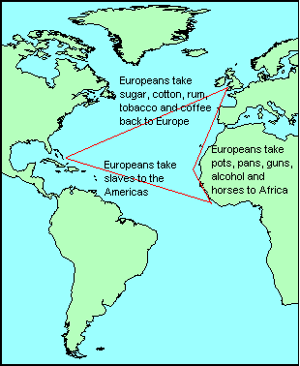
Triangular Trade
Brings Wealth to the Mother Country

Slide 7
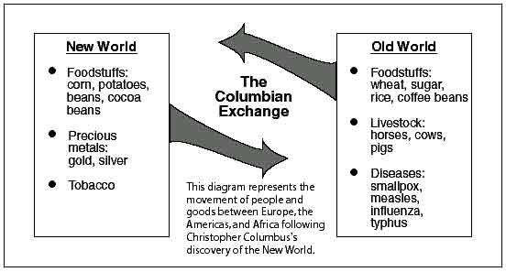

Slide 8
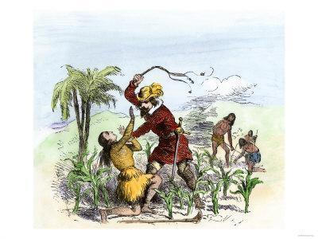
A system of production in Spain’s New World possessions which granted permission to conquistadors to enslave as many people needed to work a plantation.

Slide 9
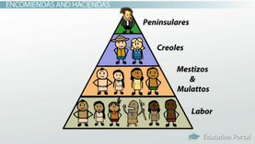
Latin American Social Structure
Born in Europe
Of European descent but born in Americas
Mixed Race-
European and Native American or European and African
Native Americans
And Africans

Slide 10
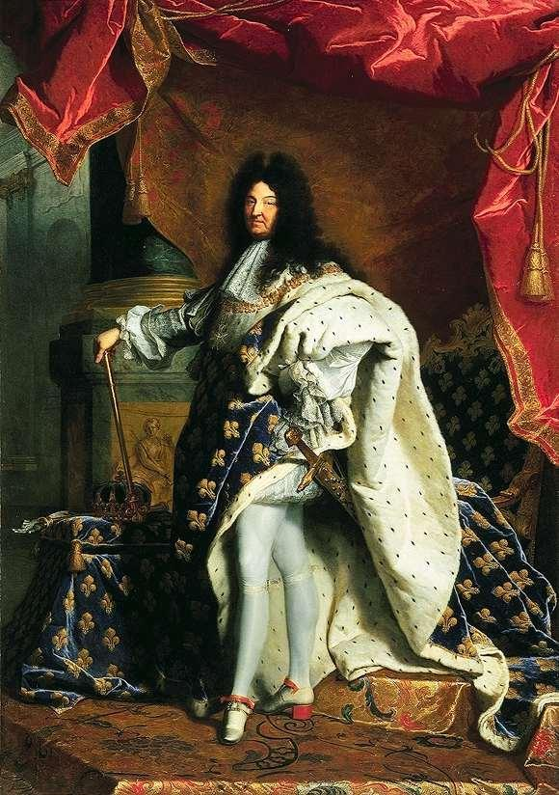
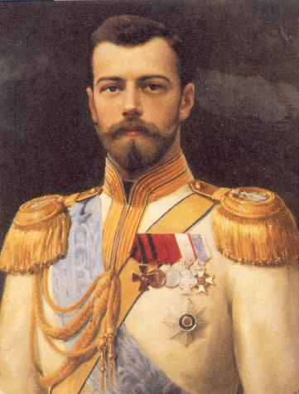
Autocratic rulers have complete authority over the government and lives of their people.
Louis XIV of France
Czar Nicholas of Russia
The “Sun” King
Notes:
*

Slide 11
Magna Carta (1215)
English nobles limited the power of the monarch by law
English Bill of Rights
A set of acts passed by Parliament to ensure its superiority over the monarchy and guarantee certain rights to its citizens
Act of Supremacy
Henry VIII took control of the Church of England because the Pope would not grant him a divorce.
Notes:
*

Slide 12
The Scientific Revolution began during the Renaissance.
It was a movement that rejected traditional authority and church teachings in favor of scientific reasoning.
A new scientific method was developed.
Notes:
*

Slide 13
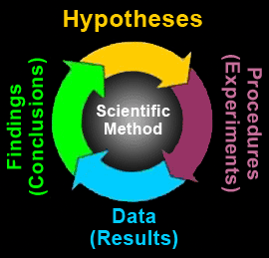
The scientific method is a process whereby scientists observe nature and make hypotheses (educated guesses).
Scientists then test their hypotheses through experiments.
A scientist must prove his hypothesis or he cannot claim it is true.
Notes:
*

Slide 14
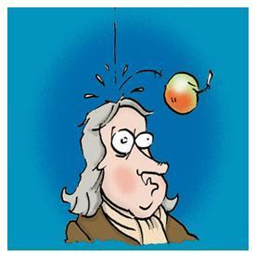
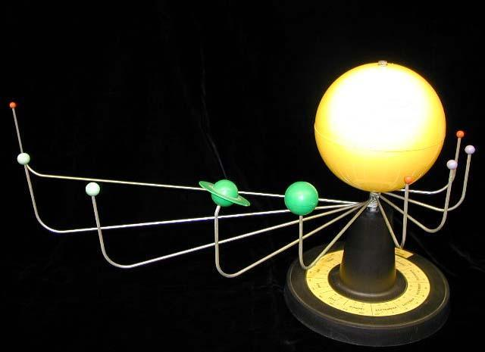
Isaac Newton
Theory of gravity
Copernicus
Galileo
Heliocentric (Sun Centered) Model of the universe

Slide 15
1
1
3
2
2
2
4
2
3
3
1
4
3
1
2
Notes:
*

Slide 16
2
4
3
2
4
2
2
1
3
3
1
4
1
3
4
Notes:
*

Slide 17
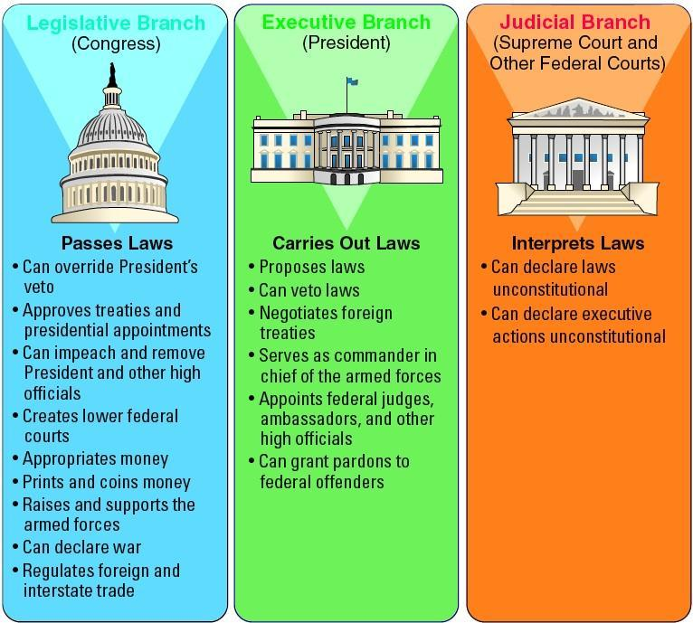
A movement in the 18th century in Western Europe
Stressed the importance of reason and science in philosophy and the study of human society.

Slide 18
Locke- natural rights- life, liberty, property
Montesquieu- three branches of gov’t.
Voltaire- freedom of speech
Rousseau- will of the people should govern

Slide 19
Inspired revolutions in the American colonies, France and Latin America
See Political Revolutions PPT

Slide 20
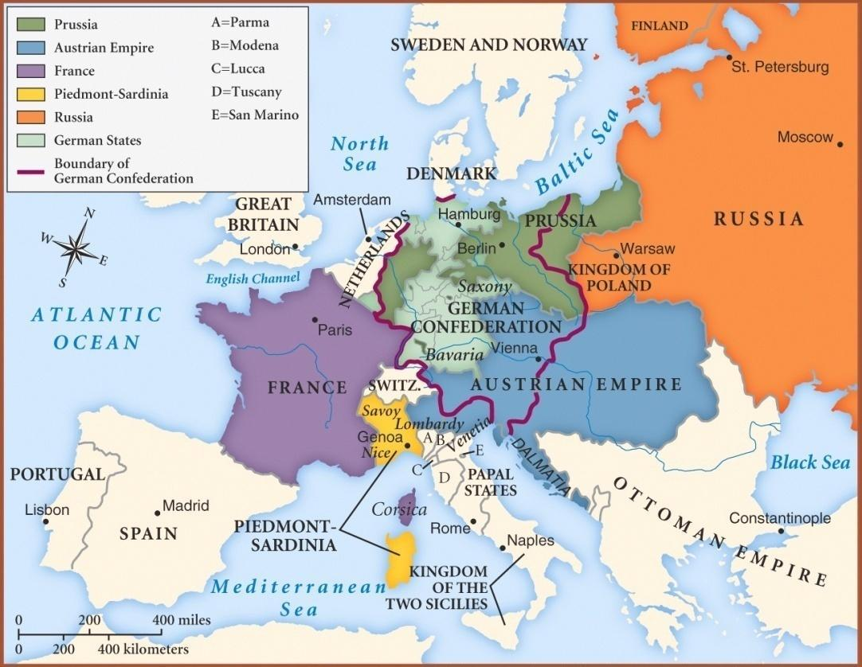
The main goal of the conference was to create a balance of power after the French Revolution that would preserve peace in Europe
Restore the monarchies of Europe to power
Conservatism- preserve traditional (monarchy) ways

Slide 21
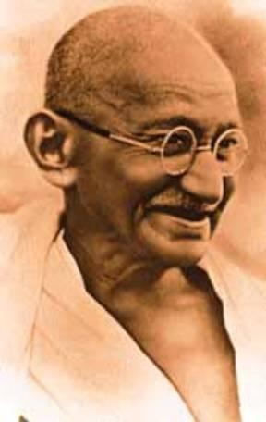
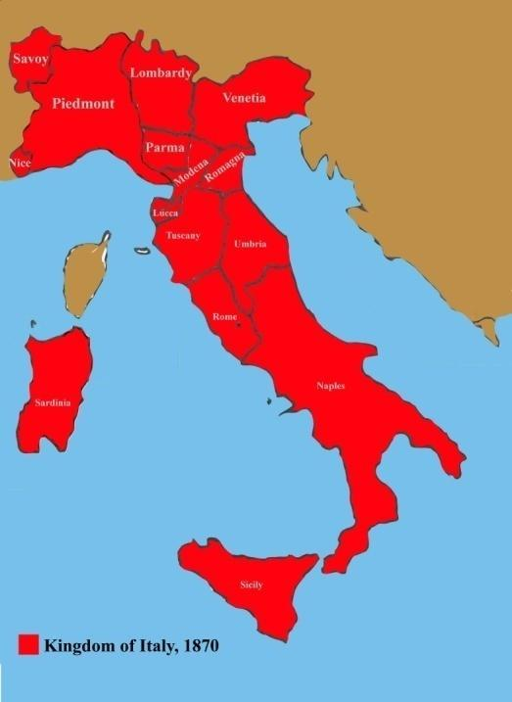
Aggressive pride in one’s nation
Unification Movements in Italy and Germany
Zionism- movement for Jewish homeland
Independence in India and Turkey
Breakup of the Ottoman Empire (Pan-Slavism)

Slide 22
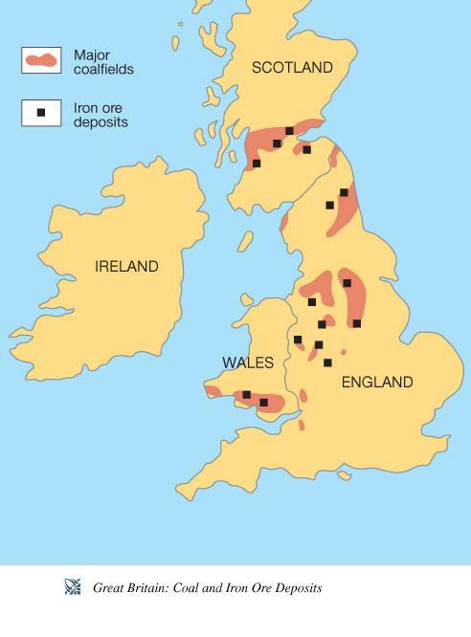
Causes
Agricultural Revolution
Geographical advantages in England
Raw Materials- Iron & Coal
Harbors
Capital ($) to invest

Slide 23
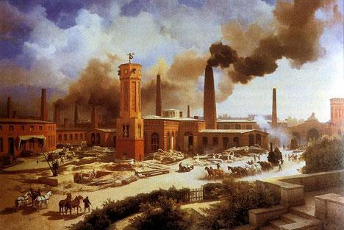
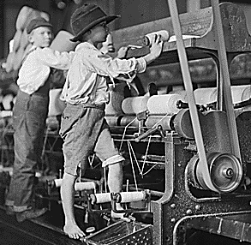
Effects
Rise of middle class
New economic theories (see Econ. Systems PPT)
Urbanization- move to cities
Improved transportation
Horrible working conditions

Slide 24
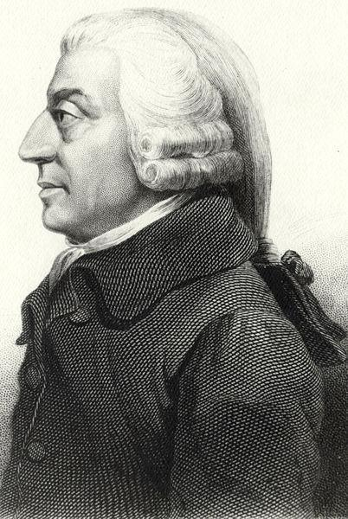
Key thinker: Adam Smith wrote The Wealth of Nations
“Laissez Faire” economics- government keeps its “hands off”

Slide 25
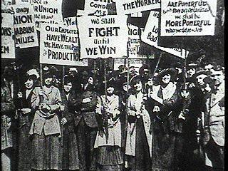
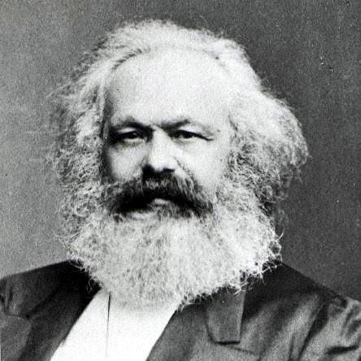
Long Term Effects
Emergence of Communism
Rise of Labor Unions
Reform negative impacts of Industrial Revolution
Karl Marx- wrote the Communist Manifesto

Slide 26
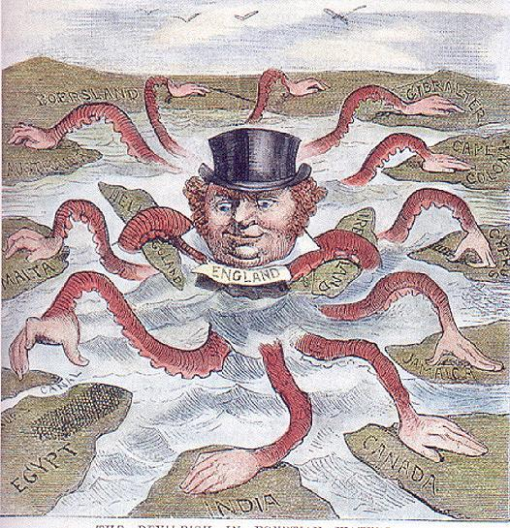
Causes
Economy- need for natural resources and new markets
Military- need for bases, protection of global empires
Social- Social Darwinism
“Survival of the the fittest” applied to nations
Religious- missionary desire to spread Christianity
Nationalism- aggressive pride in one’s nation
“My country is better than yours!”

Slide 27
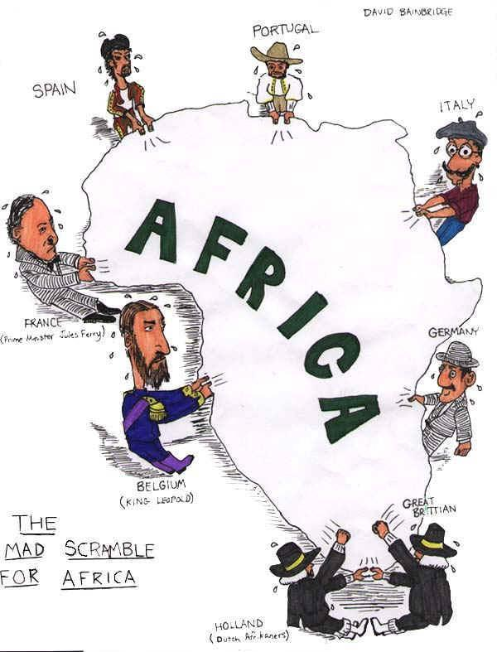
Causes
Berlin Conference 1884
Scramble for Africa
European nations divided up Africa without regard for the African people

Slide 28
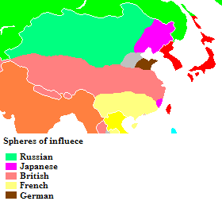
British in India
British East India company controlled 3/5 of India
Sepoy Rebellion
Crushed by British
British gov’t took Imperial control of India
Imperialism in China
Western powers carved out spheres of influence
Taiping Rebellion

Slide 29
Short Term
African and Asian economies dependent on Europeans
Western culture spreads
Traditional governments destroyed
Famines (cash crops)
Long Term
Transportation, education and medical care improved
Nationalist movements in Asia and Africa
Dependence on cash crops
Cultural diffusion
War!

Slide 30
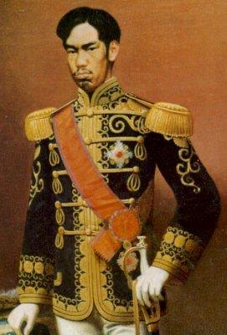
Ended Japanese isolation
Period of Modernization and Industrialization
“Beat the west at their own game!”
Militarism
Constitutional Monarchy (Emperor)

