Slide 1
War of 1812-Westward Expansion

Slide 2
Adams and Jefferson Answers
D 11. B
C 12. D
B 13. D
A 14. A
B 15. B
D 16. A
B 17. B
D 18. D
A 19. C
C 20. A

Slide 3
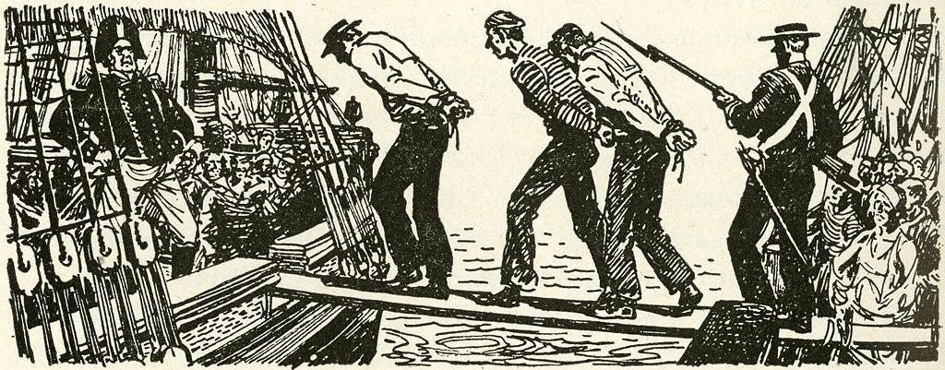
War of 1812
The British were capturing U.S. Ships and forcing Americans to be part of the British Navy, Impressment
No clear winner, both United States and Britain maintained the land that they had control over before the war

Slide 4
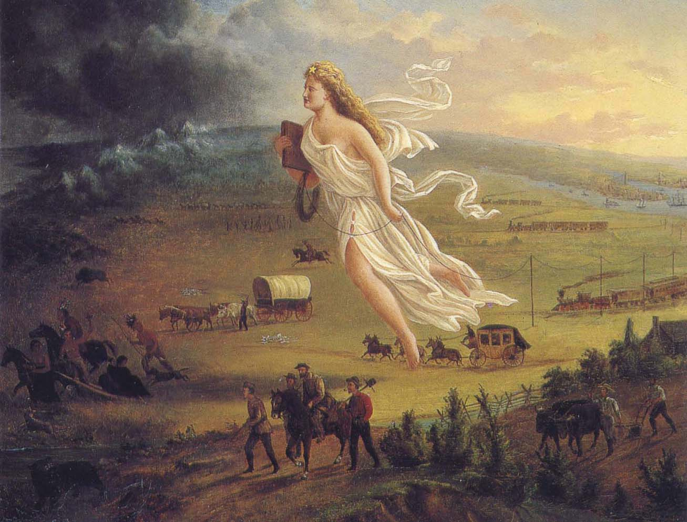
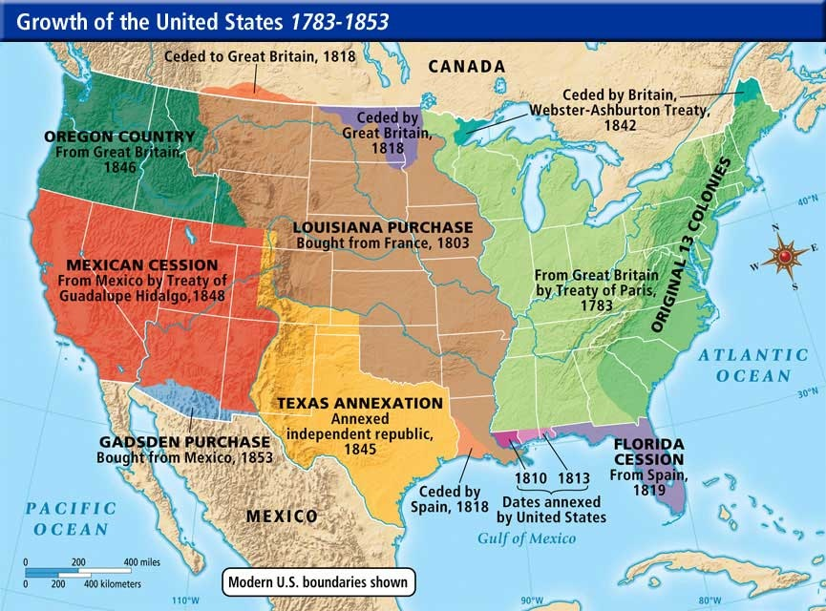
Manifest Destiny
“Natural Right” of Americans to add land between the Atlantic and Pacific Ocean
Mexican War
President James K Polk went to war with Mexico over Texas border dispute
Land Acquired During Manifest Destiny
Texas,Arizona, California, Wyoming, New Mexico, Nevada, Utah and Oregon

Slide 5
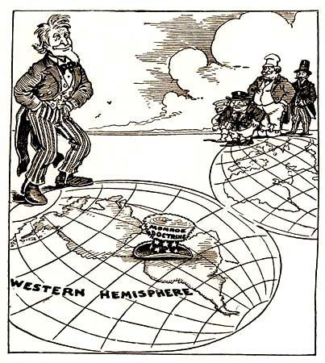
Monroe Doctrine
- U.S. warned European countries from setting up colonies in the Western Hemisphere and if they did the United States would interfere
- U.S. would stay out of European Issues

Slide 6
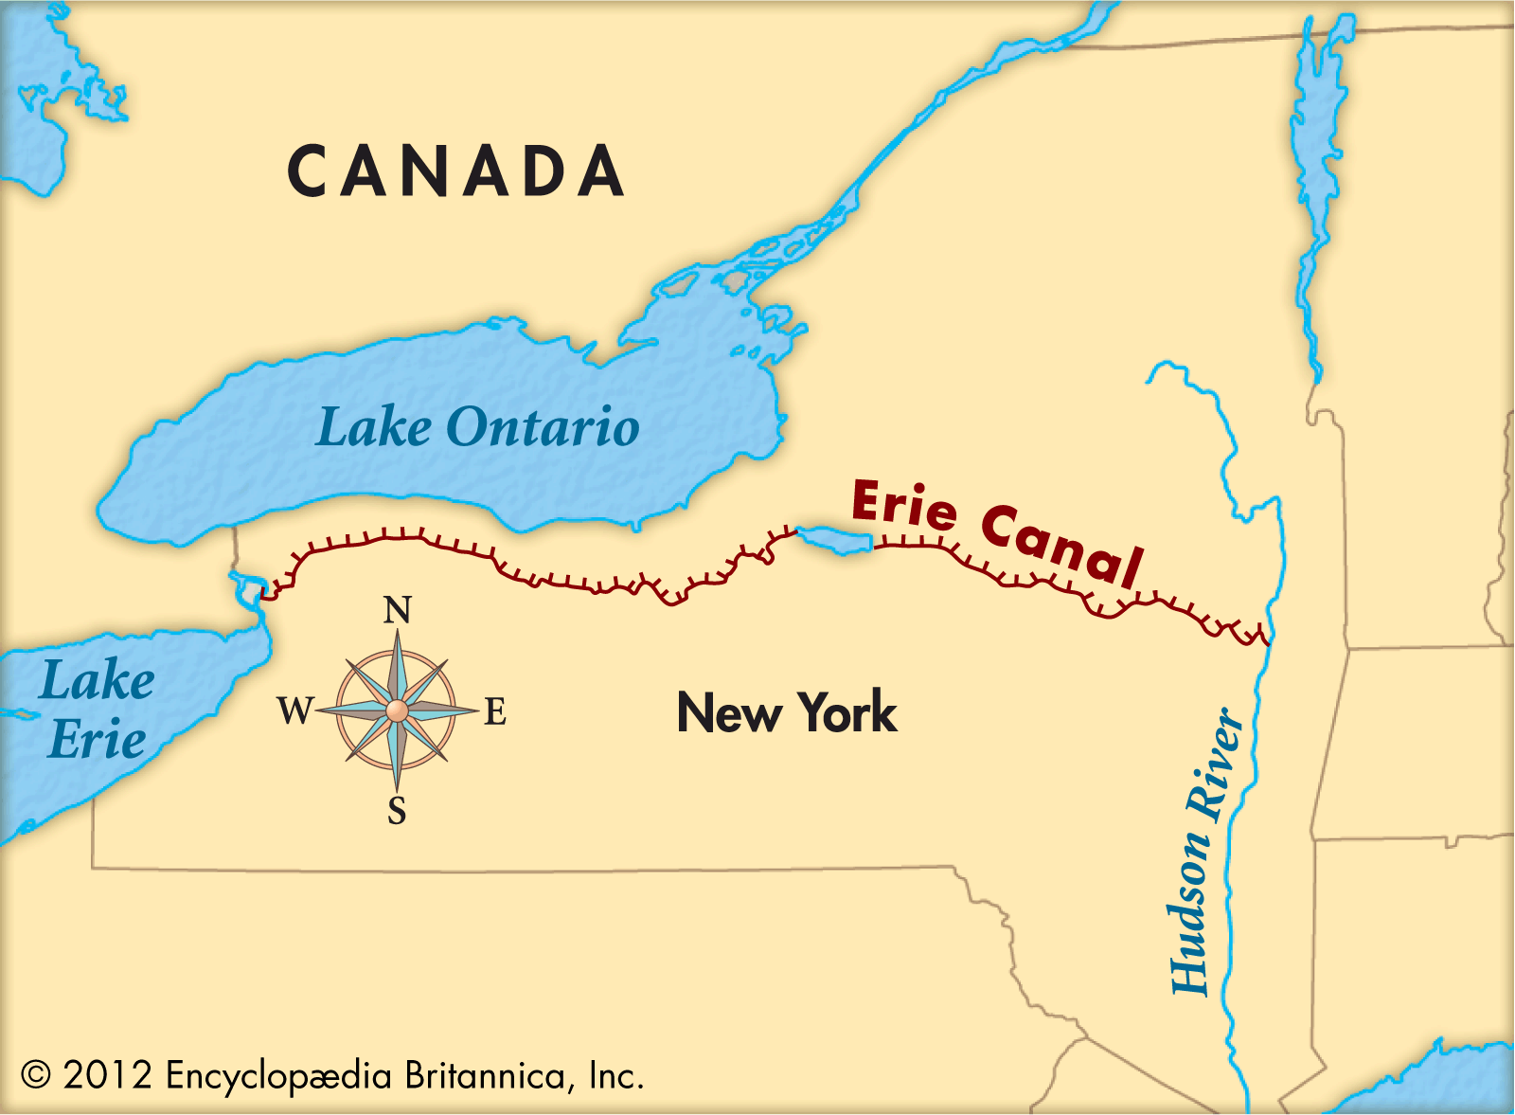
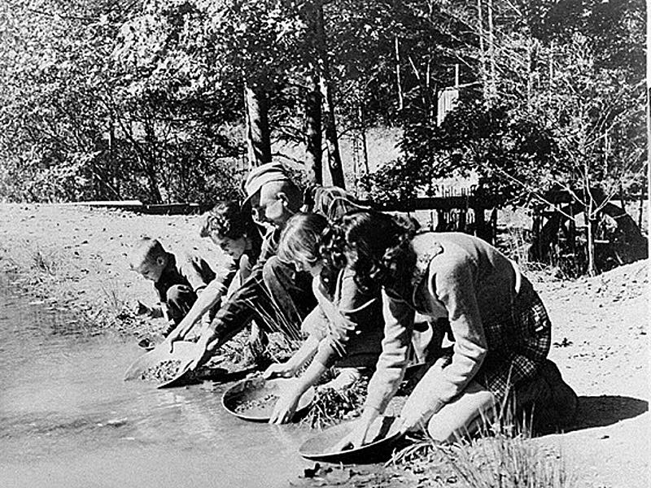
Westward Expansion
Homestead Act
Gave cheap land to people who settled in the Western Territory
Railroads and Canals
-Built to connect areas in the Midwest to areas along the Atlantic Coast
-Transcontinental Railroad help settle the west
Erie Canal
Connected Midwest to Atlantic Ocean
Great Lakes-Erie Canal-Hudson River-Atlantic Ocean
Gold Rush
California was settled as a result of gold being found

Slide 7
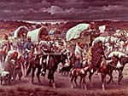
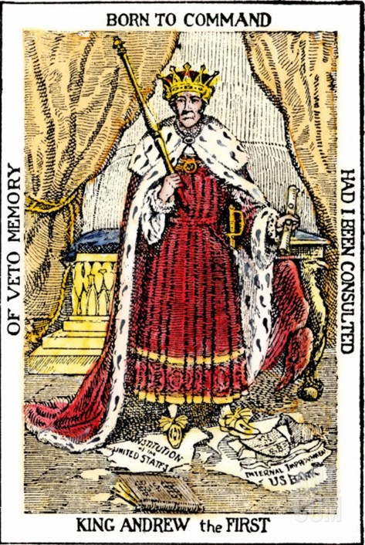
Andrew Jackson
Spoils System
Jackson rewarded supporters who helped him become elected President by giving them Federal government jobs
Indian Removal Act
- Jackson order Native Americans to be moved out of land that the American settler desired
- Trail of Tears, movement of Native Americans to Oklahoma Territory
- Hundreds of Native Americans died during the move
Expanded Presidential Power
- Implementation of the Spoils System
- Vetoed many bills that came from Congress, was compared to a “King”

