Slide 1
Wars/Human Rights Violation/Unification

Slide 2
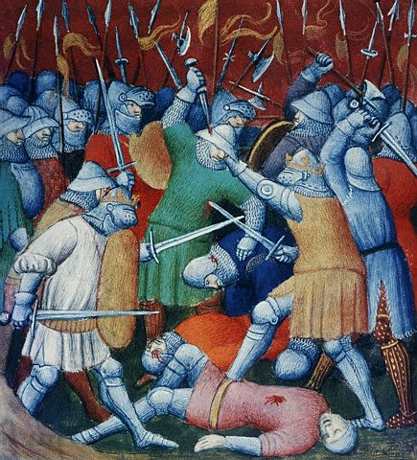
The Crusades
the Seljuk Turks take over of the Holy Lands from the Byzantine Empire in the early 11th century.
Pope Urban II Called on the Christian Knights of Europe to Take back the Holy land
increased trade resulted from the contact between Christian Europe and the Muslims
Returning crusaders brought back new spices, foods, perfumes, fabrics and ideas.
Led to the growth of wealth in Europe
Renaissance

Slide 3
Shot Heard Around the World
Archduke Francis Ferdinand of Austria-Hungary visited Serbia along with his wife
A terrorist group known as the Black Hand plotted to assassinate the archduke
Gavrilo Princip a member of the black hand pulled the trigger to kill the archduke
Austria-Hungary sent Serbia an ultimatum, official set of demands to avoid war. Serbia refused
On July 2, 1914 Austria declared war on Serbia

Slide 4
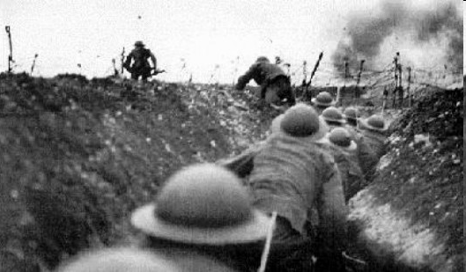
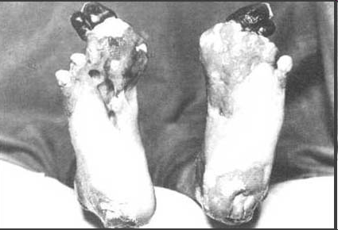

Slide 5
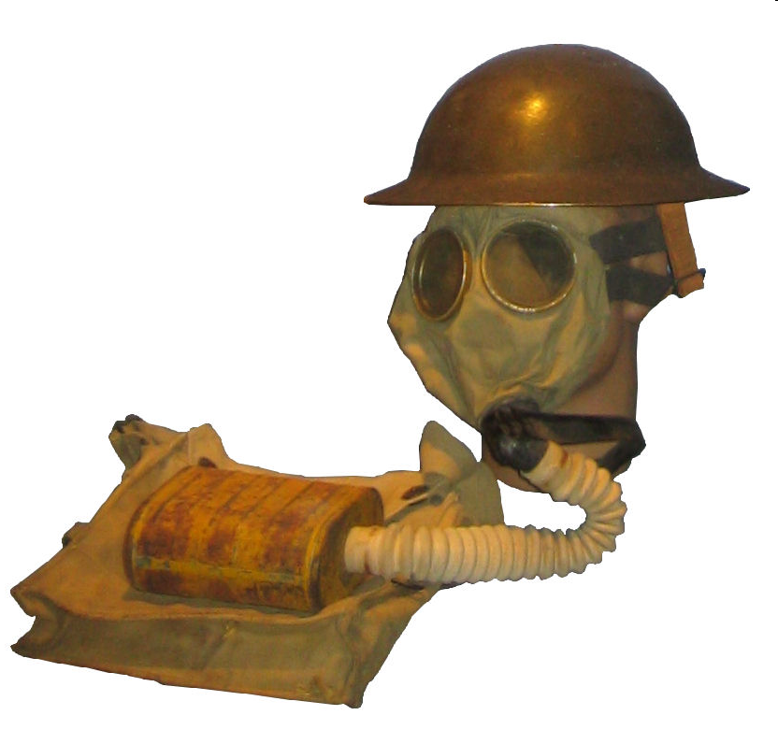
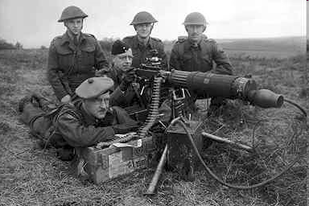
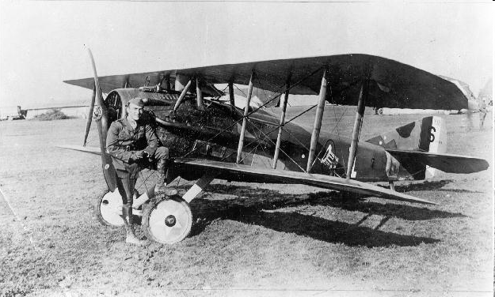
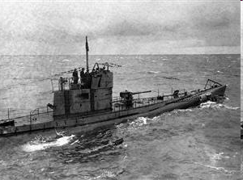
New Weapons Chart

Slide 6
Treaty of Versailles
The treaty brought an end to WWI
Germany was forced to do the following things under the treaty:
Take blame for the war
Germany had to pay $30 billion in reparations to help allied countries rebuild
Forced to decrease their army
Germany lost some territory
Germany lost its colonies

Slide 7
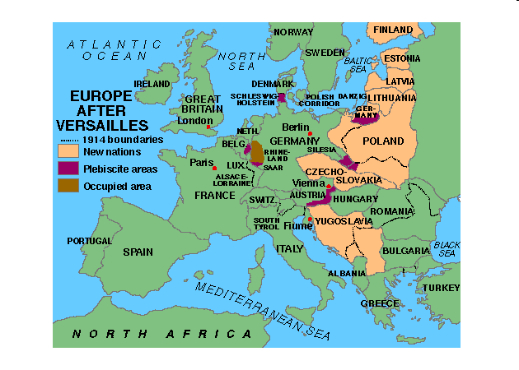

Slide 8
More Causes
Treaty of Versailles
Punished Germany so bad that Hitler and the German people hated the Allies and wanted to make them suffer.
Totalitarian States
The Axis countries were totalitarian states that did not believe in personal rights. Wanted to destroy Democracy.
World Economy
People lost jobs because of the Great Depression and the debt from WWI. The desperate people were willing to follow leaders who promised them jobs and a better life.
Failure of the League of Nations
Had little power to use against countries that broke its rules

Slide 9
Censorship
Mussolini, Hitler and Stalin used the policy of Censorship to limit the amount of information the people of their countries would receive.
Government controlled the flow of information

Slide 10
Munich Pact
Hitler wanted an area in Czechoslovakia, Sudetenland because about 3 million Germans lived in the area.
Allied leaders feared Hitler would attack all of Czechoslovakia.
September 29, 1938 Allied leaders met Hitler in Munich, Germany.
The leaders used a policy of appeasement, giving in so that others will be happy and will not cause war, and gave Sudetenland to Hitler if he promised not to attack the rest of Czechoslovakia.
Six months after the Pact Hitler took over the rest of Czechoslovakia.
Took over land in Austria

Slide 11
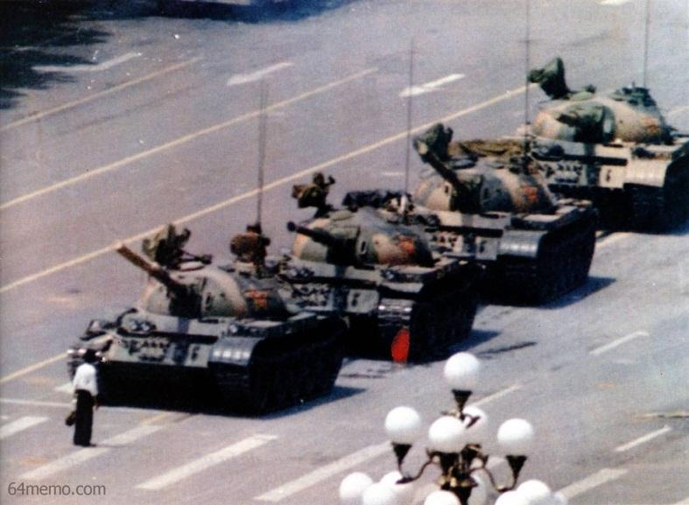
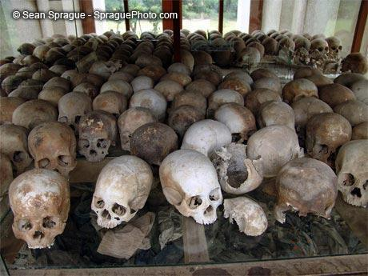
Human Rights
Tiananmen Square Massacre
Examples of other violations of human rights (denial of basic political, economic and social right to which all humans are entitled):
Tiananmen Square massacre in China: Economic changes - no democratic reforms
Dissidents under Stalin
Women and Children during Industrial Revolution
Urban population in Cambodia under Khmer Rouge

Slide 12
Human Rights Violations
Examples of Genocide (mass murder of a group of people)
Armenians during WWI
Holocaust (Jews and others) during WWII
educated persons under the Khmer Rouge
Tutsis in Rwanda
Muslims in Bosnia by Serbs
Rwanda Massacre

Slide 13
Bismarck
Prussia was the strongest German state and had the best army
Bismarck became the Prime Minister of Prussia
Bismarck wanted to unite all of the German States under Prussian rule
Bismarck used the policy of “Blood and Iron” or War and Industry

Slide 14
