Slide 1
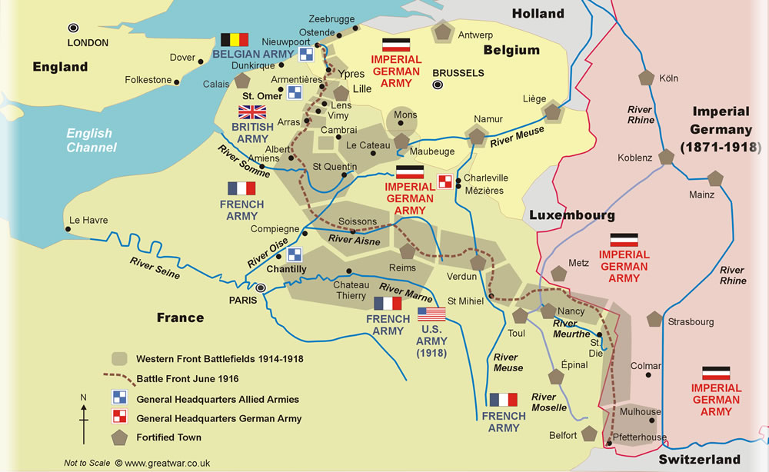
WWI’s Western Front
Following the outbreak of World War I in 1914, the German Army opened the Western Front by first invading Luxembourg and Belgium, then gaining military control of important industrial regions in France. The tide of the advance was dramatically turned with the Battle of the Marne. Following the race to the sea, both sides dug in along a meandering line of fortified trenches, stretching from the North Sea to the Swiss frontier with France. This line remained essentially unchanged for most of the war.
Between 1915 and 1917 there were several major offensives along this front. The attacks employed massive artillery bombardments and massed infantry advances. However, a combination of entrenchments, machine gun nests, barbed wire, and artillery repeatedly inflicted severe casualties on the attackers and counter attacking defenders. As a result, no significant advances were made.
In an effort to break the deadlock, this front saw the introduction of new military technology, including poison gas, aircraft and tanks.
In spite of the generally stagnant nature of this front, this theater would prove decisive. The inexorable advance of the Allied armies in 1918 persuaded the German commanders that defeat was inevitable, and the government was forced to sue for conditions of an armistice.

Slide 2
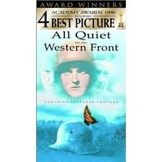
Book & Movie

Slide 3
1-Fear and Anticipation

Slide 4
2-First Bombardment

Slide 5
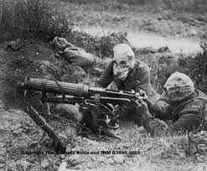
3- Gas Attack

Slide 6
4-Daily Life

Slide 7
5-Dealing with Boredom and Cramped Living Quarters

Slide 8
6-Morale

